Slide 1
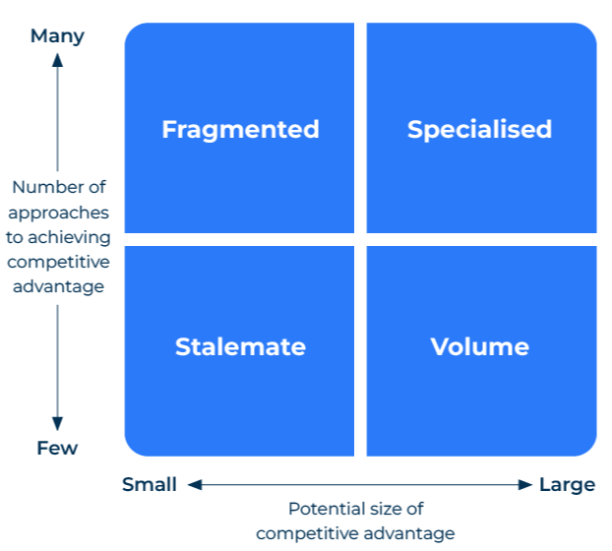
Competitive Advantage Matrix

Slide 2
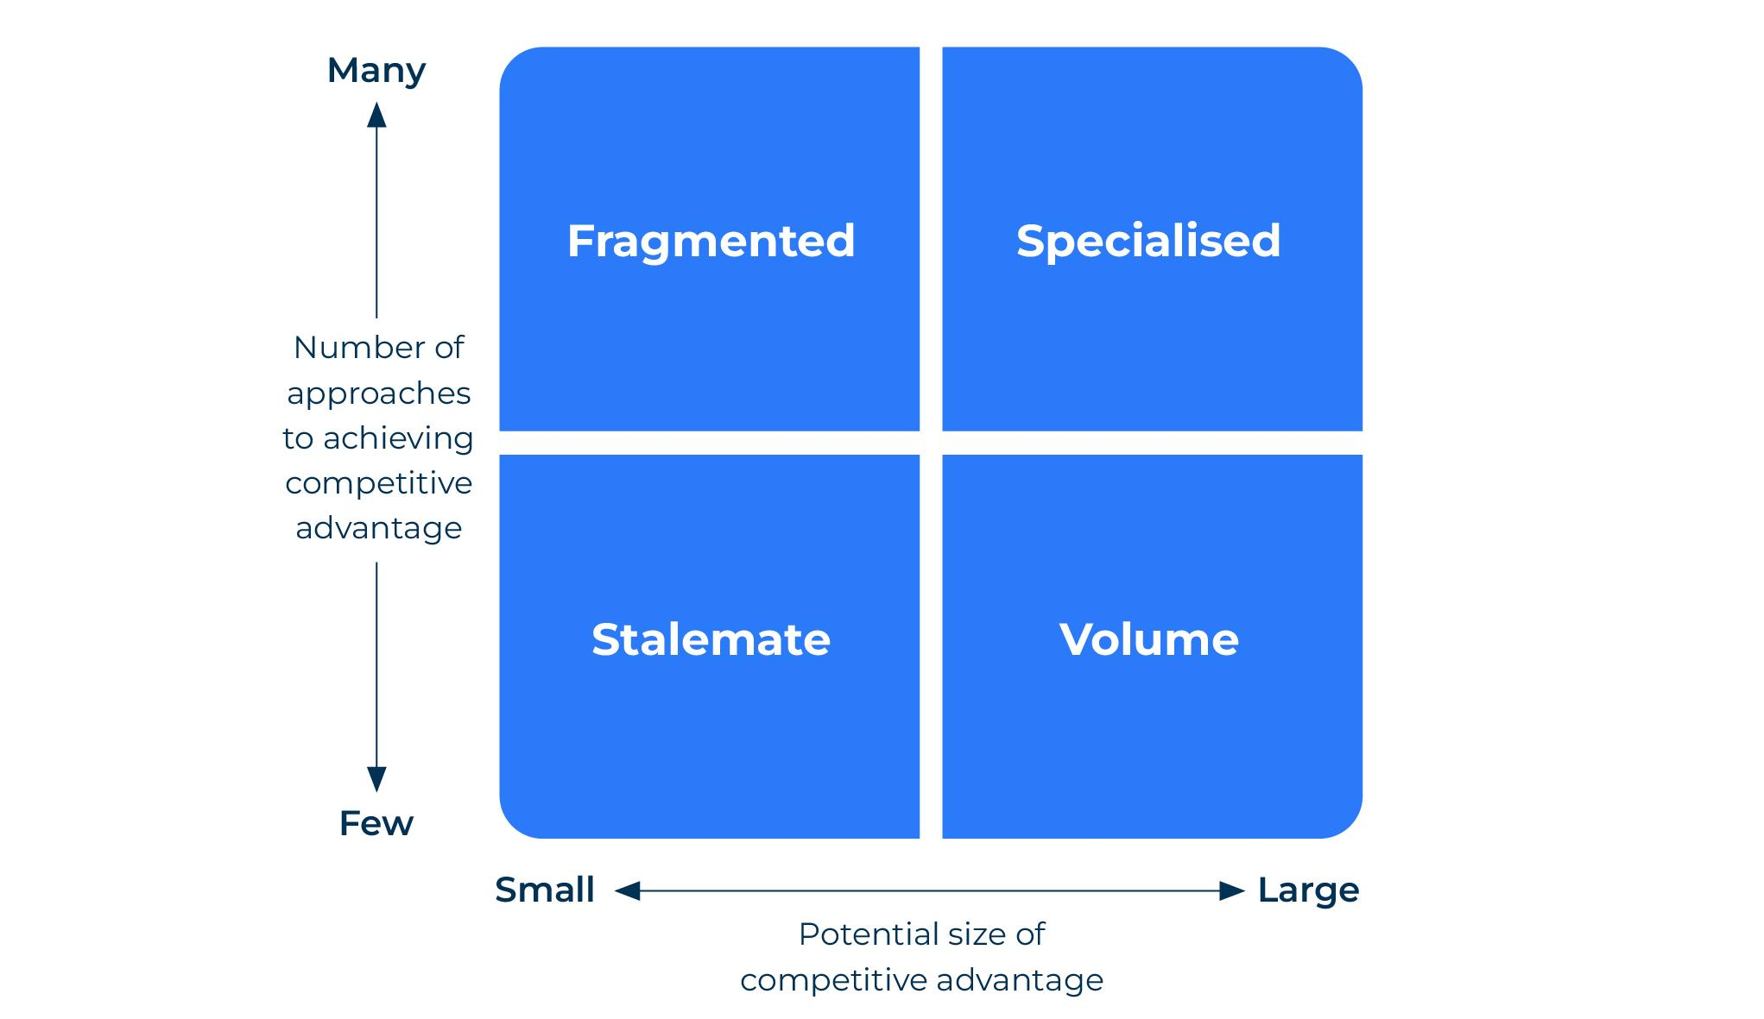
Develop a strategy based on your advantage.
Use this model to work out how to obtain a competitive advantage
The Competitive Advantage Matrix (CAM) was created by Boston Consulting Group (BCG) and is based on the premise that a competitive advantage can be achieved by differentiation and/or economies of scale.
The matrix has two axes. The horizontal axis measures economies of scale (i.e., the size of business). The vertical axis measures the number of different opportunities there are for achieving differentiation (i.e., the ability of the company to differentiate from its competitors). This results in four quadrants –
Fragmented businesses,
Stalemated businesses,
Specialised businesses,
Volume businesses.
Plot the companies, strategic business units (SBUs) or products in the matrix to build your strengths and gain a competitive advantage

Slide 3
Fragmented businesses.
Step 1
Fragmented businesses: These are small companies which compete in different ways. Typically they are retailers. Some have a specialist product, others low prices, or a site on a busy thoroughfare. These companies don't have size on their side and differentiate and win a competitive advantage through playing in a niche. Think of restaurants, printers, engineering jobbing shops and the like, all of them with loyal customer bases.

Slide 4
Stalemate businesses.
Step 2
Stalemated businesses: These specialised manufacturers could be making metal components (eg in the Midlands of the UK or the Great Lakes area of the US). They produce commodities with little differentiation and their survival depends on managing costs. These companies have much less opportunity for achieving a competitive advantage than others in the matrix.
If you have products/companies in this quadrant consider what to do with them. They don’t offer opportunities for growth and you can’t extract premium prices because they sell commodities. They are only worth keeping if you have a cost advantage such as a privileged supply of raw material.

Slide 5
Specialised businesses.
Step 3
Specialised businesses: These companies are big and strongly branded (eg food companies). Scale is important to them in achieving a competitive advantage.
Because they are specialised they offer benefits. The strong brand permits premium pricing and the economies of scale keep competitors at bay.

Slide 6
Volume businesses.
Step 4
Volume businesses: These companies need scale to be competitive and the only way they can achieve this is in large assembly sites (eg car assemblers). The problem here is that products from competitors can look the same. It is why branding is important – to try to make the company/product more specialised.

Slide 7
Things to think about.
Where is your competitive advantage – is it a differentiated offer or is it an efficient level of production that competition can’t easily match.
How could you improve your competitive advantage? What are the opportunities for building volume and/or differentiation?
Where are the threats to your competitive advantage? Which competitors could usurp your position? How could they do so?
How profitable is your competitive advantage? To what extent are you using your competitive advantage to generate cash flow and higher earnings?

Slide 8
Thank you.

