Slide 1
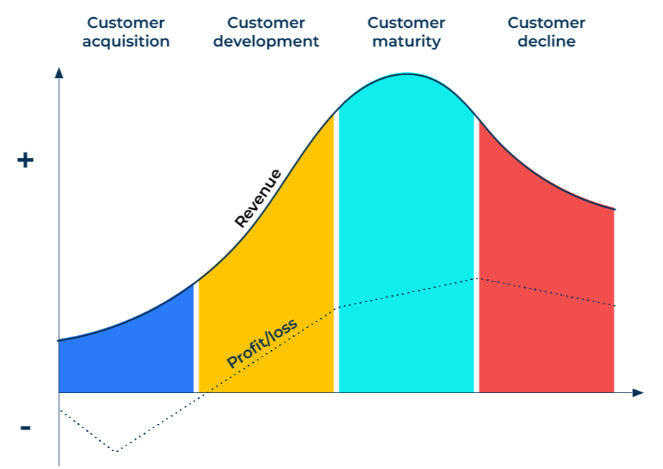
Customer Lifetime Value

Slide 2
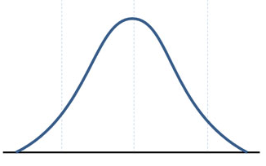
For estimating customer lifetime spend.
Use this model to find out how much customers are worth over their lifetime with your company so that you can accord them the appropriate attention.
There are considerable benefits to a company that can keep a customer for a long time. There are financial benefits based on the aggregated revenue and profits; there are benefits of advocacy; and there are benefits of a low cost of acquisition because it is spread over many purchases.
The steps provided in this model do not take into consideration the declining value in currencies. It is therefore referred to as “simple customer lifetime value”.
20% - non active customers
60% - active customers
20% - very active and profitable customers
How many of your customers are non active, active and very active?

Slide 3
Calculate revenue of customers over time.
Take a sample of customers and determine their average sales each time they buy from you. If the arithmetic mean is skewed by a number of very large customers, use the median rather than the mean. (Referred to as S)
From the same sample of customers determine the number of times they buy from your company per quarter (or per month if sales are relatively frequent). (Referred to as N)
Now multiply the average sales value by the number of times they purchase from you in a quarter to arrive at the average customer revenue per quarter. (Referred to as $X).
Average revenue per customer per quarter ($X) = S x N
Average revenue per customer per year = 4 x $X

Slide 4
Calculate the lifetime revenue.
STEP 2
Determine how many years on average a customer remains a customer at your company. (Referred to as Y).
Now determine the lifetime value of a customer using the following equation:
Simple lifetime revenue value ($) = 4($X) x Y

Slide 5
Calculate the lifetime profit per customer.
The same formula can be used to calculate the lifetime profit per customer. In step one, substitute the average profit per customer for the average revenue per customer in the equation.
Simple lifetime profit per customer ($) = 4(average quarterly profit per customer) x Y
Calculate the average cost of acquiring a new customer (a simple and crude way is to divide the annual expenditure on marketing by the number of new customers acquired each year).
The lifetime value of a customer in terms of profitability ($) = simple lifetime profit per customer – average cost of acquiring a customer
Note: this calculation is referred to as the “simple” lifetime value. The word simple is used as it does not take into consideration any adjustment for the change in value of a currency over time. Most currencies devalue over time and this is known as the discount rate. It is the interest rate used in discounted cash flow to determine the present value of future cash flows.

Slide 6
Use lifetime value to drive profitability.
STEP 4
Use the customer lifetime value to build profiles of your customers that have above average lifetime value and below average lifetime value. By identifying characteristics of customers with an above average lifetime value, you can target others with the same characteristics in order to attract more profitable customers.
Link your customer satisfaction scores to the customer lifetime value. It is likely that you will see that customers with high satisfaction scores are also those with a higher lifetime value. Use the insights from your customer satisfaction scores to increase the satisfaction of those customers who are average or below average and so boost their lifetime value.

Slide 7
Things to think about.
Calculate 3 important metrics:
Profit per customer: work out the average revenue per customer and crucially, the net profit per customer
Average lifetime: work out how long a customer stays a customer
Acquisition cost: workout how much it costs to win a customer by adding up your annual marketing costs and dividing it by the number of new customers you acquire in a year
Work out the lifetime value of your customer based on:
Now figure out which metrics you can change to improve the customer lifetime value
Customer lifetime value = (Profit per customer x Average lifetime of customer) – Acquisition cost per customer

Slide 8
Thank you.

