Slide 1
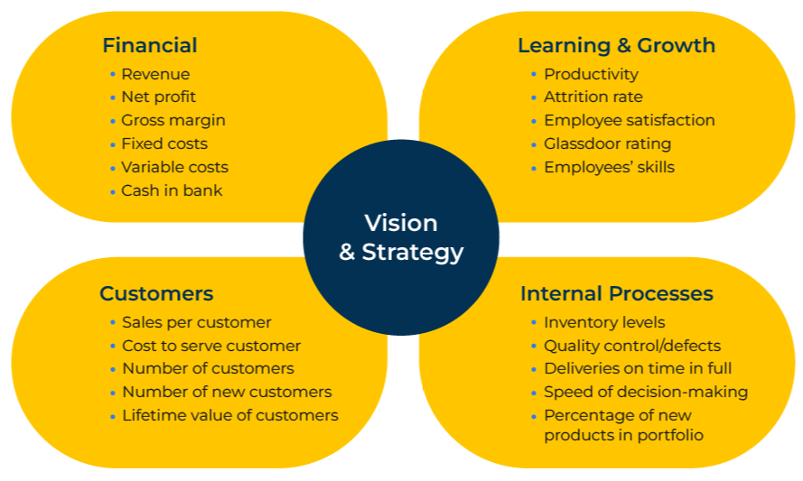
Balanced Scorecard

Slide 2
A business model to improve performance.
Use this model to focus on measures and targets that are necessary to achieve a strategy or much improved performance
The Balanced Scorecard makes use of measures in four areas of a business:
Financial: the finances of a company are its pulse and blood pressure. They show its health. Typically they include revenue, net profit, gross margin, fixed costs, variable costs, and cash in the bank.
Customers: these metrics show to what extent a company is performing well in the eyes of its customers. They include basic statistics such as numbers of customers, numbers of new customers, sales per customer as well as customer satisfaction scores, net promoter scores and the like.
Learning and growth: innovation is vital if a company is to grow. Knowledge is an asset which offers a competitive advantage. There are many measures here that can be tracked. These could include numbers of patents, amount spent on research and development, numbers of training days per employee, the skills of employees, productivity, and employee satisfaction.
Internal processes: these measures are a determination of the efficiency of a company in using its resources to maximum advantage and delivering value to customers. They could include numbers of complaints, deliveries on time and in full, inventory levels, speed of decision-making, the percentage of new products in the portfolio and so on.

Slide 3
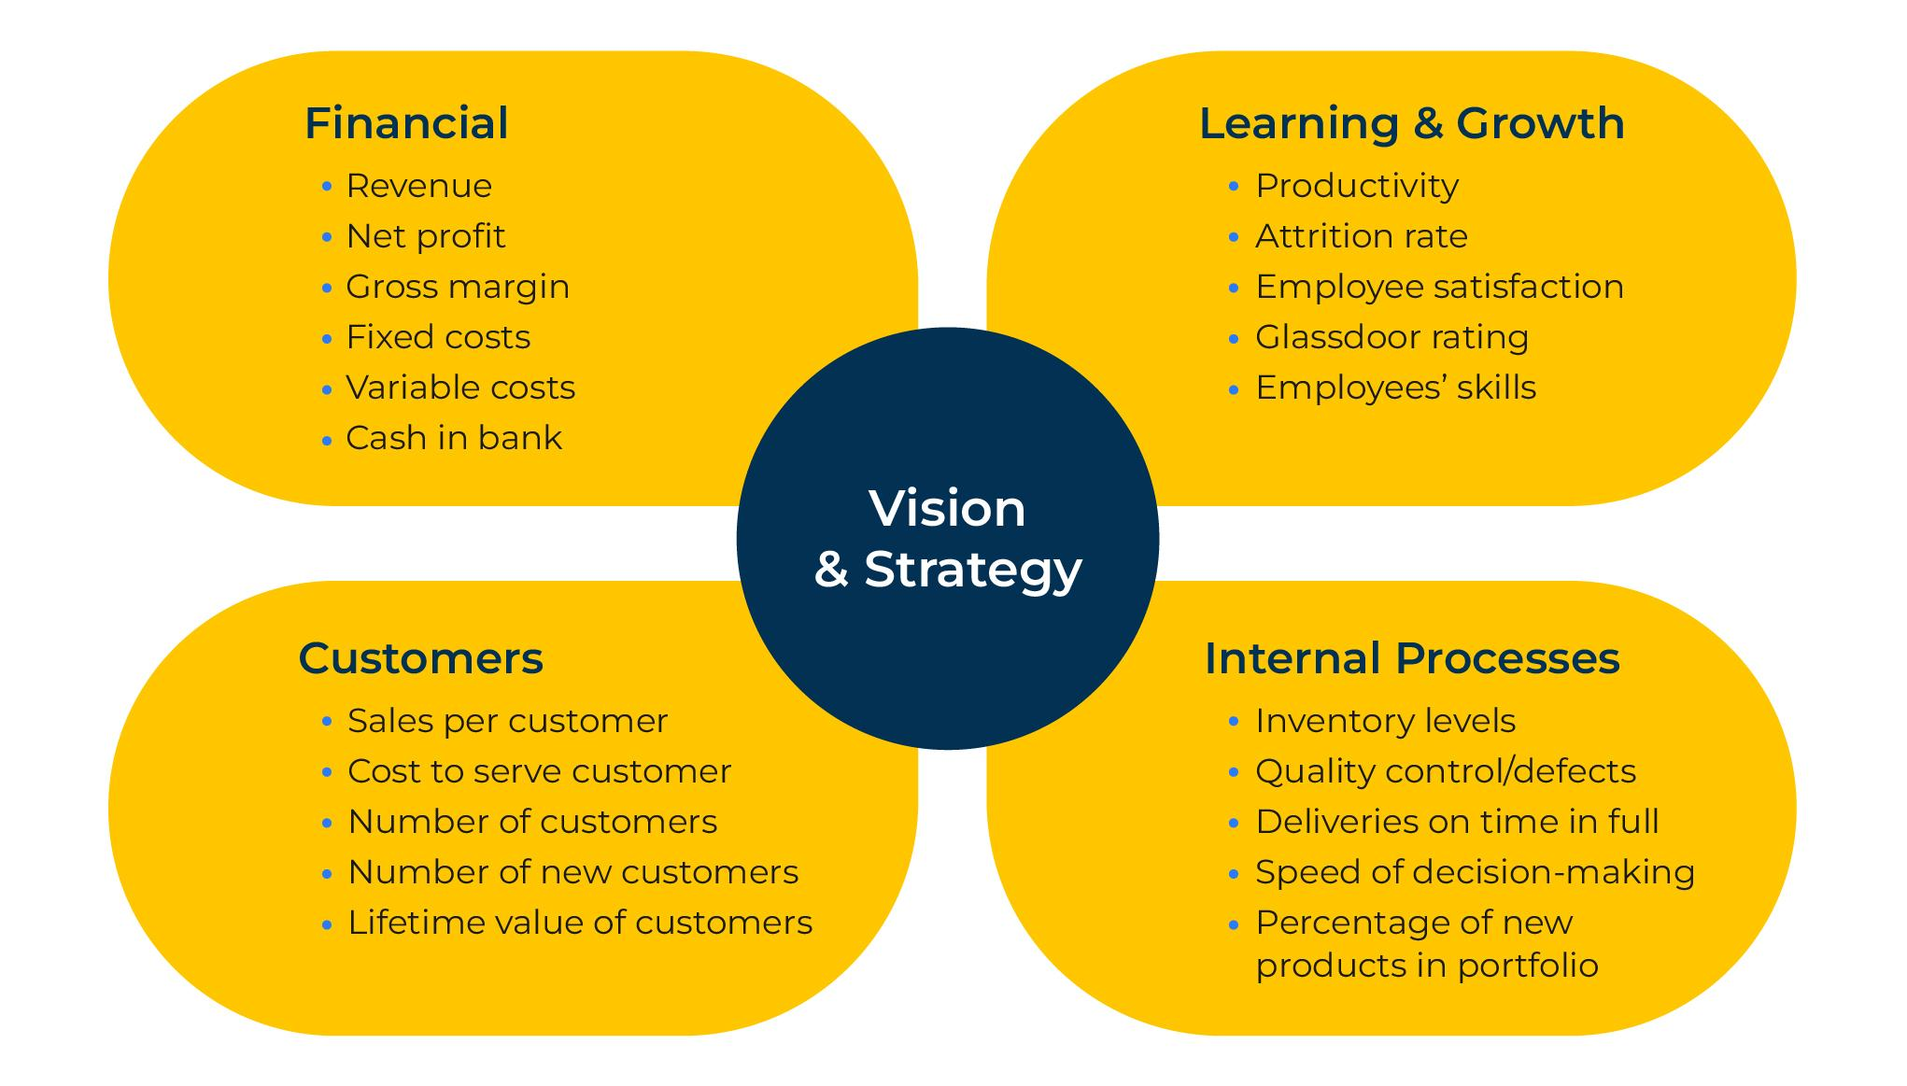
Focus on 4 key areas.
STEP 2
For each of the four areas (customers, finances, processes and innovation) set objectives, identify measures of performance, set targets and initiatives. This will enable you to keep track of your performance and check your strategy.

Slide 4
Identify measures for the Scorecard.
STEP 3
A key to the Balanced Scorecard is to find measures that are relevant in each of the four activities of the company. Don’t create a laundry list of measures; try to find measures that will help you achieve your strategic objectives. Here are some suggestions which are by no means exhaustive:
Financial measures
Revenue
Profitability
Cash flow
Bank balance
Market share
Customer measures
Customer satisfaction scores
Number of customers
Growth in number of customers
Segmentation of customers
On time delivery in full
Share of key customer accounts
Internal processes
Productivity versus the competition
Unit costs
Cycle time
Yield
Learning & Growth
Percentage of sales from new products
Number of new products launched per annum
Process time to develop new products
New product introduction versus the competition

Slide 5
Set objectives, substantiators and actions.
For each of the measures in the balanced scorecard set an objective. The more precise the objective the better.
Think about how you will substantiate whether or not you are achieving the objective.
And determine what actions are required in order to be successful.
The table opposite is a suggestion for a company that wants to grow profitably and build its brand.
 | Objectives | Substantiators | Action
Financial | Increase net profit by 15% | Check monthly accounts | Carry out pricing study
Customer | Improve customer satisfaction | Net Promoter Score of 40 | Quarterly customer satisfaction study
Internal | Increase efficiencies of meetings | Report number of meetings to Board each month | Meetings to have one page briefing in advance
Learning | Unify staff on company brand values | Brand survey results | On-board all new staff on brand values

Slide 6
Things to think about.
The key is to build a scorecard that helps your strategy
What is the overall objective for your company?
What measures will determine your ability to meet the overall objective - specifically financial measures, customer measures, learning and growth measures, and internal processes?
How easy is it to measure these different attributes?
With what frequency will the measures be made?
How can the measures be used to track and determine trends in performance?
How can the measures be used to analyse segments of threats and opportunities facing the company?

Slide 7
Thank you.

