Slide 1
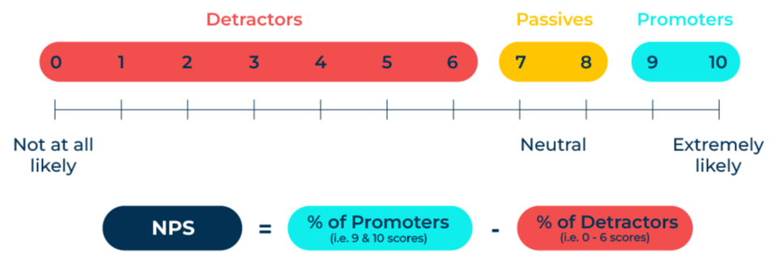
Net Promoter Score (NPS)

Slide 2
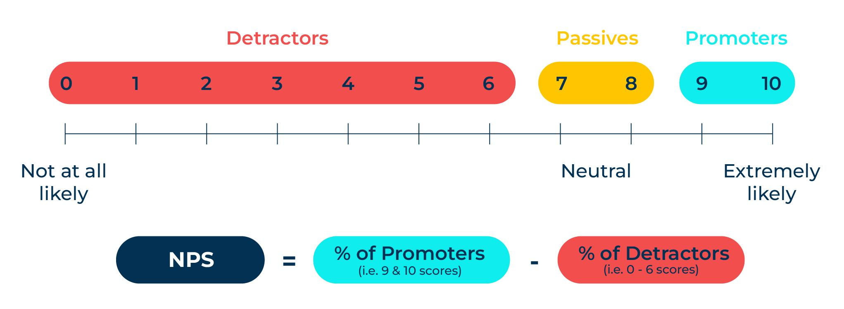
A business model for driving customer excellence.
Use this model to improve customer experience
The Net Promoter Score (NPS)measures customer satisfaction and loyalty. It is based on answers to the following question:
How likely are you to recommend brand X to a colleague using a scale from 0 to 10 where zero means not at all likely and 10 means very likely?
The Net Promoter Score is calculated from the percentage of promoters (those giving a score of 9 or 10 out of 10) minus the percentage of detractors (those giving a score of 0 to 6 out of 10). It should be noted that the number of passives (giving a score of 7 or 8 out of 10) are ignored for the purposes of the calculation.

Slide 3
Setting up a NPS survey
Consider the following:
What are the aims of the NPS study? Is it a periodic survey to check on customer satisfaction or will it be triggered by particular events?
What will be the frequency of the study? Note: although you may want to measure your Net Promoter Score after each interaction with the customer, too frequent requests for survey completions can lead to requests for participation being ignored and a very low strike rate.
Will be NPS question stand alone or will it be part of a wider list of questions? Note: it is normal to ask “Why did you give this score?”. A significant effort and cost is required to engage with customers to obtain answers to the NPS question and so it is quite normal to take the opportunity and ask some additional customer experience questions.
How will the study be administered? Will it be online or administered by someone? Note that it is not good practice for the sales team to ask the net promoter question as a false result could occur through bias.

Slide 4
Interpreting the results
It is advisable to have a sample of at least 50 respondents to achieve a reasonably robust NPS score. This is because the proportion of people who are “passives” giving a score of 7or 8 out of 10 will be ignored in the calculation. For example, in a sample of 50 respondents a sizable proportion of people could give a score of 7 or 8 out of 10. This means that the NPS score will calculated from a small number of respondents. The NPS calculation is highly sensitive to the numbers who give a score of 9 or 10 or 6 or less. As a generalisation the following table indicates typical NPS scores for different types of companies:
NPS Score | Examples of companies
Over 30 | Service companies and companies with a high service content in their offer, strong branded companies, high-tech companies, professional services companies, small and medium-size companies, good merchants and distributors
20 to 30 | Manufacturing companies of all types, large corporates.
Less than 20 | Energy companies, monopolists, chemical companies, commodity suppliers, most Western airlines
The average NPS score for business to business companies is between 30 and 35. Scores of 50 or more are considered excellent and are achieved by companies that have:
A strong brand that delivers against its promise.
Good relationships with customers through frequent contact and with staff who are friendly and empowered.
Responds quickly to requests.
Is easy to do business with.

Slide 5
Further considerations.
The Net Promoter Score is an excellent tool for tracking the performance of your company. In order to be sure that changes to the Net Promoter Score over time are believable ensure that:
Your sample size of respondents is big enough (where possible at least 100 respondents)
Respondents aren’t survey weary as a result of questionnaires that are too long or surveys that are too frequent
There is no cultural bias by mixing respondents from different geographical areas (in recognition of the fact that respondents from different countries can give wildly different answers to the same question because of positive acquiescence (where people are culturally inclined to agree positively with survey questions).
It may also be worth considering asking other questions that drive loyalty such as:
Overall satisfaction,
Satisfaction with specific parts of the company’s offer,
Likelihood to repurchase from the company.
All these questions will benefit from a supplementary question which asks “Why did you say that?”

Slide 6
Things to think about.
There is an enormous interest in building customer loyalty and for good reason. Once the expense of finding a new customer has been met, it makes complete sense to keep them for as long as possible. The Net Promoter Score is a simple metric that correlates strongly with customer loyalty.
The Net Promoter Score is best used when there is a sample of at least 50 and ideally 100 responses. This is because many people give scores of 7 or 8 out of 10 which means that the NPS score is calculated on a low sample size (the percentage of promoters minus the percentage of detractors) and can fluctuate wildly when tracked.
It may also be worth considering asking other questions that drive loyalty such as overall satisfaction, satisfaction with different parts of the company’s offer, and likelihood to repurchase. All these questions will benefit from a supplementary question which asks “Why did you say that?”.

Slide 7
Thank you.

