Slide 1
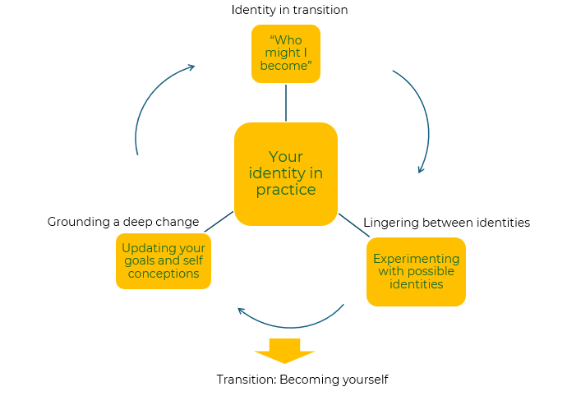
Reinventing your career

Slide 2
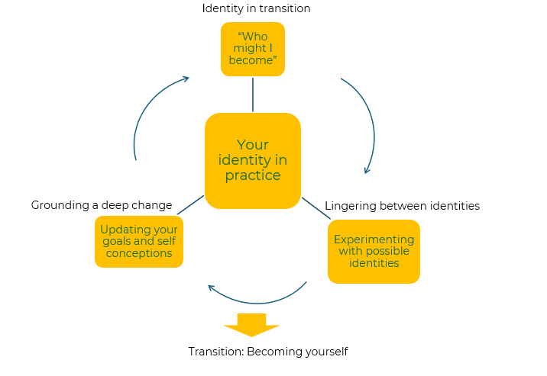
A framework for a successful career change.
Use this model explore your current career and make changes
In Herminia Ibarra's concept of "Working Identity," the processes of identity in transition, lingering between identities, and grounding a deep change play crucial roles in individuals' career transitions and professional development.
Identity in Transition: This process involves actively exploring new roles, behaviours, and ways of thinking as individuals transition into new professional identities. This active exploration allows them to experiment with new roles and behaviours, gradually shaping their emerging identity.
Lingering Between Identities: During this process, individuals experience a period of ambiguity and uncertainty as they navigate the space between their old and new identities. Individuals may struggle with letting go of aspects of their previous professional identity that no longer serve them or align with their new career direction.
Grounding a Deep Change: This process involves integrating new experiences, insights, and learnings into one's identity to create a sense of coherence and authenticity. Individuals draw upon their past experiences, strengths, and values to ground their new identity and establish a sense of continuity and purpose in their professional lives.

Slide 3
Start with Self-Reflection.
Begin by reflecting on your current skills, strengths, interests, and values. Identify what aspects of your current career you find fulfilling and what aspects you would like to change or explore further.
Why do I want to make a job change?
What aspects of my current job do I enjoy?
What aspects of my current job do I find challenging or unsatisfying?
What are my career goals and aspirations?
What skills and strengths do I bring to the table?
What skills or experiences do I want to develop or gain in my next role?
What type of work environment do I thrive in?
What are my non-negotiables in a job?
Have I explored all potential options for growth and development in my current role?
Am I prepared for the challenges and uncertainties of changing jobs?
These questions can serve as a starting point for meaningful self-reflection and can help you gain clarity and insight as you consider making a job change.

Slide 4
Explore Different Options.
When exploring different career options and industries you need to get involved in informational interviews, attending industry events and conferences, or taking on new projects or assignments that expose you to different areas of interest.
Actively seek out new experiences, roles, and opportunities related to your desired career path.
Engage in activities such as networking, informational interviews, and skill-building to broaden your understanding of potential identities and possibilities.
Experiment with different roles, responsibilities, and ways of working to gain insight into what resonates with you.
Now, what do you think are your options? Which best suit where you are now, where you want to be and how you can get there?

Slide 5
Experiment with New Roles and Activities.
Experimentation is key to discovering what truly resonates with you. Take on side projects, volunteer work, or part-time roles in your areas of interest to gain hands-on experience and test the waters before committing to a full career change.
Try out new behaviours, roles, and ways of interacting to gain firsthand experience and insights.
Take on stretch assignments, volunteer opportunities, or part-time roles to test your skills and interests in different contexts.
Be open to feedback and learning from both successes and failures as you experiment with different aspects of your identity.
Now, what seems to fit best with your skills and aspirations? Which of the experiments did you really enjoy? Which made you feel good? Which made you want more?

Slide 6
Integration.
This is where you start to make changes. You will have a view on what you want to be and how you want to change.
Reflect on the insights gained from your experimentation and integrate them into your evolving identity.
Identify patterns, strengths, and values that align with your desired career path and incorporate them into your sense of self.
Seek out opportunities to synthesize your experiences and develop a coherent narrative that reflects your evolving identity and aspirations.
You are changing and have changed. You are moving on from your hopes and aspirations to getting more involved in your new career.

Slide 7
Commitment.
Once you've explored, experimented, and integrated new experiences into your identity, it is time to commit to a new direction or role that aligns with your values and goals.
Embrace your new identity with confidence and conviction, recognising that career transitions involve ongoing growth and adaptation.
Set goals and take concrete actions to move forward in your chosen direction, holding yourself accountable for your progress and continued development.
How does it feel in this new identity? Is it something you feel comfortable with and want to pursue? Can you envisage doing this for a good time to come?

Slide 8
Continuous Learning and Adaptation.
STEP 6
Career transitions can be messy and uncertain. Embrace the discomfort of not having all the answers right away and be willing to iterate and adjust your approach as you learn more about yourself and your desired career path.
Stay open to new opportunities, feedback, and experiences that can further shape your identity and trajectory.
Remain flexible and resilient in the face of challenges, recognising that career transitions are often nonlinear and require ongoing adjustment.
You are now on your way. Stick with it. Don’t expect everything to be perfect; be prepared to continuously learn and adapt.
Transitioning into a new career can be challenging, and setbacks are inevitable. Stay persistent and resilient in the face of obstacles, and view setbacks as opportunities for growth and learning rather than reasons to give up.

Slide 9
Things to think about.
This framework is about reinventing yourself. You will have reflected on yourself – your strengths and weaknesses and your ambitions.
You will have experimented, and this will have given you the opportunity to test yourself.
You will have worked out what is important to you and where you should invest your time and effort.
This will hopefully have taken you to a better place.

Slide 10
Thank you.

