Slide 1
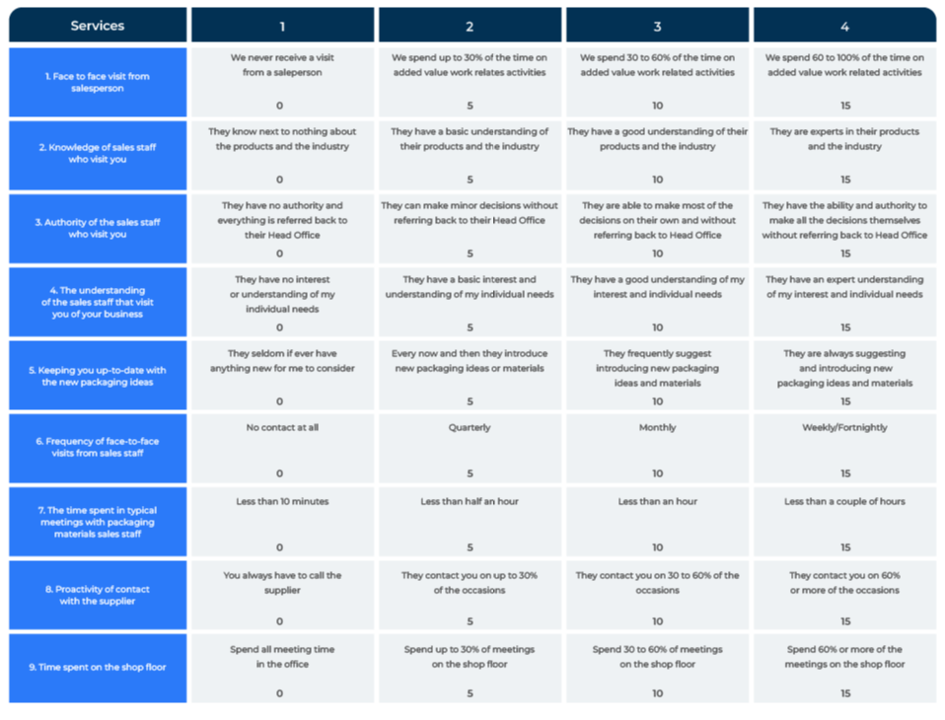
SIMALTO

Slide 2
A model to identify what customers value.
Use this model to find out how to improve the products and services you supply
Marketers are always asking themselves how their product is performing. They want to know if it meets customers’ expectations and, if not what needs changing and by how much. Moreover, they want to know what people would pay for any improvements.
Conjoint is one means by which these questions can be answered. However, conjoint is a statistician's tool. It needs specialist software to set it up and analyse the data. It needs sufficiently large sample sizes if the results are to be believed - 100 interviews as a minimum and more if possible.
SIMALTO is an alternative trade-off model that enables marketers to work out what people value and where they would like to see improvements. It has the advantage over conjoint in being able to work with smaller sample sizes.

Slide 3
The model uses a trade-off grid.
SIMALTO is an acronym for Simultaneous, Multi-Attribute, Level Trade-Off. This tool presents respondents with an variety of criteria and asks them where they would like to see improvements and how much they value these improvements.
The SIMALTO tool can be used with a small sample of respondents (eg less than 50 data points) (compare this with conjoint which normally requires 200 or more completed surveys).
Respondents are shown a grid (online) that lists many product or service attributes. The figure opposite shows 5 services (the list was longer in the actual survey).
The next slide contains a description of how the grid is used in a survey.
Attribute | Level 1 | Level 2 | Level 3 | Level 4
Weight of tool | 9.3 lbs or 4.2kgs (5) | 8.4 lbs or 3.8kgs (10) | 6.7lbs or 3kgs (15) | 5.4lbs or 2.5kgs (20)
Durability (time between major repairs) | 6 months (5) | 12 months (10) | Two years (15) | Three years (20)
Durability, ability of tool to withstand abuse | Will withstand a drop from a short ladder (5 feet) (5) | Will withstand a drop from long ladder (9 feet) (10) | Will withstand a drop from a single story building (16 feet) (15) | Will withstand a drop from a two-storey building (22 feet) (20)
Time spent on tool maintenance | 60 minutes per week (5) | 30 minutes per week (10) | 15 minutes per week (15) | 5 minutes per week (20)
Battery life | 2 hours continuous use. (10) | 4 hours continuous use (15) | 6 hours continuous use (20) | 8 hours continuous use (30)

Slide 4
Ask current service standards and expectations.
Respondents are asked to consider the services on the left-hand side of the grid and indicate their importance. This could be by ranking (respondents indicate which is most important, second most important etc) or through a points spend (allocating 50 points to be spent across the different services to show their importance).
For those services that are important, respondents are shown different levels of service or product features. These range from low levels on the left to high levels on the right. Accompanying these “levels” are text descriptions of the service or product offerings (this is helpful since it contextualises service levels in terms of real-world coordinates rather than as abstract numerical values). Respondents are asked which of these descriptions (columns 1 to 4 in the grid) is what they receive at the present.
They are then asked the service level they would like to receive. They could be happy with the current level of service. Equally, they may wish for a better level of service in which case they would choose one of the descriptions in the columns to the right hand side of what they receive at the present. It is also possible people may be happier with a lower level of service in which case they would choose a response to the left of what they receive at the present. These expectations are marked on the questionnaire.
The numbers on the grid are a notional indication of the cost of moving to a high level of service. Respondents are allocated a number of points (say 30) and asked to spend them to indicate which improvements they desire. The total number of points respondents are allocated to spend forces them to trade off their decision because there are not enough to improve everything. Responses are marked on the questionnaire.

Slide 5
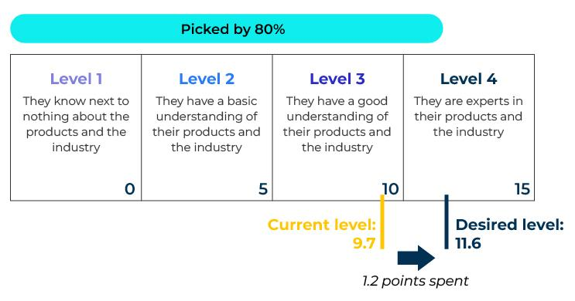
Analysis of SIMALTO.
An analysis is made of what people receive at the present and what they would like to receive. In the example below, “Knowledge of the sales staff on the telephone” was chosen as important by 80% of respondents. The current level of service they receive is 9.7 and on average 1.2 points were spent to improve services requiring sales staff to become experts.
9 - knowledge of the sales staff you speak to on the telephone

Slide 6
Other analyses.
In a SIMALTO survey other questions are asked beyond those related to the grid. For example questions may be asked about buying behaviour and brand preference. There would be many classification questions so that the results can be analysed by type or respondents.
Questions can be asked to find out what people would pay for the selected improvements. From these answers it is possible to obtain a dollar value for the specific improvements that have been requested.

Slide 7
Things to think about.
SIMALTO is worth considering by business to business marketers who, faced with small samples, cannot carry out a conjoint survey. It is a useful tool for establishing unmet needs and which of these are most valued.
The SIMALTO tool can also be used to find out what improvements employees would like in working practices.
When developing a SIMALTO grid, think like a respondent. What words would they use? Use the customers’ vernacular to describe the different levels of the offer.
Another option for measuring value on products and services is conjoint. This requires a minimum sample size of 100 respondents – a number which isn’t always available.

Slide 8
Thank you.

