Slide 1
Service Profit Chain

Slide 2
Drive profits through employee engagement
Use this model that links employee satisfaction and customer loyalty to increase profits
The service profit chain model was developed by Heskett, Jones, Loveman, Sasser, and Schlesinger – all members of Harvard Business School. They proposed that employees who are happy in their work are more likely to go the extra mile to satisfy customers. Loyal employees reduce the cost to the company as there is less hiring, less training and higher productivity.
The service profit chain is a model that can be applied to any size of company – large or small. It is a model particularly suited to businesses where employees have a good deal of access to customers. Airlines, retail and leisure companies are obvious examples. However, the model has an application for all types of businesses.

Slide 3
Create a great culture.
The starting point for service profit chain is to ensure that you have a great culture. The culture within an organisation is organic – it grows, especially following the example of the leadership team. Ask yourself the following questions:
If someone was to describe the culture of your company in just two or three words, what would they say?
What makes your company a great place to work?
Nowhere is perfect – what are the negative aspects of the culture at your company?
How committed is your company to creating great customer experience?
How empowered are people within your company to deliver a great customer experience without permissions from on high?
What evidence do you have that you are a customer centric company – what is your Net Promoter Score? What is your customer satisfaction score? How loyal are your customers to your company?
How prepared are staff at your company to go the extra mile to keep customers happy?
How supportive is the company of its own staff? In what way does it look after staff?
What is the main reason for staff leaving your company?

Slide 4
Align staff to the company objectives.
Culture is important and it is the starting point. Thereafter, this culture needs turning into customer centricity. Ask yourself the following questions:
How does your company measure employee satisfaction? How frequently does it do so? What metrics of employee satisfaction does it use?
How does the leadership team communicate its corporate objectives to staff?
What emphasis does the leadership team put on customer centricity?
What training does the company provide on delivering excellent customer experience?
What guidance is given to staff at all levels on the limits of their empowerment?
How is staff remuneration linked to delivering excellent customer experience?

Slide 5
Track customer satisfaction.
It is necessary to ensure that customers are feeling the benefit of an excellent customer experience. Ask yourself the following questions:
How does your company measure customer experience?
What soft measures are there of customer experience? (E.g. smiles on customers faces, anecdotal praise on members of staff)
What harder measures (metrics) measure the customer experience? (E.g. Net Promoter Score and customer satisfaction scores from customer surveys, use of customer loyalty cards, trend in average sale per customer)
What performance targets are set on customer satisfaction?
What actions are taken if the performance targets fall short?

Slide 6
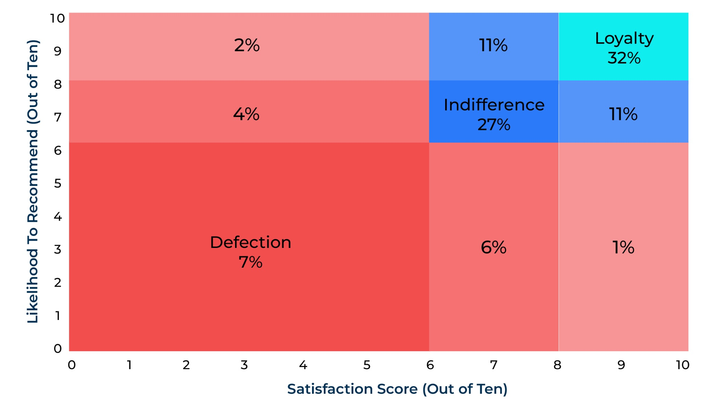
Link customer experience with financial performance.
Finally it link customer experience to profits and revenue. Ask yourself the following questions:
Does your company measure revenue at risk (an easy way of doing this is to cross analyse the proportion of people who are loyal (answers to the Net Promoter Score question) and the proportion of customers who are highly satisfied. A company performing well should have 40 to 50% of its customers giving and 9 or 10 out of 10 on likelihood to recommend and 9 or 10 out of 10 on customer satisfaction – the green square in the revenue at risk matrix opposite)
What correlation can you determine between the measures of customer satisfaction and financial metrics. E.g.:
Revenue per customer over time
Profit per customer
Lifetime value per customer
Staff recruitment and training costs
Sales per member of staff
Revenue at risk matrix

Slide 7
Things to think about.
Grouping companies together to better meet their needs is not easy. It requires good intelligence on consumers – their demographics, their behaviour, their psychographics and their needs. However, a segmentation based on customer needs and behaviour is important in making a company marketing orientated. It also is a strategy that is hard for competitors to copy so it gives a competitive advantage.
Business to business companies find needs based segmentation more difficult as the decision making unit is complicated and frequently changes. It may be more practical for business to business companies to address company characteristics such as their behaviour. The behaviour of business to business companies is influenced very much by their size and the industry in which they operate.

Slide 8
Thank you.

