Slide 1
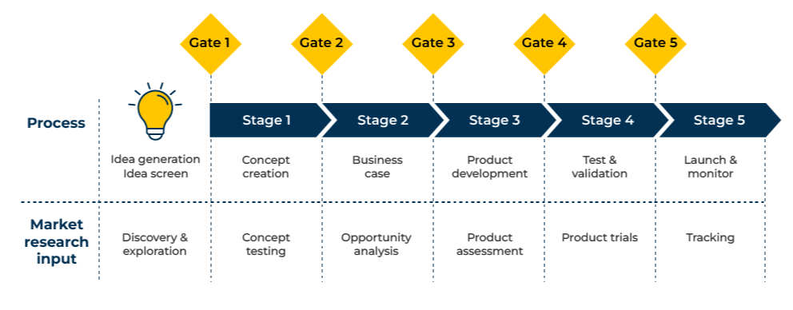
Stage Gate New Product Development

Slide 2
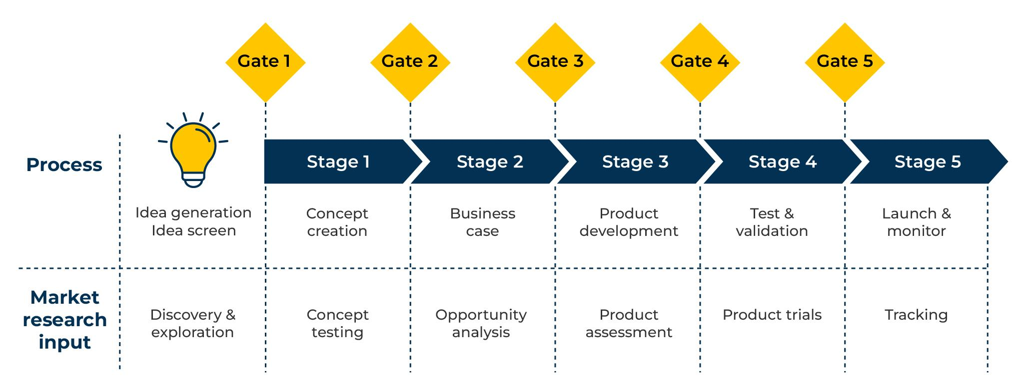
For the development of new products and services.
Use this model to help launch new products
The model begins with idea generation and screening.
Concepts are selected and move through 5 stages, each passing a gate before the next stage.
Criteria should be set that determine whether a new concept passes through a gate to the next stage.
Market research plays a big role, testing reactions to new products.
Throughout the stages, consideration must be given to the feasibility of manufacturing the new products and their financial viability.

Slide 3
Idea generation.
Idea generation is best carried out in a workshop. Participants in the workshop could represent the whole company.
The purpose of the workshop is to generate as many ideas as possible. This means people need to be creative. The moderator may have a number of exercises to release the creative talents of participants.
Before moving into idea generation mode, time should be spent thinking about customers and their needs.
People can quickly dry up with ideas so it is worth running the idea generation through a number of rounds.
Any and all ideas are welcome at this stage and it is not unusual to receive 50 to 100 suggestions. There needs to be a process for screening these ideas. The criteria for screening are usually:
How attractive will this idea be to our customers?
What is our capability of making this new idea at a decent profit?
High
Reconsider capability
To Stage Gate 1
2
1
Market attractiveness
4
3
9
6
7
8
Low
5
Reconsider mkt attractiveness
Abandon
Low
Capability of making product at a profit
High
New ideas

Slide 4
Concept creation.
An idea that passes the gate following the workshop must now be turned into a concept and put through an initial test with customers. Create a picture or graphic that illustrates the concept (the new product). Run the concept in front of around 20 respondents to find their reactions (qualitative research using focus groups or one-to-one interviews). Focus the questions on target customers for the concept. Ask the following questions:
What are first reactions?
How is this concept considered special and different from what is currently available?
What current products or services will be replaced by the new concept?
Who will find the concept most attractive?
In what way will the concept yield benefits for customers?
What level of benefit over existing solutions will the new concept provide?
What barriers will the new concept have to overcome to be successful?
What price premium (if any) will the new concept command?
How likely are people to buy the new concept?
How could the concept be improved?

Slide 5
Business case.
If the new concept passes successfully through Stage 1, it moves to Stage 2. At this point it is necessary to develop a business case for the new concept. The following subjects should be covered:
Target market
Who will buy the new concept? Their demographics/firmographics.
How many potential customers are there for the new concept?
In which geographical area are they?
Market size
How big is the potential market for the new concept?
What share of this potential market could the new concept take?
How long will it take it to reach this market share?
Competition
Which companies/products are anticipated to be the biggest competition?
How is the new concept better than the competition? How much better is it?
What reactions can be expected from the competition when the new concept is launched?
Channel to market
How will the new concept reach customers (through which channels)?
How likely will the channels be to embrace the new concept?
Pricing
Approximately how much will people pay for the new product?
What will be the different prices as it moves through the channel to market?
What price will the company receive?
Promotion
How will the new concept be promoted to the target audience?
What customer value proposition will be used in promotions?
How much will the promotion cost?
Production capability
What is the company’s capability of producing the new concept?
What additional investment will be required to produce it?
How much will this investment cost?
What volumes are forecast to be produced?
Profitability
How profitable will the new concept be at different volumes?
Will there be any cannibalisation of existing sales and profits?

Slide 6
Product development.
Assuming that the business case for the new concept is accepted, it will move to a product development stage. Prototype(s) will be made to test the feasibility of making the new product. This stage will provide a better understanding of any difficulties that could be faced when making the product as designed.
How easy is it to make the product as specified?
How easy will it be to make the product in the company’s current production facilities?
What additional facilities will be required?
What raw materials are required for the new product?
Where will the raw materials be sourced?
What will be the cost of the raw materials?
How secure is the supply of raw materials?
How easy/difficult is the making of the prototype?
What will be the most difficult problems faced in production?

Slide 7
Test and validation.
If the new concept passes the prototype manufacturing stage, it is now time to carry out more detailed tests with potential customers. Sufficient prototypes should be made to be tested by potential customers (if possible around 100 respondents).
Products will be given to respondents (who may be required to sign secrecy agreements) to evaluate over a period of time that is considered “normal use”. Questions will be:
Having tested the new product, what are first reactions?
In what respect did it perform well?
In what way could the performance be improved?
How much better is it than the products that are currently in use?
In what ways is it better?
How likely would people be to choose it in preference to the product currently in use?
What price is considered appropriate for this new product?
How likely would people be to buy it at this price?
What would make the product more appealing?

Slide 8
Launch and monitor.
The final part of the stage gate process is to launch the new product and monitor its performance. In launching the new product it will be necessary to set an appropriate price. For this, consideration could be given to Van Westendorp or Gabor Granger tools.
The launch will also need a marketing plan which will target segments with appropriate promotions and channel strategy.
There need to be targets, responsibilities, timelines and controls put in place:
What is the timeline for the launch?
Who will be responsible for the launch?
What checks will be in place to ensure that targets are met (or corrective action is taken to meet them)?
What backup plans are in place if “Plan A” does not work?
What processes will be used to obtain feedback from the early customers? (Tracking surveys).

Slide 9
Things to think about.
Use the stage gate process when launching new products. It is designed to screen out products that will not be successful in the market and whose launch would be a costly mistake.
When setting up a stage gate process for new products, measures should be agreed at the outset as to what is needed to move to the next gate.
People who dream up new ideas are extremely valuable in any business. However, like parents of children, they can be very defensive of their ideas. It is why independent research is important in deciding whether the idea can move forward from one gate to the next.

Slide 10
Thank you.

