Slide 1
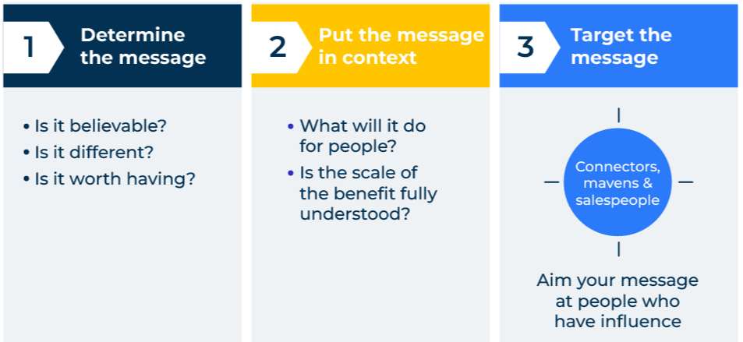
Tipping Point

Slide 2
The framework is based on three premises.
Use this model for influencing actions
Malcolm Gladwell in 2000 published a book called The Tipping Point: How Little Things Can Make A Big Difference. The book helps us understand customer behaviour. It is based on three premises:
1. The right people
An idea needs connectors to move it around a market. Connectors, as the term suggests, are connected with many others. Gladwell called these people Mavens. Mavens are information specialists who are particularly good at accumulating and distilling new knowledge. The right people must also include salespeople because they are able to persuade others that new ideas are worth adopting. In today’s world the many influencers that exist in social media would be regarded as Mavens.
2. The idea needs to be sticky
By this, Gladwell means that the message or the idea must be memorable. Various devices can be used to make an idea memorable – repetition helps a lot, so do memory cues (things that are associated with a product or idea). These could be graphics, colours, sounds – things that evoke the senses.
3. The idea must have context
The idea must be right for the moment in time. For example, when vandalism became a serious issue in New York, the concept of zero tolerance for minor crimes was able to take hold as a means of slowing down major crimes. The time must be right for the idea to be adopted.

Slide 3
Look for the small dots.
To find a tipping point it is important to ask the right questions, especially at an early stage. The likelihood is, not many people will be behaving in a certain way (the tipping point is yet to be reached). Qualitative research will be more useful than quantitative research.
Familiarise yourself with System 1 and System 2 thinking. The tipping point is very often highly influenced by System 1 thinking (ie emotional decision making).
All new ideas start small. Some take a long time to come to fruition (except in the fashion industry) and so they can be dismissed. Outliers will be more interesting than averages because these are the dots that will show the direction of the trajectories.

Slide 4
The framework could be used to change behaviour.
For example, the framework could be used to improve the targeting of a message to customers:

Slide 5
Things to think about.
What is happening on the edge of your business? How sustainable will this movement be?
Who are the people that are doing things that are different? What is driving them? How are they satisfying their needs?
What could you do to encourage the growth of one of these small groups?
What is there about your products that is distinctive and different? With whom does this distinctive/difference resonate?
What could you do to encourage sales of your products amongst one of these outlying audiences? What scope is there for celebrity endorsement?
How can you make the message about your product more contagious and have greater lasting impact?
Who are the connectors, mavens, influencers and salespeople that can take your product forward?

Slide 6
Thank you.

