Slide 1
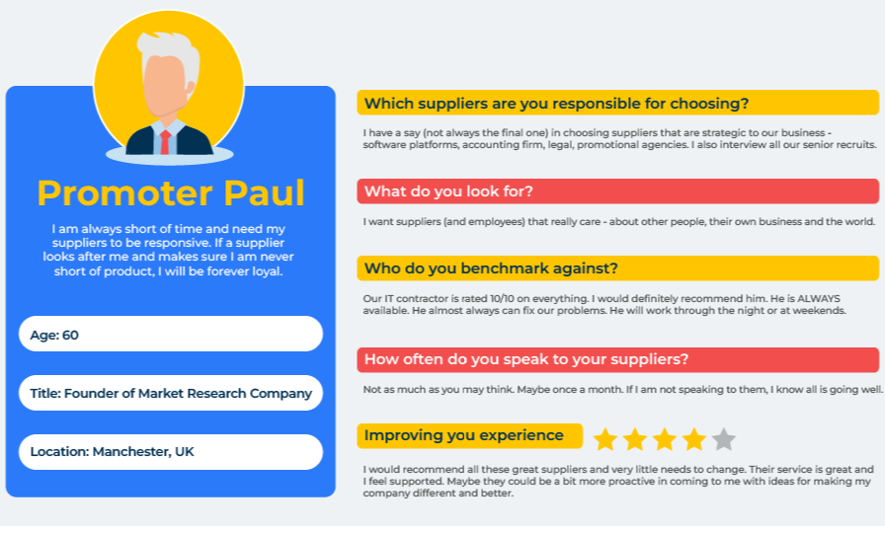
Personas

Slide 2
A model for improving marketing messages.
Use this model to sharpen the way you communicate with customers and potential customers
A persona is a character. It is a description of somebody, not just anybody. It is the image, the face and personality of a (made up) person. If you can characterise a persona within a group of customers, it becomes easier to target them. Persona development is important in advertising to give a focus to promotions. With the persona in mind you know who you are talking to, who you are designing for and who you want to do business with. Persona development nearly always focuses on the buyer of the product.
You can develop personas for different decision makers and influencers. For example, it may be helpful to build a persona of someone who is an influencer rather than a customer or even a “negative” persona – someone you want excluding from targeted communications.
Developing personas requires a qualitative and creative approach. Insights on the personas can be obtained from many sources – sales teams, market research reports, the internet, LinkedIn etc.
Decide which personas you want to develop. It could be the key decision maker within the decision-making unit, a lost customer, a promoter, a detractor, a potential customer etc. Now use the next slide to build a picture of this person.

Slide 3
Persona profile.
Persona Title | Description
Name
Company role
Job title
Work responsibilities
Company
Size
Industry
Location
Role in product decision-making
Decision drivers
Demographics
Age
Gender
Education/qualifications
Salary
Marital status
Number of children
What keeps them awake at night
Challenges at work
Challenges at home
Ambitions in life
Guiding values
Empathy
Model of car they drive
Music they listen to
Favourite books
Where they go on holiday
Pets owned
Favourite sport
Media
Newspapers that are read
Journals that are read
Favourite websites
Blogs that are visited
The aim is to build a portrait of a character. Personalise this character as much as possible. Give them a name and bring them to life by imagining (as near to reality as possible) their work life, their home life and their psyche. Find an appropriate photo of someone on the internet to represent your persona.
The factors in the worksheet opposite are by way of example. Add or subtract items that in your opinion will give a good flavour to this persona.

Slide 4
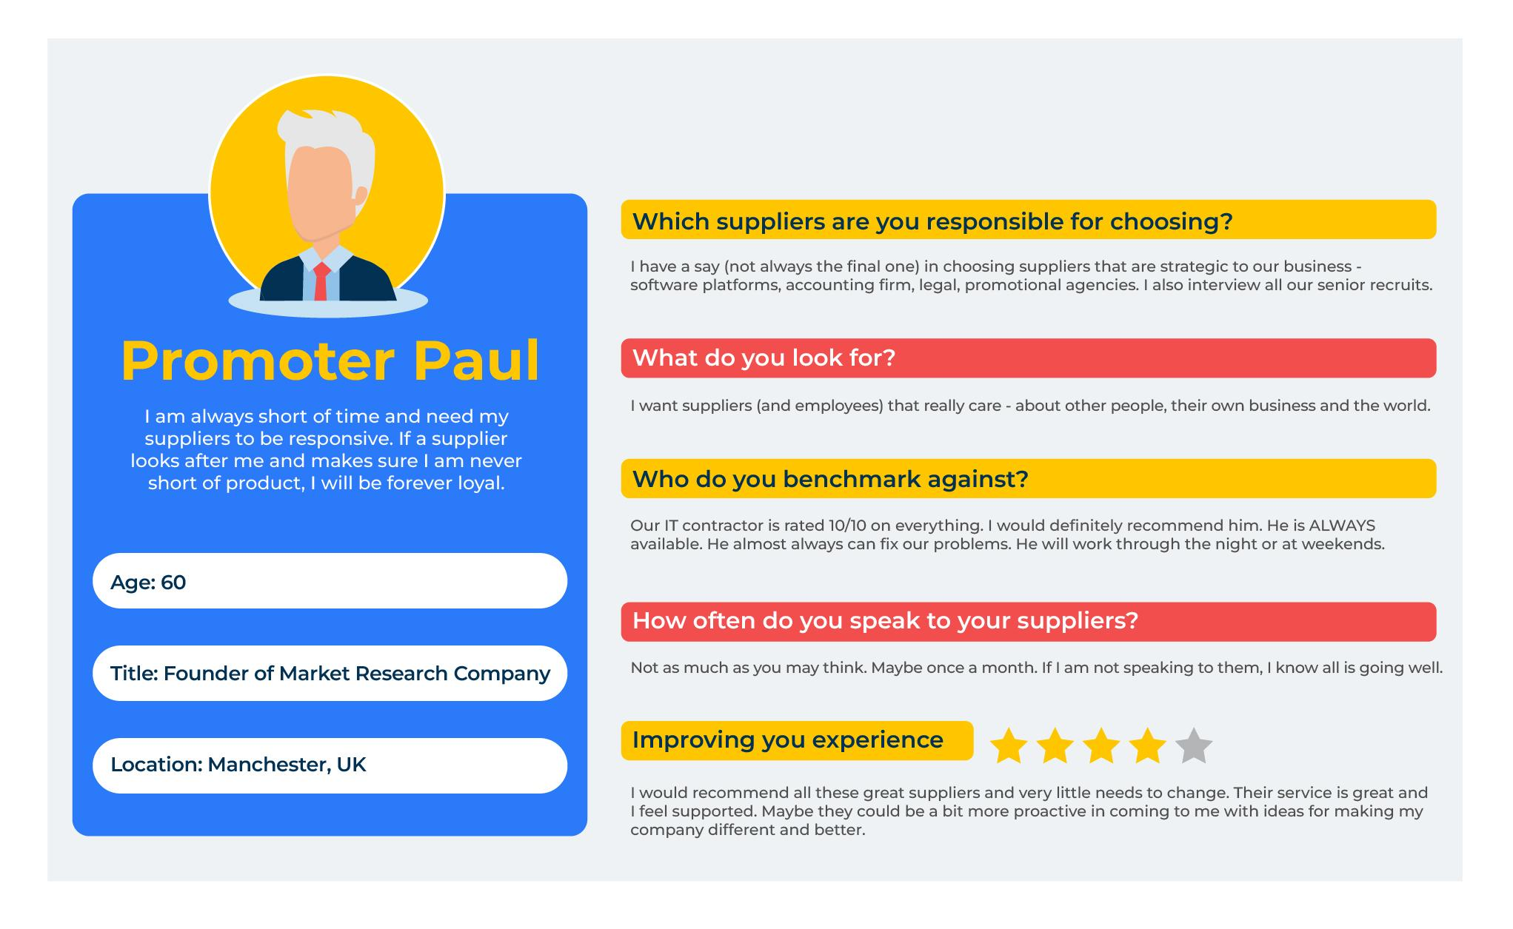
Build multiple personas.
Collect as much data as possible on your customers and potential customers. This can come from quantitative and qualitative data, from survey data, and in-house data on your Customer Relationship Management system.
Armed with this data carry out a workshop. Workshop participants soon get into the swing of inventing the persona. Make sure a moderator keeps the delegates on track.
And remember, this is just one persona with one role. Build different personas to represent different customer groups such as promoters, passives and detractors. They will be influenced by different triggers.

Slide 5
Build an elevator pitch.
An elevator pitch is a short message to a potential customer that gives them a reason to buy your product. The elevator pitch is a sort of customer value proposition (CVP). Only include things that our customers value and where we are superior. The key is to make the pitch short and punchy – as if it could be delivered in an elevator in just a few seconds.
Build an elevator pitch for each persona using the following framework:
Headline | The Elevator pitch
Target persona | For you dear customer…
Value | …we know you value xxx…
Superior | …and our product is the best on the market because xxx…
Profit | … which means you will benefit by xxx…..
Call to action | …let me suggest the next step is xxx.

Slide 6
Things to think about.
When developing persona, make it personal. Give the person a name. Imagine what sort of person this is – their age, where they live, their family background, their aspirations at work, the type of car they drive etc. This person should be as close as possible to the bullseye in the range of people you target.
You will require a number of persona to represent the different segments you are targeting.
The personas you have developed are your customers. Consider making a large cut-out model of these people and bring them into your marketing meetings because they will want to listen to what you say!

Slide 7
Thank you.

