Slide 1
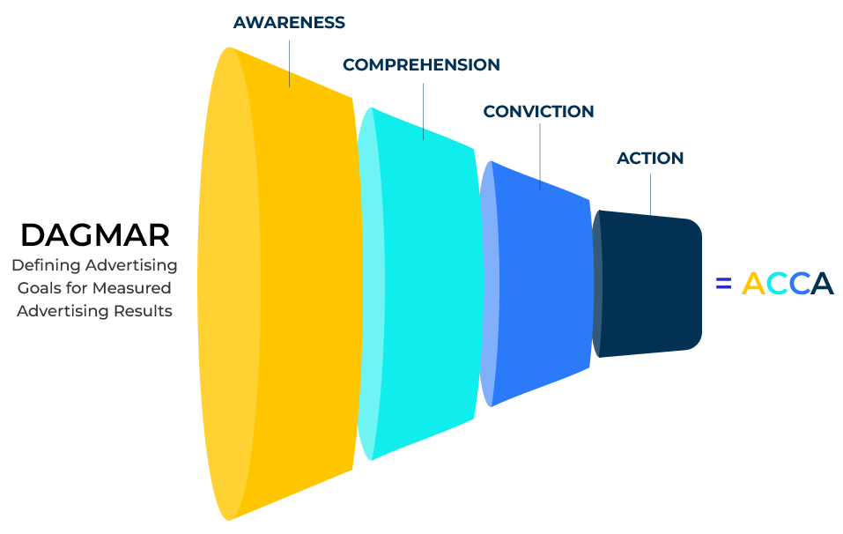
DAGMAR

Slide 2
A business model to manage promotions.
Use this framework to maximise returns on promotions
DAGMAR (Defining Advertising Goals for Measured Advertising Results) is a framework developed by Russell Colley in the 1960s to guide the setting and measurement of advertising objectives. While it was initially designed for advertising, its principles can be applied to various promotional strategies.
DAGMAR encourages a long-term perspective by recognizing that some communication objectives, particularly those related to changing attitudes or behaviours, may take time to achieve. This aligns with the idea of building enduring relationships with the audience.
By incorporating the principles of the DAGMAR framework into your promotional strategy, you can ensure a systematic and measurable approach to achieving communication objectives and, ultimately, driving desired consumer actions.

Slide 3
Define clear objectives.
The DAGMAR framework emphasizes the importance of setting clear and measurable objectives. In a promotional strategy, this means establishing specific goals such as increasing brand awareness, generating leads, driving sales, or promoting a new product.
 | Complete these boxes
What are the long term objectives/goals of the company? What are the promotional goals and how do they fit in with the business goals?
How important is the brand in the long term goals? What are the brand objectives and guidelines? How are they adhered to?
How much emphasis is put on lead generation versus brand building?
How are the goals measured?

Slide 4
What is the hierarchy of effects.
DAGMAR proposes a hierarchy of effects that consumers go through, starting from awareness, moving to comprehension, conviction, and finally, action. This helps in planning promotional activities that guide consumers through the stages of the decision-making process.
 | Complete these boxes
What is the decision making unit for the product/service you are considering? What roles do the different people play? What are they each looking for?
What is the hierarchy that take consumers from awareness through to action? Describe these stages – what are customer needs and interests at each stage? How does it differ in the DMU?
How effective is your company in meeting customer needs at each stage of the hierarchy? How could it be more effective?
What is needed to move potential customers from stage to the next?

Slide 5
Set measurable objectives.
DAGMAR emphasizes the need for objectives that are specific and measurable. For example, objectives might involve achieving a certain percentage increase in brand recall, a specific number of leads generated, or a measurable lift in sales within a defined period. The framework encourages the establishment of a benchmark or starting point against which the effectiveness of the promotional efforts can be measured. This baseline helps in evaluating the success of the campaign.
 | Complete these boxes
What measures are important and should be used at each of the levels of the hierarchy? What is the baseline measure?
How do you achieve the measures? Could the objectives be changed to make the measures more practical?
What plans are in place for making adjustments if the measures fall short?

Slide 6
Use of creative and media strategies.
DAGMAR guides the development of creative strategies and the selection of media based on the communication objectives. It emphasises aligning the creative approach with the desired response from the target audience.
 | Complete these boxes
Who is in charge of your creative strategies? How aligned is this person(s) with the promotional objectives?
How do your creative strategies build your brand? How much emphasis is given to digital promotion versus traditional marketing?
What attempts are made to measure the effectiveness of the different creative and media strategies?

Slide 7
Thinking long term.
DAGMAR encourages a long-term perspective by recognising that some communication objectives, particularly those related to changing attitudes or behaviours, may take time to achieve. This aligns with the idea of building enduring relationships with the audience.
 | Complete these boxes
What are the measures that are important for short term effectiveness and long term effectiveness? How are you measuring loyalty and long term success?
When you make changes to your promotions, do you distinguish between tweaks to ads versus a change in promotional direction?
How do you know if customer behaviours are changing? How flexible are you in meeting those changes?
Consider also looking at the AIDA framework that has similarities to DAGMAR.

Slide 8
Editable framework.
Use this to add your own text and edit to suit your own branding
AWARENESS
COMPREHENSION
CONVICTION
ACTION
DAGMAR
Deﬁning Advertising
Goals for Measured Advertising Results
= ACCA

Slide 9
Thank you.

