Slide 1
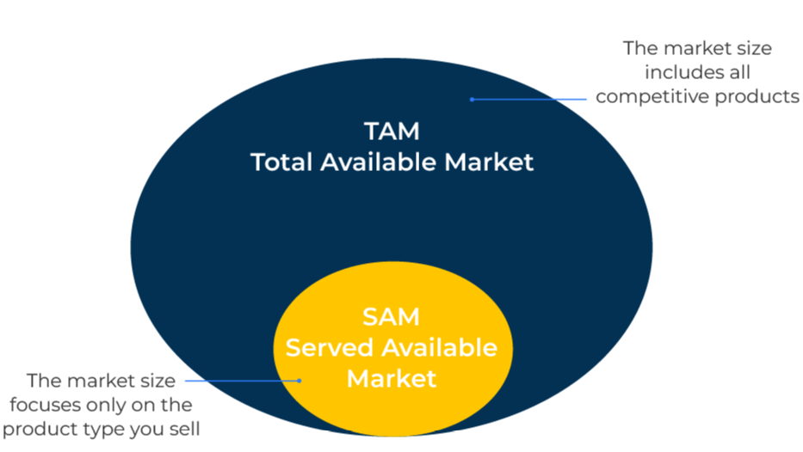
Market Sizing

Slide 2
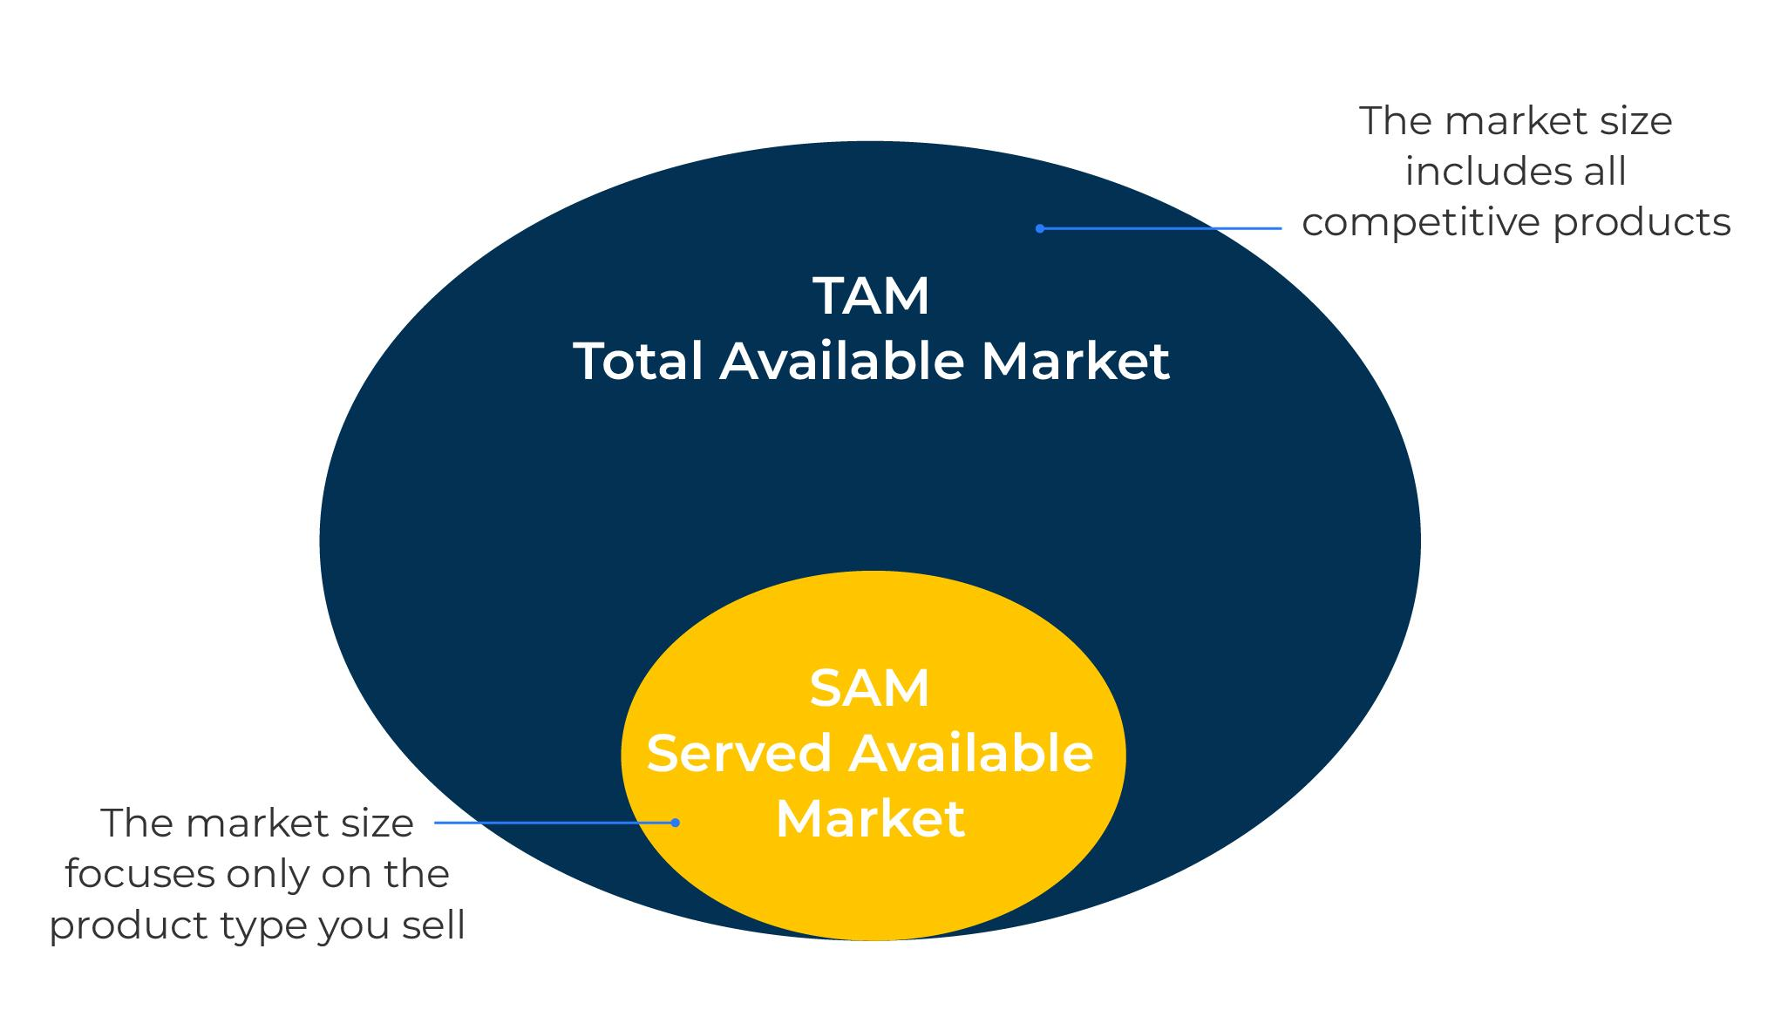
A model to assess potential opportunities.
Use this model to find out the size of a market for your products or services
There are two important components to a market size –
The total addressable market (TAM made up of companies/people who currently buy the product as well as those who potentially could do so)
The served available market (SAM made up of only the companies/people who are currently buying the product).
You must decide whether you want to assess the TAM or the SAM (it is usually the SAM).
There are three approaches to market sizing:
Top-down – take a bird’s eye view using published reports and macro data
Supply side – make estimates based on assessments of the size of each competitor supplying the market.
Demand side (bottom up) – use average consumption per user together with estimates of the number of user to create a formula that leads to the market size

Slide 3
Top down assessment.
This is a high-level view of the market using published data, previous research, government reports and potentially input from industry experts.
Government statistics, trade associations and published reports can provide instant figures. These should always be reviewed with caution and where possible cross checked and validated. It may be necessary to use the statistics as the base for a further calculation.
A further approach is to use ratios. For example if a market size is known in country A and you want to estimate the market size in country B it may be possible to use a ratio with gross domestic product, population size, electricity production or any other variable on which there are published statistics:
Market size country A (known)
Estimate of market size in country B (unknown)
=
Gross domestic product in country A (known)
Gross domestic product in country B (known)
Estimate of market size in country B
=
Market size country A x Gross domestic product in country B
Gross domestic product in country A
No two countries are exactly the same and so you will have to make adjustments to the estimate based on economic or cultural differences between the countries.

Slide 4
Supply side assessment.
If you can obtain estimates of the revenue of each major supplier, the sum of these revenues will equal the market size. Revenue figures can be found from company financial reports.
Financial reports may not be up-to-date or include revenue. In which case, use the numbers of employees per company (widely available) and apply an average revenue per employee to calculate company revenue. (Note: in the UK the average revenue per employee is £120,000).
Equally, if you have just one accurate revenue figure for a company and a good estimate of the market share of this company you will be able to calculate the total market size e.g.:
Company A: Revenue
Company A: Market share
Market size (by calculation)
$15 million
18%
=
$83 million

Slide 5
Demand side assessment.
In this approach, build a model of the market from average consumption figures.
For example, if you know how many companies there are in the market you are addressing (this figure can be found from government statistics or Hoovers) and you know the average consumption of a product per company, you can assess the market size:
Numbers of companies in the market
x
=
Average consumption of product per company
Market size
This estimate of demand is good for explaining the market size but is subject to error based on the average consumption of product. A small error on this consumption figure will, through multiplication, result in a big error on market size.

Slide 6
Bringing it together.
All assessments of market size are subject to error. Usually it is not possible to determine the level of error. It is therefore good practice to assess the market size by more than one approach. Assessments that vary considerably between the approaches will suggest a reappraisal.
In most markets there are experts whose views are worth tapping. These experts may arrive at estimates of the market size by judgement. Whilst it isn’t possible to assess the accuracy of such judgements, they are worth obtaining as a further crosscheck.
Always bear in mind the purpose of the market size assessment. If you are entering a new markets such as China, it may be academic to know the overall market size. Your interest should be in knowing if there is sufficient market to justify your sales ambitions.

Slide 7
Things to think about.
Market size estimates seldom need to be precise. It is good practise to obtain triangulation on the assessment by using a top down (macro or high level) and bottom up approach (modelled from end user intelligence and market statistics).
It can be helpful to assess market size in number of units. This avoids the problem of products having different prices as they move through the value chain.
If the value of the market is assessed in currencies, it is important to state whether the figure is at manufacturers’ selling prices or consumer buying prices.

Slide 8
Thank you.

