Slide 1
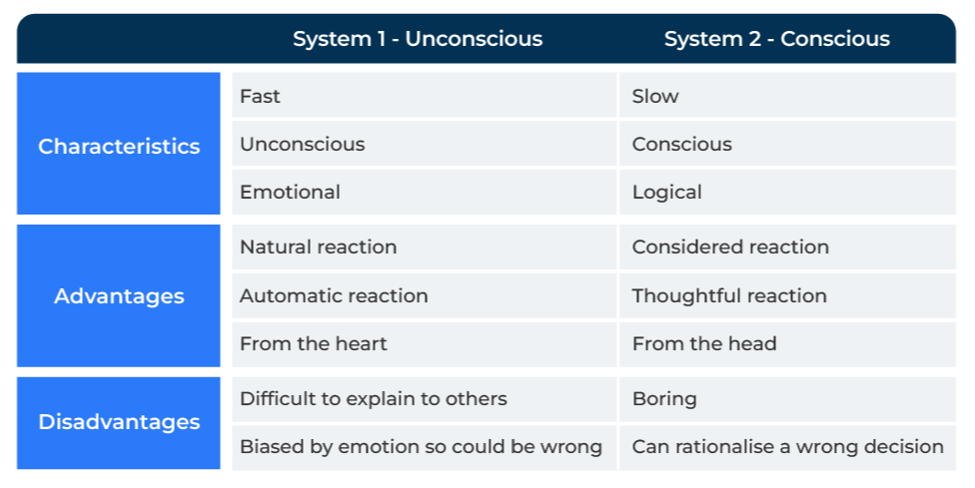
System 1 & System 2 Thinking

Slide 2
A model for working out what drives decision making
Use this model to work out how to influence customer decision making
This model is the brainchild of Daniel Kahneman. His theory is based on the way human decision-making is influenced by heuristics (biases).
These biases come from reference points that are used to compare things - past history, the way the question is framed, and the fact that we very often won’t change our mind because we are psychologically committed to a decision.
This decision-making takes place at two levels – one is unconscious, fast and emotional (System 1) and the other is slow, conscious and logical (System 2).

Slide 3
Think about what influences decision making.
System 1 thinking is driven by emotions and people often do not recognise that they are thinking. The process occurs in the subconscious and is subject to bias.
System 2 thinking is how most of us think we make decisions when in fact it could be a post-rationalisation that follows the true driver which was emotions.
System 1 thinking is influenced by biases (heuristics). What has happened in the past will almost certainly shape what we think and our actions in the future. There are a number of factors that influence the biases:
Anchoring: Reference points help us in our decision making. A fact or a figure mentioned to someone, it could influence their answer.
Availability: People are influenced by things we can quickly and easily recall (eg happened recently or of critical importance)
Optimism and loss aversion: There is a prevalence of us overestimating the benefits and underestimating the costs of things. It results in doing things that are risky and against our better judgement.
Framing: The way a question is asked can affect the answer.
Sunk cost: We are guilty of throwing good money after bad. People are drawn to continue down the same path, perhaps to try to change the outcome and alleviate any feelings of regret.

Slide 4
Dig deep.
If you ask somebody why they do something or why they chose a particular brand/supplier, the first level of response is likely to be logical. People do not like to admit that they make decisions on the fly or from the gut. This means that if asked why they chose a supplier they almost certainly will mention that the price was right, the availability was acceptable, the quality met their needs etc. These factors may well have influenced the decision but there may have been others. There may have been a greater level of trust with one supplier, they may have liked the people in that company, they may have thought that buying from the company conferred some status etc. These are influences that may not even be recognised initially by the decision maker.
Answers to questions can provide clues that indicate which system is operative. When digging deep develop questions that uncover whether the respondent is thinking fast and emotional (System 1) or slow and logical (System 2):
Questions | System 1 | System 2
How many years have you used your current supplier? | 10 years or more | Change suppliers regularly
Which supplier would you use if your current supplier was no longer available? | Another supplier mentioned immediately | Can't say, would have to think about it
If your current supplier was an animal, what would it be? | A dog, a cat (in other words a pet) | A horse, a lion (in other words a rational animal)
Digging deep requires qualitative research. It is always worth asking the “why” question three times. The first time may elicit a rational response (system 2) and further questioning may uncover more subtle reasons (system 1).

Slide 5
How to use the thinking.
Digging deep (step 1) will help you understand the influence of System 1 and System 2 thinking. The most important contribution of the model is using it in communications with customers and potential customers. There is no right or wrong way of using the model. Across a wide audience of customers there will be people who can be influenced by both System 1 and System 2 thinking. For example:
Using System 1 thinking
Appeal to people’s desire to make quick decisions (easy and lazy decisions):
Create a loyalty club/card encouraging people to automatically default to choosing your company.
Use testimonials so that people can lean on someone else’s decision-making process and choose your company.
Use a message that indicates you are the safe and obvious choice.
Make it easy to do business.
Using System 2 thinking
Logical thought (System 2 thinking) can be prompted with specific actions:
Offer incentives that appeal to logic (e.g. price will be reduced by 20% if the decision is taken before the end of the month).
Show comparative data on your product and the competition.
Provide a stack of rational reasons why your company (and its products) is the best.
Use gamification to draw people in. For example scratch cards, puzzles and competitions.

Slide 6
Things to think about.
Use focus groups and qualitative research to discover what people really think of your products and those of your competitors. Create an emotional profile which shows how your brand is associated with certain words such as happy, pleased, trust, valued, safe etc versus stressed, frustrated, irritated, disappointed, unsatisfied etc. What is the emotional profile of your competitors using the same words? This can be used to develop emotional profiles.
Use emotions to make your marketing communications more effective. Instead of talking about the features of your products, talk about how the customer will feel after they have bought your product.

Slide 7
Thank you.

