Slide 1
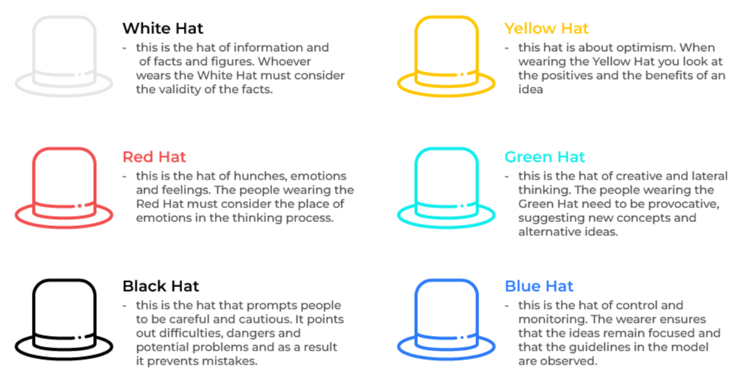
6 Thinking Hats

Slide 2
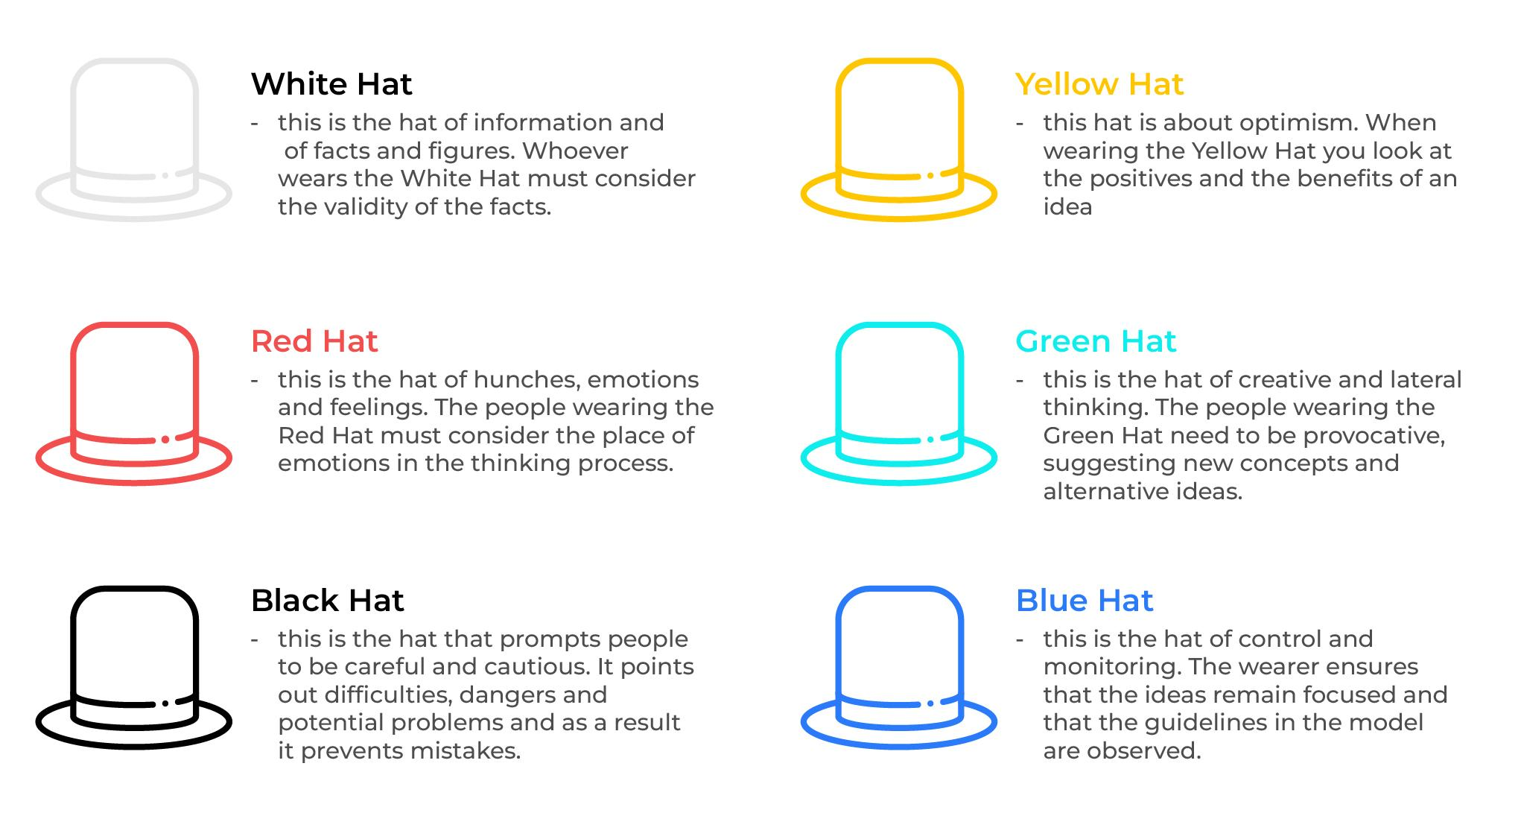
A brainstorming model.
Use this model to run more efficient meetings and get new ideas
Edward de Bono believes that there is much wasted time in meetings. People argue one point of view and others argue another with no agreement. His 6 thinking hats uses parallel. He does this with 6 coloured hats, each with a purpose:

Slide 3
Different approaches to using the hats.
A moderator is required. This is the person with the Blue Hat. They are responsible for making sure that the appropriate processes are used. They set time limits for how long hats are worn, they say which next colour of hat will be used, they check to see that the objectives of the meeting are being met. According to de Bono there is much flexibility about using the different coloured hats. For example, they could be used in three different scenarios:
#1 scenario. Everyone works together as a large group and the moderator tells people which coloured hat to use, and when to change to the next colour in a search for a solution.
#2 scenario. A large group is split into smaller groups each with six people. Each of the smaller groups addresses the same problem. The people in these smaller groups of 6 are each allocated a different coloured hat and discuss the problem. After the discussion the moderator brings the smaller groups together to receive their feedback and arrive at a consensus.
#3 scenario. A large group is broken into subgroups, each of a different colour. For example, 20 people in a workshop would make five groups of four people. Each group would be allocated a different colour and asked to address a problem from the point of view of their colour. The colours are then rotated so each small group has a chance to apply the different thinking. The Blue Hat overseas this process.

Slide 4
Sequencing the use of the hats.
Blue Hat: There are no hard and fast rules as to the sequence of the coloured hats. It makes sense for the person with the Blue Hat (the moderator) to begin proceedings and explain the process.
White Hat: The moderator suggests that everybody wears a White Hat and discusses the facts that are available about the problem. The questions are always "what do we know?“, "what facts do we have?", “what does this tell us?”.
Green Hat: The moderator moves on to the Green Hat which is the creative part of the discussion. Brainstorming takes place to consider any and all possible solutions. Questions here are “what are the alternatives?”, “How can we do things better?”.
Yellow Hat: The Yellow Hat is donned to think through the advantages and benefits of the suggestions. Questions here are "what are the advantages of this solution?" and "why do we think the solution is workable?".
Black Hat: This is aimed at finding out why the suggestions may not work. Questions at this stage could be "what are the risks of this suggestion?" and "why will this suggestion not work?".
Red Hat: The Red Hat can be used periodically to find out people's emotional reactions to the suggestions. Here we are looking to find out answers to "what are our feelings about the suggestion?" and "what do our heart s tell us about this suggestion?“, “how do we think our customers will feel about this?”.
And keep looping back to different colours at any time and as often as is thought necessary!

Slide 5
Length of time spent in discussion.
There are no hard and fast rules on how long should be spent wearing a particular colour of hat.
It makes sense to spend as much time is necessary with the White Hat – laying all the facts on the table. A complicated problem may need an hour or two on this session while something simple may take just a few minutes.
Thereafter, de Bono recommends that the time should be limited as to how long is spent on each colour of hat. This forces people to move on quickly remembering that it is always possible, indeed it is often necessary, for a return to a particular colour of hat. For example, 5 to 10 minutes may be sufficient time spent on the Yellow, Green, and Black Hats. The Red Hat, the emotional hat, requires less time – possibly no more than a minute. The idea here is to get a quick gut reaction. The Red Hat may be worn a number of different times in a session.

Slide 6
Tips.
The six thinking hats is an excellent tool for energising a workshop. It encourages collaboration.
Three tips:
Moderator. The person that wears the Blue Hat, the moderator, should have some experience with the tool. At the very least they should have read about the tool and its use before the meeting. Other people attending the meeting do not need any knowledge of the tool as it will be explained at the time.
Descriptions of the hats. It is worthwhile having handouts or flipcharts that summarise the six coloured hats and their purpose. People will need to be reminded of the focus of their thinking when wearing a particular colour of hat.
Capturing the results. There must be some means of recording and capturing ideas. Someone could be assigned as a note taker using a flip charts so everyone can see that all the ideas have been captured as intended.

Slide 7
Thank you.

