Slide 1
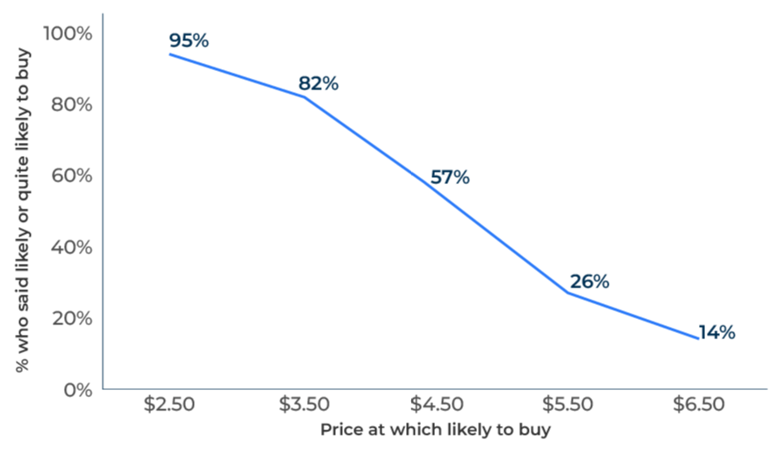
New Product Pricing

Slide 2
A business model for pricing new products.
Use this model to determine the optimum price for a new product
Launching a new product and pitching it at the right price is critical. A price that is too high will kill sales and a price that is too low will jeopardise profits. Many companies set the price of new products by looking at competitive products and making a judgement as to where the new product fits. Pricing models that simulate buying situations can be a more objective way of establishing the optimum price. If the budget is big enough and completed surveys can be obtained from 200 or more respondents, conjoint may be the best tool to use.
Here we consider two different models – Gabor Granger and Van Westendorp, which can be used with smaller samples and give a good indication of the launch price.
In both cases you will need to:
Have a sample of potential buyers of the product who will complete the survey (if possible at least 30 completed surveys and ideally over 100)
Have a facility for suitably describing the new product (the questions can be asked after a product trial or respondents can be shown a description of the product before being asked their likelihood of buying at certain prices). The new product could be shown to people in an online questionnaire or if the interview is by telephone, via a web link (which assumes that the respondent will be able to access it through a computer, an iPhone or an iPad).

Slide 3
GABOR GRANGER
This is a simple tool developed by Clive Granger and André Gabor - two economics professors . Respondents are shown the new product and asked how likely they would be to buy it at a specified price.
"How likely are you to buy this product at this price (specify)?" Very likely, quite likely, neither nor, not very likely, not likely at all.
The prices that are suggested are predetermined and should cover a range of five or six options from quite cheap to quite expensive. In theory each respondent should be presented with a random price from these five or six options. In practice respondents can be started on the highest price, asked how likely they are to buy at that price. The price is then lowered, level by level until the respondent says they are likely or very likely to buy.
Surveys that lower the price incrementally in this way have proved reliable (in practice very few people hang back and wait for a bargain basement price - they understand the purpose of the survey and respond honestly).

Slide 4
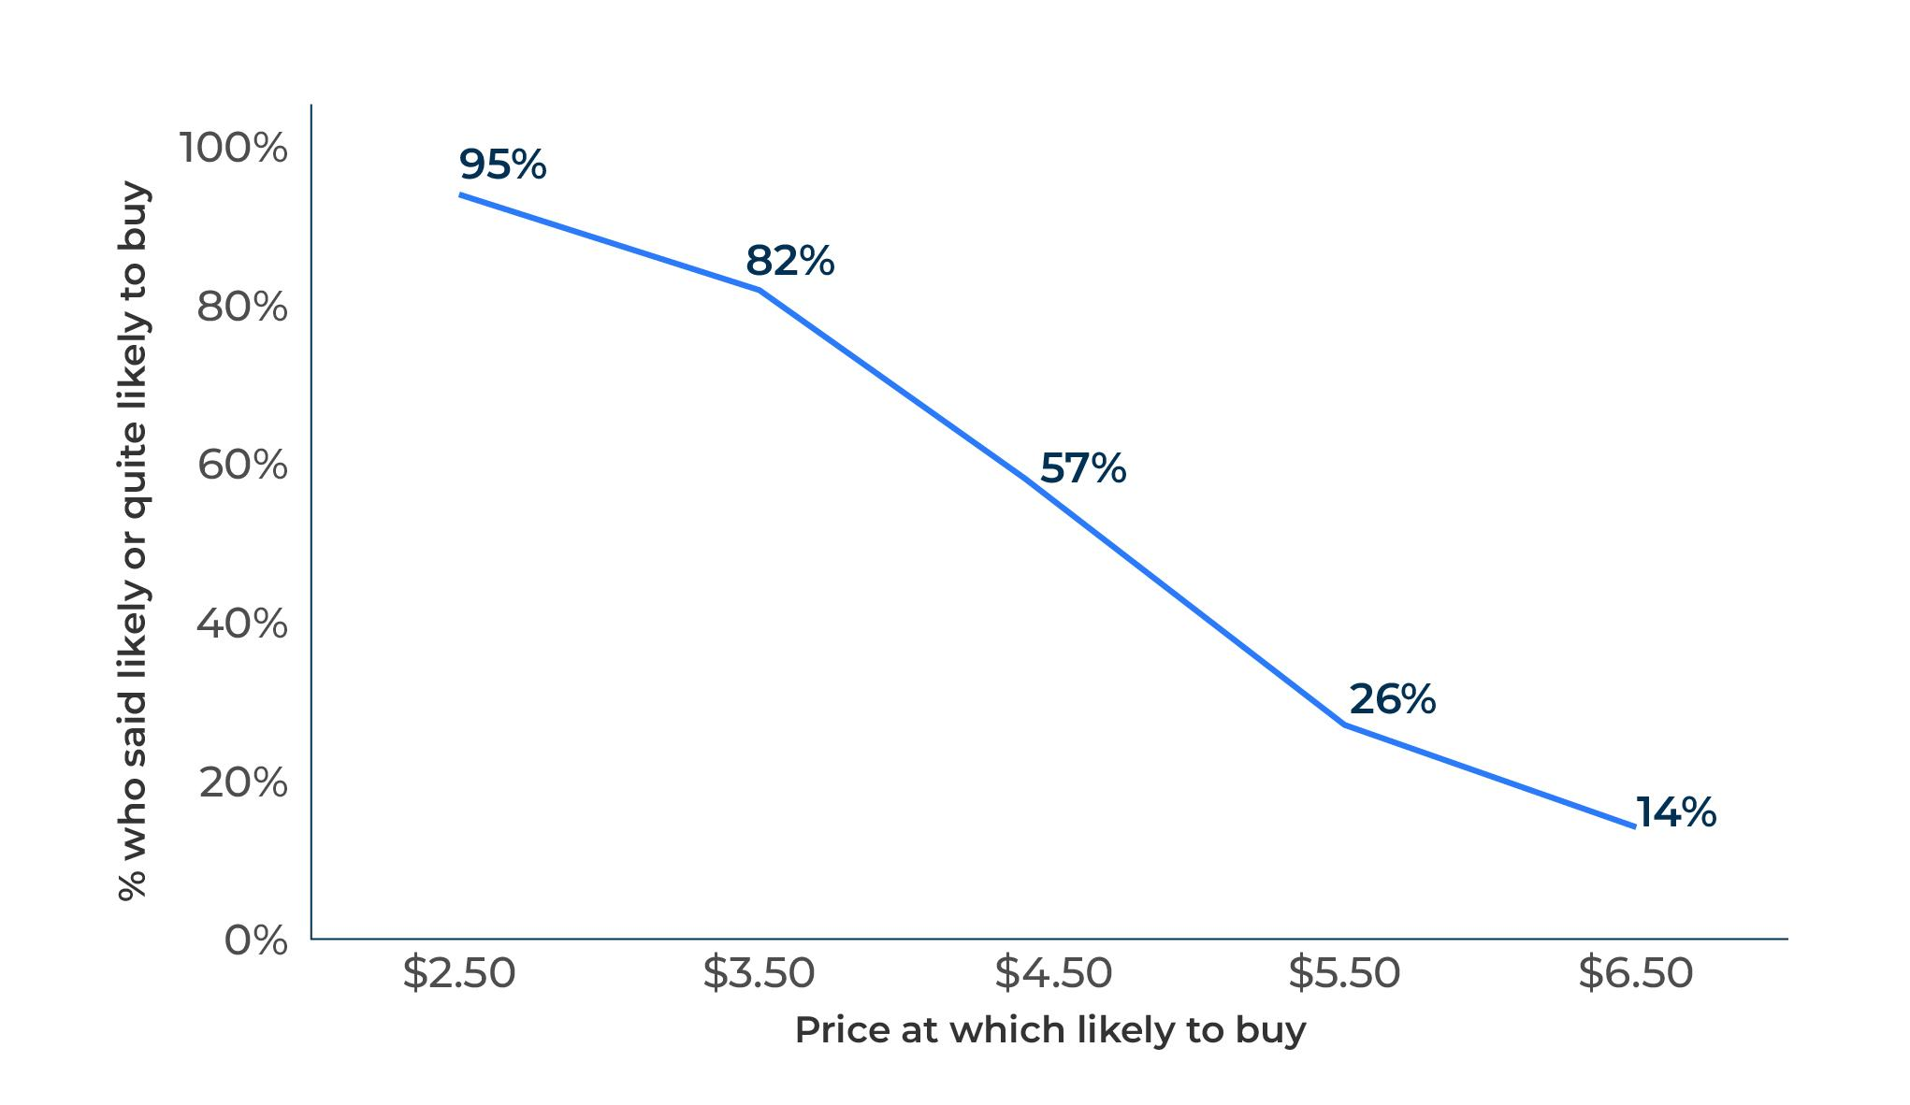
Interpreting Gabor Granger.
A price curve can be determined from the responses to the question as shown in the figure opposite.
Judgement can then be made at which price to position the new product. Assuming that a profit could be achieved at a price of $3.50, this looks a good price for the new product as it would be attractive to around 80% of the target audience.
It should be remembered that the actual number of people who will buy the product is likely to be substantially less than the proportion that said they would do so in the survey.
It is not possible to be definitive about the exact proportion that would buy. As a working hypothesis it could be assumed that a half those who said they would buy would actually do so – in other words around 40% in this example.

Slide 5
van Westendorp
This pricing tool is slightly more sophisticated that Gabor Granger. It is from Peter van Westendorp, a Dutch economist, who proposes asking four questions after someone has seen the new product.
At what price would you consider this product/service to be cheap? [A range of prices is shown]
At what price would you consider this product/service to be too expensive? [The same range of prices is shown]
At what price would you consider this product/service to be priced so cheaply that you would worry about its quality? [The same range of prices is shown]
At what price would you consider this product/service to be too expensive to consider buying it? [The same range of prices is shown]
The responses received are used to construct a price sensitivity meter (PSM). This is shown on the next page.

Slide 6
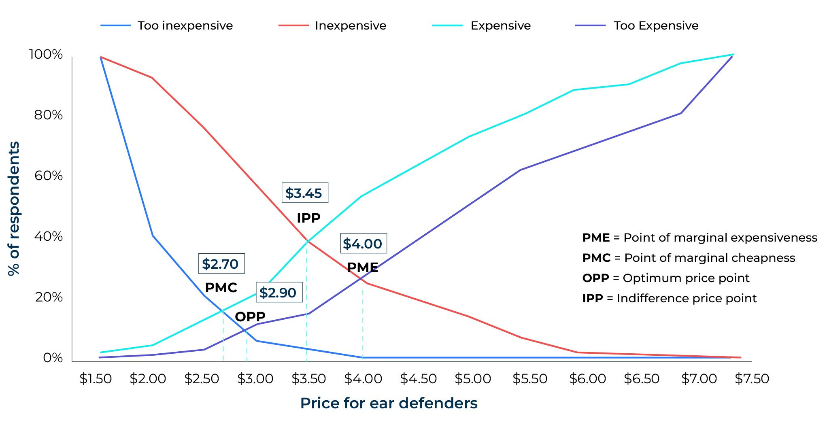
Interpreting van Westendorp.
The intersection of the lines on the graph indicate four different pricing points. The labels given to these pricing points by van Westendorp can be misleading. The optimum price point tends in practice to be on the low side. In most markets there are options for discounts and so the launch price would usually be towards a higher level such as the IPP (Indifference Price Point).
The van Westendorp approach implies a scientific result when in fact a good amount of judgement must still be applied. Respondents who answer questions on the new product will give a quick response without any influence from promotions. It is not as accurate as a product placement in which a new product is sold alongside competitive products. However, experience has shown that it gives a good indication of the best price at which to launch a new product.

Slide 7
Things to think about.
Establishing the price of a new product is critically important as it determines the success of the launch and the profitability of sales. The Gabor Granger tool can be used to test concepts before prototypes are made. Once a prototype is developed and can be shown to respondents, the Van Westendorp tool will indicate the optimum price.
Both Gabor Granger and Van Westendorp have proved to give realistic price levels for new products. It is worth considering launching at a slightly higher price than that which is suggested by the tool if it is a market which expects discounts.

Slide 8
Thank you.

