Slide 1
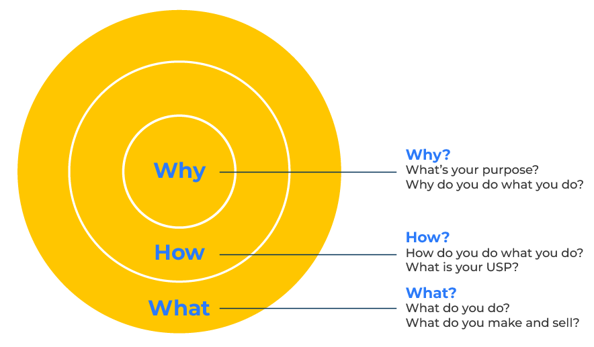
Golden Circle

Slide 2
A business tool to motivate people.
Use this framework for inspiring everyone to take action
Sinek's Golden Circle is useful in motivating people by providing a framework for leaders to communicate a compelling and authentic purpose (Why), align values (How), and articulate specific actions and outcomes (What).
When individuals understand and resonate with the "Why," they are more likely to be motivated, engaged, and committed to their work and the goals of the organisation.

Slide 3
Benefits of the Golden Circle.
Inspiring Purpose - because people understand why they are doing something.
Alignment of Values - shared values give a feeling of belonging.
Enhanced Team Engagement - the circle fosters a collaborative environment.
Long-Term Commitment - motivation to a cause breeds loyalty.
Innovation and Creativity - intrinsic motivation prompts creativity.
Customer and Stakeholder Connection - it isn't just employees that are motivated. Customers and other stakeholders can feel a shared purpose.

Slide 4
Start with “Why?”
First of all define your purpose. Articulate the core purpose or belief that inspires and drives your organisation. Also, connect emotionally. Make an emotional connection with your audience by communicating the passion and inspiration behind your organisation's existence. Emphasize the impact you aim to make beyond just the products or services you offer.
 | Complete these boxes
Why does your organization exist?
What values and principles guide your work?
What inspires people at your place of work? What makes them want to get up and come in to your company?

Slide 5
Move to “How?”
Identify core values by defining the principles and values that guide your actions and decision-making. These are the fundamental beliefs that shape your company’s culture.
Explain what you do. Communicate your key strategies, philosophies, or approaches that differentiate your company. How do you bring your core values to life in your day-to-day operations?
 | Complete these boxes
What do you really, really value at your company?
Beyond what you make, how would you say what you do makes a contribution to the world?

Slide 6
Now think about “What?”
Clearly outline the specific products, services, or solutions your company provides. This is the tangible outcome of your work. While discussing the "What," highlight unique features or aspects of your offerings that set you apart from others in the market..
 | Complete these boxes
What do you make or do at your company? What is the physical output of your efforts?
And what differentiates your products from others on the market?

Slide 7
Bring everything together.
Create a concise and compelling Golden Circle statement that incorporates your "Why," "How," and "What." This statement should capture the essence of your company and communicate it in a way that resonates with your audience.
 | Complete these boxes
What do you believe in at your company? (This is the “Why?”)
How do you provide what you do? (This is the “How?”)
And how does it benefit people? (This is the “What?”)
For example: "We believe in challenging the status quo (Why) by providing innovative and sustainable solutions (How) to empower our customers and create positive, lasting change in the world (What)."

Slide 8
Finally…
Ensure that your entire company understands and aligns with the Golden Circle. Leaders and employees should be able to articulate the "Why," "How," and "What" in a consistent manner.
Integrate the Golden Circle into your external communications, including marketing materials, website content, and any public-facing messages.
Evaluate decisions made at your company based on whether they align with your core purpose, values, and strategies.
Communicate the "Why" to inspire and motivate your teams. Regularly remind employees of the broader purpose and impact of their work.
Acknowledge and celebrate achievements and contributions that align with your company's purpose. This reinforces the connection between individual efforts and the overall mission.
Be prepared to revisit and refine your purpose, values, and strategies. Adapt the Golden Circle to reflect changes in the market, industry, or internal dynamics.

Slide 9
Editable framework.
Why?
Use this to add your own text and edit to suit your own branding
What’s your purpose?
Why do you do what you do?
Why
How?
How do you do what you do? What is your USP?
What?
What do you do?
What do you make and sell?
How
What

Slide 10
Thank you.

