Slide 1
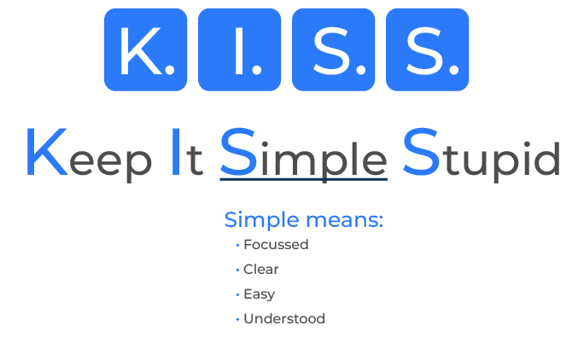
Keep It Simple

Slide 2
A tool to drive efficiency.
Use this framework to carry out projects on time and on cost
"Keep It Simple, Stupid" (KISS) is a principle that suggests simplicity should be a key goal in design and decision-making. It originated in the field of engineering and design but has since been widely adopted in various areas, including business.
The idea behind KISS is to avoid unnecessary complexity and make things as straightforward and uncomplicated as possible.

Slide 3
Small, clear, important tasks.
Define Clear Objectives:
Clearly define the project's objectives and goals. Ensure that all team members have a shared understanding of what needs to be achieved. This clarity helps in maintaining focus throughout the project.
Break It Down:
Divide the project into smaller, manageable tasks or phases. This makes it easier to tackle each component individually, reducing the overall complexity.
Prioritise Tasks:
Identify and prioritize tasks based on their importance and dependencies. Address critical tasks first to ensure that essential components are completed before moving on to less critical ones.
Limit Features and Scope:
Be selective about the features and scope of the project. Avoid adding unnecessary elements that may complicate the project without adding significant value. Focus on delivering what is essential to meet the project's goals.

Slide 4
Quick, clear, limited meetings.
Clear Communication:
Foster open and clear communication within the team. Ensure that everyone understands their roles and responsibilities. Effective communication helps prevent misunderstandings and keeps everyone on the same page.
Use Agile Methodologies:
Agile methodologies, such as Scrum, emphasize iterative and incremental development. This approach allows for flexibility and adjustments during the project, making it easier to adapt to changing requirements.
Limit Meetings:
Minimize the number and duration of meetings. While communication is crucial, too many meetings can be counterproductive and consume valuable time. Keep meetings focused on essential updates and problem-solving.
Regularly Review and Refine:
Periodically review the project's progress and reassess priorities. This ongoing evaluation allows for adjustments as needed, ensuring that the project stays aligned with its objectives.

Slide 5
Work together, not over the top.
Collaboration and Team Involvement:
Encourage collaboration and involvement from all team members. Leverage the collective expertise and insights of the team to simplify processes and identify more straightforward solutions.
Avoid Over-Engineering:
Resist the temptation to over-engineer solutions. Sometimes, a simpler approach is more effective and easier to maintain in the long run. Focus on meeting requirements without unnecessary complexity.
Document Clearly:
Keep documentation clear, concise, and easily accessible. Well-documented processes, requirements, and decisions help prevent confusion and provide a reference point for team members.
Manage Change Effectively:
Embrace change but manage it effectively. Be mindful of how changes may impact the project's simplicity and adjust plans accordingly. Communicate changes clearly to all stakeholders.

Slide 6
Test and learn.
Test Early and Often:
Incorporate testing early in the development process. Regular testing helps identify and address issues before they become major problems, reducing the risk of complications later in the project.
Learn from Experience:
After completing a project, conduct a retrospective to learn from the experience. Identify what worked well and what could be improved. Use these insights to enhance future projects and maintain a continuous improvement mindset.

Slide 7
Editable framework.
K. I. S. S.
Use this to add your own text and edit to suit your own branding
Keep It Simple Stupid

Slide 8
Thank you.

