Slide 1
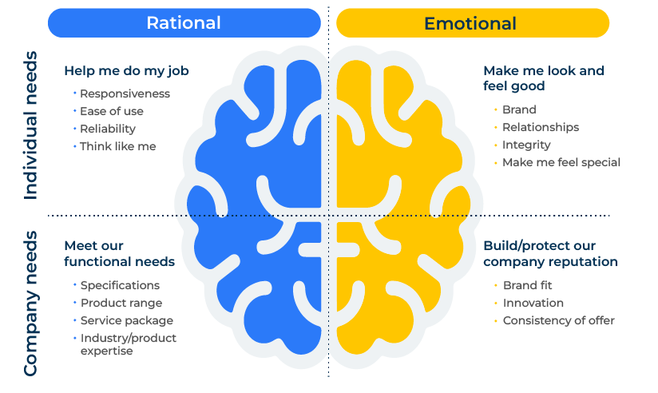
Left & Right Brain Thinking

Slide 2
A business model for understanding behaviours.
Use this framework to develop a customer centric and adaptable business strategy
Left and right brain thinking refers to the idea that different cognitive functions are associated with the two hemispheres of the brain. Left brain thinking is often associated with analytical and logical processes, while right brain thinking is linked to creativity and holistic thinking.
Integrating left and right brain thinking in the development of a business strategy allows for a comprehensive and well-rounded approach. By leveraging analytical and creative thinking, businesses can create strategies that are not only grounded in data and logic but also innovative, customer-centric, and adaptable to change.

Slide 3
Leverage left brain thinking.
Complete the following questions to see how left brain thinking (rational and logical) can help your strategic plan.
 | Complete these boxes
What are the market trends, customer behaviours, and competitive landscapes using quantitative data?
Do you have detailed plans, measurable goals, and clear timelines for implementation?
What are potential risks and uncertainties associated with various aspects of the business strategy?
How can you improve efficiency and implement process improvements to streamline operations and reduce costs?

Slide 4
Leverage right brain thinking.
Complete the following questions to see how right brain thinking (emotional and intuitive) can help your strategic plan.
 | Complete these boxes
How good are you at generating new ideas, products, and services that can set your business apart in the market?
How good are you at ensuring that products and services meet the emotional and experiential needs of customers?
How good are you at creating a brand that resonates with the target audience, encompassing visual elements, messaging, and the overall brand experience?
How good are you at storytelling, helping to communicate the company's vision, mission, and values in a way that resonates with stakeholders and customers?
How flexible are you at adapting to evolving market conditions, technological advancements, and customer preferences?
How understanding are you of the interconnectedness of various elements within the business environment and how they impact your overall strategy?

Slide 5
Integrating left and right brain thinking.
Balanced decision making
Integrate both left and right brain thinking for balanced decision-making. Combine analytical rigor with creative insights to make well-informed decisions that consider both quantitative and qualitative factors.
Innovation in Execution
Apply creativity not only in ideation but also in the execution of strategies. Innovative implementation, marketing, and customer engagement can set a business apart from competitors.
Continuous Learning
Foster a culture of continuous learning. Both left and right brain thinking contributes to a dynamic learning environment, where the company is responsive to market feedback and constantly seeks opportunities for improvement and innovation.

Slide 6
Editable framework.
Rational
Use this to add your own text and edit to suit your own branding
Emotional
Help me do my job
Make me look and feel good
Individual needs
Meet our functional needs
Build/protect our company reputation
Company needs

Slide 7
Thank you.

