Slide 1
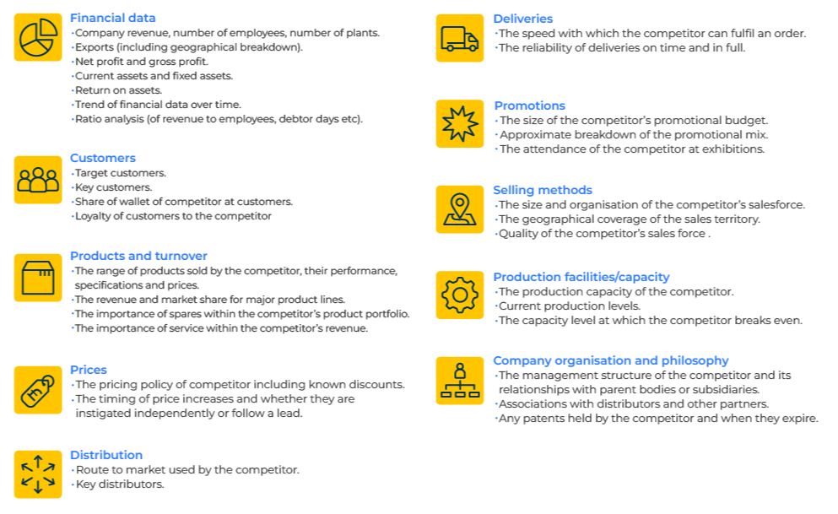
Competitive Intelligence

Slide 2
For assessing the strengths and weaknesses of competitors.
Use this model to develop a strategy for attacking or defending your position against other companies.
The aim is to collect as much intelligence on competitors as is legally possible.
Sources of intelligence include financial accounts, websites, press releases, market research surveys, distributors etc.
The following frames are by way of example. The intelligence that you collect should be for a purpose – e.g. to benchmark, to anticipate strategic responses, for acquisition etc.
As with all models you should determine what the objectives are of the exercise. Is it a one-off exercise to determine the strengths and weaknesses of competitors or is it a model to continuously track the performance of competitors?
The tool is flexible and you can collect data for as many or few companies as suits.
As a suggestion you should populate the templates with specific intelligence. Equally, you could devise a scoring system which judges competitors to be better or worse than your own company on the various criteria; the aim being to determine your relative strengths and weaknesses.

Slide 3
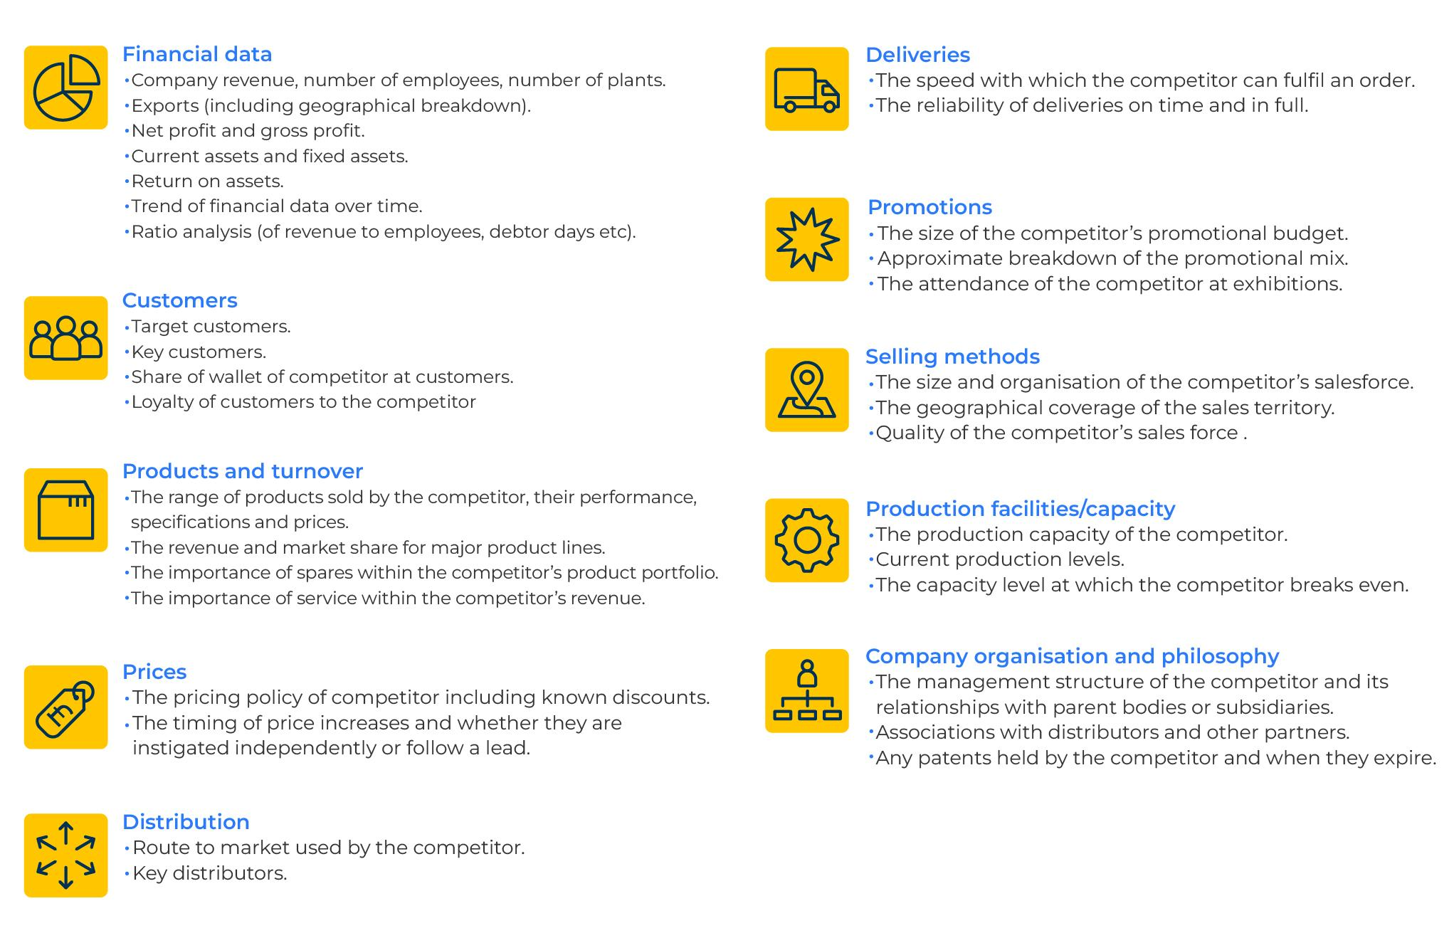
Overview of competitive intelligence.

Slide 4
Financial data.
Step 1
Collect as much financial data as possible on your company and competitors with which you wish to benchmark
Financial data | Your company | Competitor A | Competitor B
Company revenue (year)
Number of employees
Number of plants.
Exports (including geographical breakdown)
Net profit
Gross profit
Current assets
Fixed assets
Return on assets
% gross profit of revenue
Ratio of revenue to employees

Slide 5
Customer and product data.
Step 2
Collect key data on your company and as much as is possible on competitors. Data on competitors may be limited in which case you may have to make educated guesses.
Customers | Your company | Competitor A | Competitor B
Number of customers
Key customers
Share of wallet at customers
Net promoter score
Products and turnover | Your company | Competitor A | Competitor B
Key products
Market share for major product lines
% of revenue from spares
% of revenue from service

Slide 6
Price and channel data.
Step 3
Collect as much intelligence as you can on your and your competitors’ prices and their channel to market.
Prices | Your company | Competitor A | Competitor B
Av net price for key products
Typical % discounts
Dates of price increases
Channel | Your company | Competitor A | Competitor B
Main channel to market
Key distributors

Slide 7
Deliveries and promotional data.
Step 4
Collect as much data as possible on your deliveries, your promotions and those of your competitors. Data on competitors is usually limited and so you may have to make intelligent guesses.
Deliveries | Your company | Competitor A | Competitor B
Typical order to delivery time
% of deliveries on time and in full
Promotions | Your company | Competitor A | Competitor B
Promotional budget ($)
Main promotional tool
Attendance of exhibitions

Slide 8
Sales, production and organisation.
Step 5
Collect data on your and your competitors selling methods, production facilities, and company or organisation. Remember that your salesforce are your eyes and ears and may well have reasonable estimates that you can use.
Selling methods | Your company | Competitor A | Competitor B
Number of field salesforce
The geographical coverage of the sales territory
Quality of the competitor’s sales force
Production facilities/capacity | Your company | Competitor A | Competitor B
The production capacity of the competitor
Current % of capacity
Break even level
Company organisation and philosophy | Your company | Competitor A | Competitor B
Cultural strength
Leadership strength
Patents (including expiry)

Slide 9
Things to think about.
Consider how you are going to keep the competitive intelligence up-to-date. Use your sales force and Google alerts to keep up to date with changes. Create a repository where customer intelligence can be filed and shared.
Keep encouraging people who are your eyes and ears for intelligence. They need to know that what they are collecting and sharing is valued.
Remember to join the dots between pieces of market intelligence. For example, adverts for a new product development manager could indicate that the competitor is bound on an innovation strategy.

Slide 10
Thank you.

