Slide 1
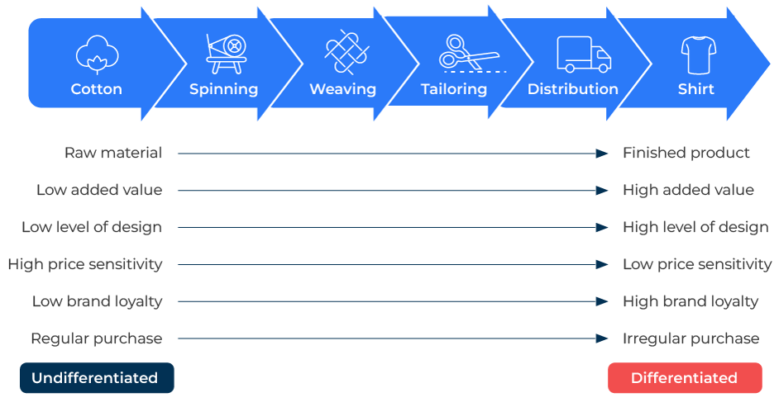
Chain of Derived Demand

Slide 2
A business model to improve your leverage.
Use this framework to determine where to focus your marketing
The chain of derived demand refers to the idea that the demand for a product or service is derived from the demand for another product or service further down the supply chain. Understanding this concept is crucial for businesses when developing a marketing strategy. You need to know where you stand so that you can find leverage which is to your advantage.
Think through the chain of derived demand in your industry. Where do you sit in the chain? Who is the “captain” of the chain (ie the main controller)?

Slide 3
Identify key influencers.
Determine the products or services that influence the demand for your offerings. For example, if you sell components used in manufacturing, understand which end products are in high demand.
 | Complete these boxes
Who is the final buyer of things that contain your product/service?
What do these final buyers value? How much of that value is contributed by your products?
Who controls this chain? Who makes the most profit? Where do you sit?

Slide 4
Segment the market.
Segment your target market based on the industries or businesses that heavily rely on the products or services you provide. Tailor your marketing messages to address the specific needs and challenges faced by these segments.
 | Complete these boxes
Within the industries in the chain that you supply, how could you segment companies according to their needs?
What would happen to products in the chain if your product wasn’t available?
How do people in the chain use the product? How does your product help make the product attractive and easy to use?
How can you align your offer to meet the needs of the segments?
What action is required to make improvements for your target audience?

Slide 5
Develop marketing messages that resonate.
Since the demand for your product is derived from the demand for another product, educate your target audience about the benefits and value your product adds to the final product or service. Clearly communicate how your offerings contribute to the overall quality, efficiency, or cost-effectiveness of the end product.
 | Complete these boxes
What marketing messages would communicate to end users the benefits of your products?
How do your products improve the quality, longevity, ease of use of the final products?
What monetary value could be put on each of these benefits?
To what extent is your product perceived to be better or worse than competitors’ products?
What action is required to make improvements for your target audience?

Slide 6
Integrate your offer with the supply chain.
Collaborate with partners in the supply chain to ensure seamless integration. Work closely with suppliers, distributors, and retailers to optimise the flow of goods and information. This collaboration can lead to better visibility, efficiency, and customer satisfaction.
 | Complete these boxes
What relationships do you have with companies down the chain? How can you improve those relationships?
What can you say to companies down the chain about your offer that will favour its inclusion with the product they sell?
How can you get people down the line to say “Intel inside” (or at least the same thing for your brand)?
What action is required to make improvements for your target audience?

Slide 7
Consider customised offers.
Develop customised solutions that address the specific needs of businesses in the supply chain. Tailor your products or services to enhance the performance or features of the final product, making it more appealing to end consumers.
 | Complete these boxes
What changes to your product or messages about it can you develop for specific companies down the chain?
What penetration of the channels have you achieved?
What are the opportunities for finding new routes to market – i.e. alternative channels?
What does each of the organisations in the channel require in terms of margin and service support?
What action is required to make improvements for your target audience?

Slide 8
Editable framework.
Shirt
Use this to add your own text and edit to suit your own branding
Cotton
Spinning
Weaving
Tailoring
Distribution
Raw material
Finished product
Low added value
High added value
Low level of design
High level of design
High price sensitivity
Low price sensitivity
Low brand loyalty
High brand loyalty
Regular purchase
Irregular purchase
Undifferentiated
Differentiated

Slide 9
Thank you.

