Slide 1
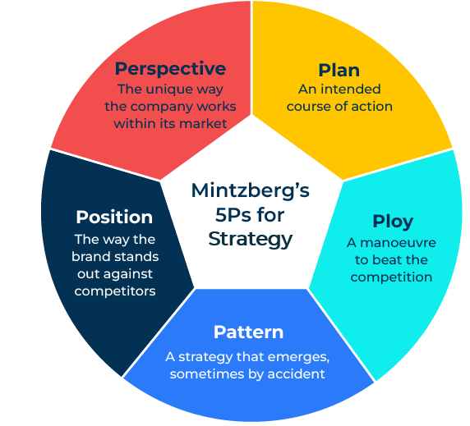
Mintzberg’s 5Ps for Strategy

Slide 2
A model that helps devise a competitive strategy.
Use this model to help work out a business strategy
Henry Mintzberg, an academic and a business thinker, developed a model for helping classify and understand business strategies. He recognised five different strategies, each named with a P:
This model describes different strategies and can be helpful in showing how a strategy works within a particular market. In this model it is particularly important to understand relative strengths and weaknesses of the competition.

Slide 3
Questions to ask about your planned strategy.
This first series of questions ask about the extent to which your company is driven forward by a planned strategy.
Does your company have a master plan for where it wants to be in 3 to 5 years time?
Who is responsible for ensuring that this master plan is enacted and stays on track?
To what extent does your plan consider the strategies of competitors?
Does your company have separate plans for different parts of the company? Are these integrated into the master plan?
How frequently does your company change its plans?
To what extent does everybody know what roles, responsibilities and contribution will be to the plan?
After consideration of these questions would you say that your company has a strong planned strategy? Do you think this is the right strategy for your company? Would another strategy be more relevant? Which other strategy?

Slide 4
Questions to ask about your strategy as a ploy.
A ploy is a cunning plan to turn something to your advantage. When the Trojans hid their soldiers inside a wooden horse in order to win the city of Troy, it was using the horse as a ploy.
Where are your competitors focused?
What ruse could fool them?
What actions could you take that would be underneath your competitors radar?
What would be the chances of success of this strategy?
How long would it take, how much would it cost, who would take charge of it?
What Plan B do you have in case the ploy doesn’t work?
After consideration of these questions would you say that your company has a good ploy? Do you think this is the right strategy for your company? Would another strategy be more relevant? Which other strategy?

Slide 5
Questions to ask about your strategy as a pattern.
A strategy based on a pattern requires a company to be highly flexible in order to change and take advantage of what may be a new opportunity. This strategic approach is most suited when the company is uncertain about its future within a market.
How agile is your company? How able is it to change direction quickly should this be required?
How good is it at recognising changes within its market and the competitive environment?
How believable is this new pattern within the market? Will it sustain?
To what extent is the company “betting the farm” by following a new trend?
Who will ensure that the change in direction is followed through by everyone at the company?
After consideration of these questions would you say that following a pattern or trend is the right strategy for your company? Would another strategy be more relevant? Which other strategy?

Slide 6
Questions to ask about your strategy as a position.
A strategy based on taking a “position” very much follows Michael Porter’s generic strategies of taking a low-cost position, differentiated position or playing within a niche.
Does your company have a particular cost advantage? How significant is this cost advantage? Is it sufficient to provide a strong competitive edge?
Does your company have a brand that people will specify to the exclusion of all others because they believe it offers them special benefits? How strong is the loyalty to the brand? Will it appeal to a mass market or only a small segment of the market?
Does your company have products that have strong appeal to a small segment of the market? Within this small segment will you be able to achieve a leading position with high prices and high profit margins?
After consideration of these questions which specific generic strategy should your company choose? It should be remembered that the best strategies are where you can take a very clear position. Being stuck in the middle can be difficult. Do you think this is the right strategy for your company? Would another strategy be more relevant? Which other strategy?

Slide 7
Questions to ask about perspective as a strategy.
Some companies have a strong culture, a view of the world, or as Mintzberg would say a “perspective”. This can be used to strategic advantage.
How strong is your company culture? How would you describe it?
How different is your company culture from that of your competitors?
To what extent is your company culture recognised by customers?
How much do customers value your company culture?
How easy will it be to recruit people to your company that readily fit your company culture?
How will you communicate your company culture to new customers?
How durable is the culture within your company? What is the chances of the changing if there is a change in leadership?
After consideration of these questions would you be able to build a strategy based on “perspective”? Do you think this is the right strategy for your company? Would another strategy be more relevant? Which other strategy?

Slide 8
Things to think about.
Strategies are critical for the successful growth of any company. However, strategies have to be flexible and may change. The strategy of a company must align with its strengths and the needs of the target market.
Although strategies require some flexibility, it is important that they do not change too frequently. A company has to give a strategy sufficient time for it to bear fruit.

Slide 9
Thank you.

