Slide 1
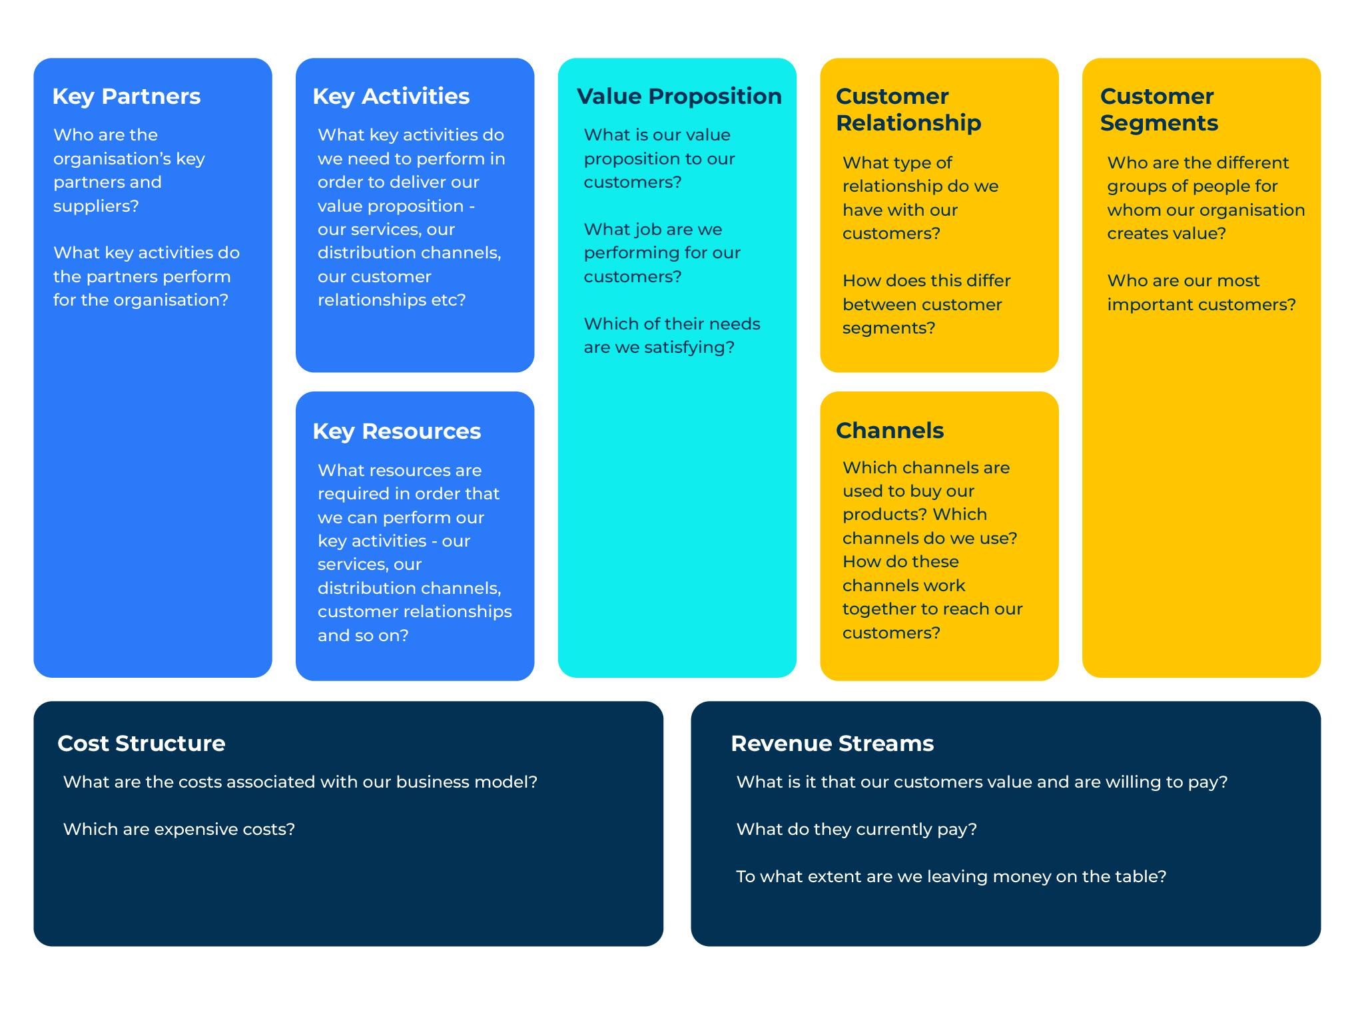
Business Model Canvas

Slide 2
A business model that puts everything on one page.
Use this model to assess key building blocks of a company to see where improvements can be made
The business model canvas, developed by Alexander Osterwalder and Yves Pigneur, has 9 building blocks:
Value proposition: a company exists to supply customers with something they need. It is important for a company to fully understand which of the customers’ needs are being satisfied and to what extent. Questions asked within this block are “What is our value proposition to our customers?”, “What job are we performing for our customers?”, “How can we reduce pain for our customers?”, “Which of our customers’ needs are we satisfying?”.
Key activities: a company performs a number of different activities such as manufacturing, buying, selling or adding value. Questions to be asked are “What key activities do we need to perform in order to deliver our value proposition and satisfaction to our customers?”.
Key resources: resources are required and are likely to include people, buildings, equipment, distribution channels, patents, relationships with suppliers etc. Questions here are “What resources are required in order to perform our key activities and deliver satisfaction to our customers?”.
Key partners: a company has suppliers of various kinds ranging from those that provide services through to those that offer products. The quality of these partners and the relationship with the company has a significant bearing on its success. We want to know answers to “Who are our key partners and suppliers?”, “What key activities do our partners perform for our company?”.
Continued on next page

Slide 3
A business model that puts everything on one page continued…
Customer segments: not all customers are the same and some have a greater predilection for a company’s products than others. Recognising the needs of these different segments and being able to satisfy them is crucial to the success of a business. Questions are “Who are the different groups of people we serve and what within our offer do they really value?”.
Customer relationships: a strong company has a mix of customers and good relationships with them. It will have good customer satisfaction scores and customers with high levels of loyalty. Questions are “What type of relationships do we have with our customers?”, “How do these relationships vary between customer segments?”, “Which segments are key to our company’s success and how can we build upon these?”.
Channels: a company has to move its offer through to customers and it will do so directly and through distributors and marketing channels. Many companies have online offers as well as using bricks and mortar distribution. The means by which these products get to market is another vital component of a business’s strength. Here we want to know “Which channels are used to buy our products?”, “Which channels are our strengths and which could we used to better effect?”.
Revenue streams: money comes into the company from sales and creates a revenue stream. It is the lifeblood of a company and a measure of success is the degree to which this works efficiently with a minimum number of bad debts and a good number of fast payments. Questions here are “what is it in our offer that customers value and are willing to pay for?”, “For each of our offers could we achieve greater revenue and margin by raising or lowering our prices?”.
Cost structure: whatever the company makes will have a cost made up of variable and fixed costs. The efficient management of these costs is crucial to the competitiveness and profitability of the company. Questions are “What are the costs associated with our business model?”, “How can we change our cost structure to the benefit of customers and our profitability?”.

Slide 4
The 9 building blocks can be mapped on one page.
These building blocks force us to think about the most important issues within a company. Once everything is mapped out on one page it is easy to see strengths and weaknesses.
In the following pages we show how to build a picture of the strength of your company taking each block at a time. For now notice that the blocks to the right hand side of the canvas are to do with customers and those on the left are to do with producing the offer.

Slide 5
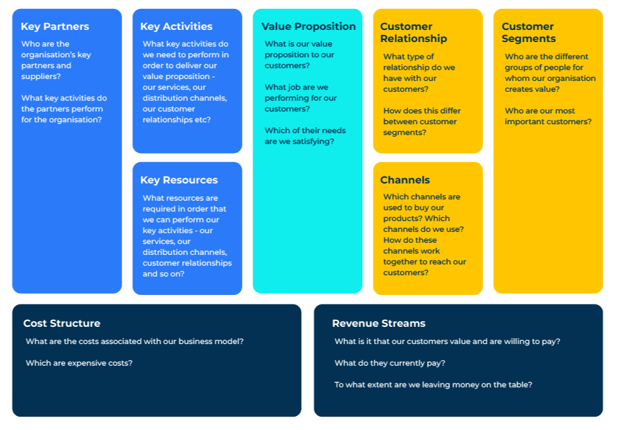
Customer segments.
STEP 1
The starting point (as always) is to address customer segments – your target consumers. (The block highlighted in red on the right).
Here you should describe your customer in a few words. Everything else on the canvas is influenced by the customer.
There are some obvious questions to ask here such as:
Who are the different groups of people for whom our organisation creates value?
who do we not want to do business with because it doesn‘t meet with our offer?
Who are our most important customers?

Slide 6
Value proposition.
STEP 2
Next we must look at the value proposition. This is your product offer and how it is a solution to the job that the customer has to do.
It is important to be able to be able to communicate your value proposition because this is the reason why people buy the product. Remember that when people buy a drill bit, they are buying the ability to make a hole. What is the job that your product undertakes for the customer?
Working out the value proposition is one of the most difficult parts of the canvas. It is easy to describe your product but that is not what we are looking for. We are looking for how your product delivers a solution.
Questions to ask here are:
What jobs are we performing for our customers?
Which of their needs are we satisfying?
How do we do this better than the competition?

Slide 7
Channels.
STEP 3
The third thing to look at is Channels. This is how you get your offer to the market. Also within this block should be considered the channels that are used to communicate with the customer.
If you fully understand the customer (as in the first step) you will know where customers like to shop, what they look for, what communications they are responsive to, what solutions they need.
Questions to ask here are:
Which channels are used to buy our products?
Which channels do we use?
How do these channels work together to reach our customers?

Slide 8
Customer relationships.
STEP 4
The fourth thing to look at is customer relationships. This block tests to what degree your offer is meeting the needs of your target audience. What sort of customer relationship does the customer expect – do they want to speak to someone within your company or is it going to be online with very little personal interaction with the customer. This will depend on the price and technical complexity of what you are selling.
Questions to ask here are:
What type of relationships do we have with our customers?
What type of relationships do our customers want with us?
How do these relationships differ between customer segments?

Slide 9
Revenue streams.
STEP 5
We now move on to how you capture revenue. This is critical within any company as it addresses the question "how do we make money?". It may be by selling a product, subscription, licensing etc. Within this building block is the important subject of “price”. How are prices determined and are we capturing enough value?
Questions to ask here are:
What is it that our customers value and they are willing to pay?
What do they currently pay?
To what extent are we leaving money on the table?

Slide 10
Key resources.
STEP 6
The sixth block discusses the key resources – the things that makes the model work. Here you should think about the things that are unique to your business. It may be the specific types of equipment you use within the company. It may be specific software or intelligence.
Questions to ask here are:
What resources are required in order that we can perform our key activities our services, our distribution channels, our customer relationships and so on

Slide 11
Key activities.
STEP 7
The seventh building block is key activities. Key resources drive key activities. If a key resource is a patent, a key activity will be selling the unique and patented product. If a key resource is the salesforce, a key activity will be calling on important customers and prospects.
Questions to ask here are:
What key activities do we need to perform in order to deliver our value proposition, our services, reach our distribution channels, and support our customer relationships?

Slide 12
Key partners.
STEP 8
Building block eight is “key partners”. All businesses need relationships with outside suppliers for the model to work.
Key partners will vary and could be advertising agencies, IT suppliers, key raw material suppliers - organisations that help you accomplish everything that you're doing.
Questions to ask here are:
Who are your organisation’s key partners or suppliers?
What key activities do the partners perform for your organisation?

Slide 13
Cost structure.
STEP 9
The final building block is the cost structure. This is where you identify your most significant costs.
These significant costs will vary from business to business. For a manufacturer the most significant cost will be raw materials. In a service business the most significant cost will be people/Labour.
Questions to ask here are:
What are the costs associated with your business model?
What are the most expensive costs?

Slide 14
Things to think about.
The business model canvas forces you to think about the most important issues within your company. Once everything is mapped out it is easy to communicate issues (good and bad) to people within the company.
Look at the questions posed in the nine boxes that make up the Business Model Canvas. How would you rate your company’s success in each of these boxes? Where is your company strong and where are you weak?
Having completed all the boxes on the canvas, what strategy do you propose for the business?
What are the key indicators in each building block that should be measured as you pursue your strategy?
Consider creating a Business Model Canvas for key competitors? What does this tell you about their strategy and their strengths and weaknesses?
How could you use The Business Model Canvas for testing the viability of new ideas?
How could The Business Model Canvas be used for sharing the strategy through different departments within the business?

Slide 15
Thank you.

