Slide 1
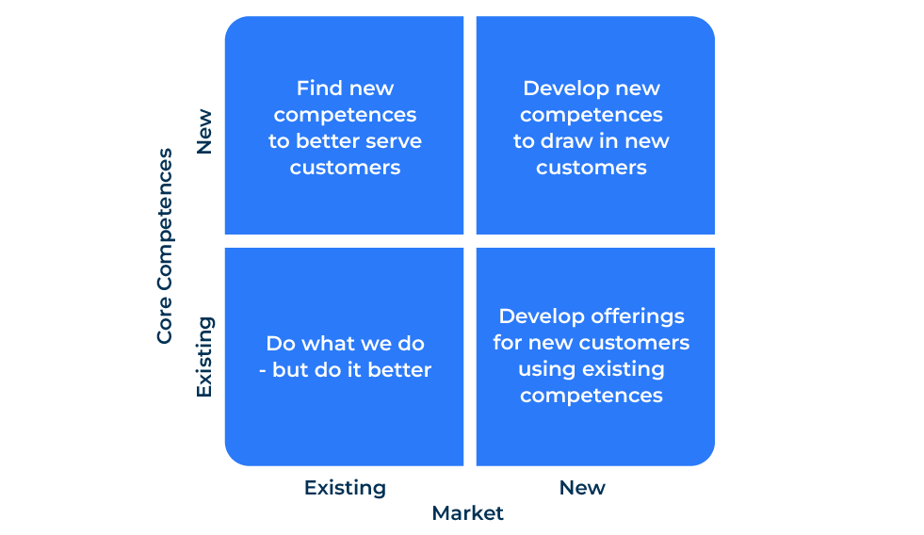
Core Competences

Slide 2
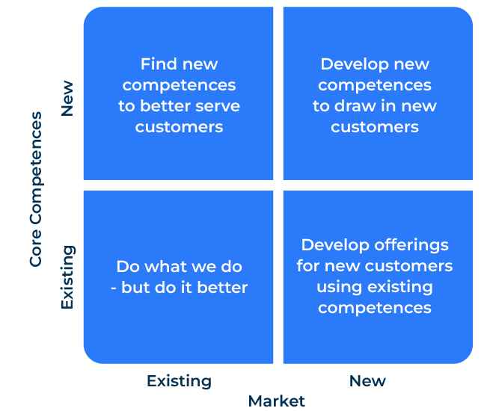
A business model for finding a competitive advantage.
Use this model to grow your company
Gary Hamel and C.K. Prahalad introduced the concept of core competencies in their influential article "The Core Competence of the Corporation," published in the Harvard Business Review in 1990.
The core competencies framework suggests that organisations should focus on and build upon their unique capabilities or competencies that provide a competitive advantage.
There are four ways this framework can be used in developing a business strategy:
Do what you do – but do it better for existing customers
Find new competences to better serve existing customers
Use your current competences to serve new customers
Find new competences for new customers.

Slide 3
Identify your core competences.
Assess your organisation's strengths, capabilities, and unique skills. Look beyond just products and services to identify what your company does exceptionally well. Consider the activities and processes that distinguish your organisation from competitors.
 | Complete these boxes
What does your company do particularly well? How do you do it?
What recognition do you get for what you do well?
How useful is this competence to people who buy your products?
Which competitor is closest in offering a competence as good as yours? How is yours better?
What action is required to make improvements for your target audience?

Slide 4
Evaluate the strategic fit of your core competences.
Assess how well your core competencies align with your overall business strategy. Ensure that your core competencies contribute to creating a sustainable competitive advantage for your company.
 | Complete these boxes
What is your overall strategy for the business? How do your core competences help you achieve a competitive advantage?
How can your core competencies create unique value for customers?
How do your core competences deliver superior value to customers and outperform competitors?
What action is required to make improvements for your target audience?

Slide 5
Invest in developing your core competences.
Allocate resources to strengthen and build upon your core competencies. This may involve investing in research and development, employee training, or technology upgrades.
Foster a culture that encourages continuous improvement and innovation around your core competencies.
 | Complete these boxes
Which of your core competences can you build on? What will you do to improve it and add value to customers?
What resources are required to build this/these core competences?
Do people in your company recognise the importance of your core competences? Is there a culture of continuous improvement of them?
What action is required to make improvements for your target audience?

Slide 6
Consider alliances to strengthen your core competences.
Consider your strategic partnerships with other organisations that complement or enhance your core competencies. Collaborate with partners who bring additional expertise and resources to the table.
 | Complete these boxes
Which companies do you work with that strengthen your core competences? What is the strength of commitment of these relationships?
Which other companies could you work with to build on your core competences?
How can you protect these relationships with partners from competitors coming in on the act?
What action is required to make improvements for your target audience?

Slide 7
Develop KPIs related to your core competencies.
Develop key performance indicators (KPIs) related to your core competencies. Regularly evaluate how well your organisation is leveraging its core competencies and meeting strategic objectives. Periodically reassess and renew your strategic approach based on changes in the market, technology, and customer preferences. Make sure your employees are aware of their contribution.
 | Complete these boxes
What KPIs will ensure your core competences stay that way?
What do you do to keep reassessing your core competences and their impact on your strategic plan?
How well do individuals in your company understand their contribution to maintaining and building your core competences?
What steps do you take so ensure you understand changes in the needs of the market and the core competences of competitors?
What action is required to make improvements for your target audience?

Slide 8
Editable framework.
Develop new competences to draw in new customers
Use this to add your own text and edit to suit your own branding
Find new competences to better serve customers
New
Core Competences
Develop offerings for new customers using existing competences
Do what we do
- but do it better
Existing
Existing
New
Market

Slide 9
Thank you.

