Slide 1
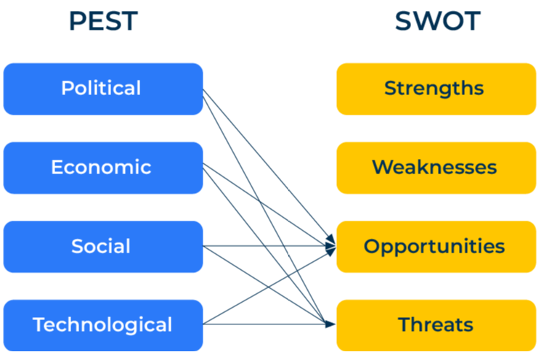
PEST

Slide 2
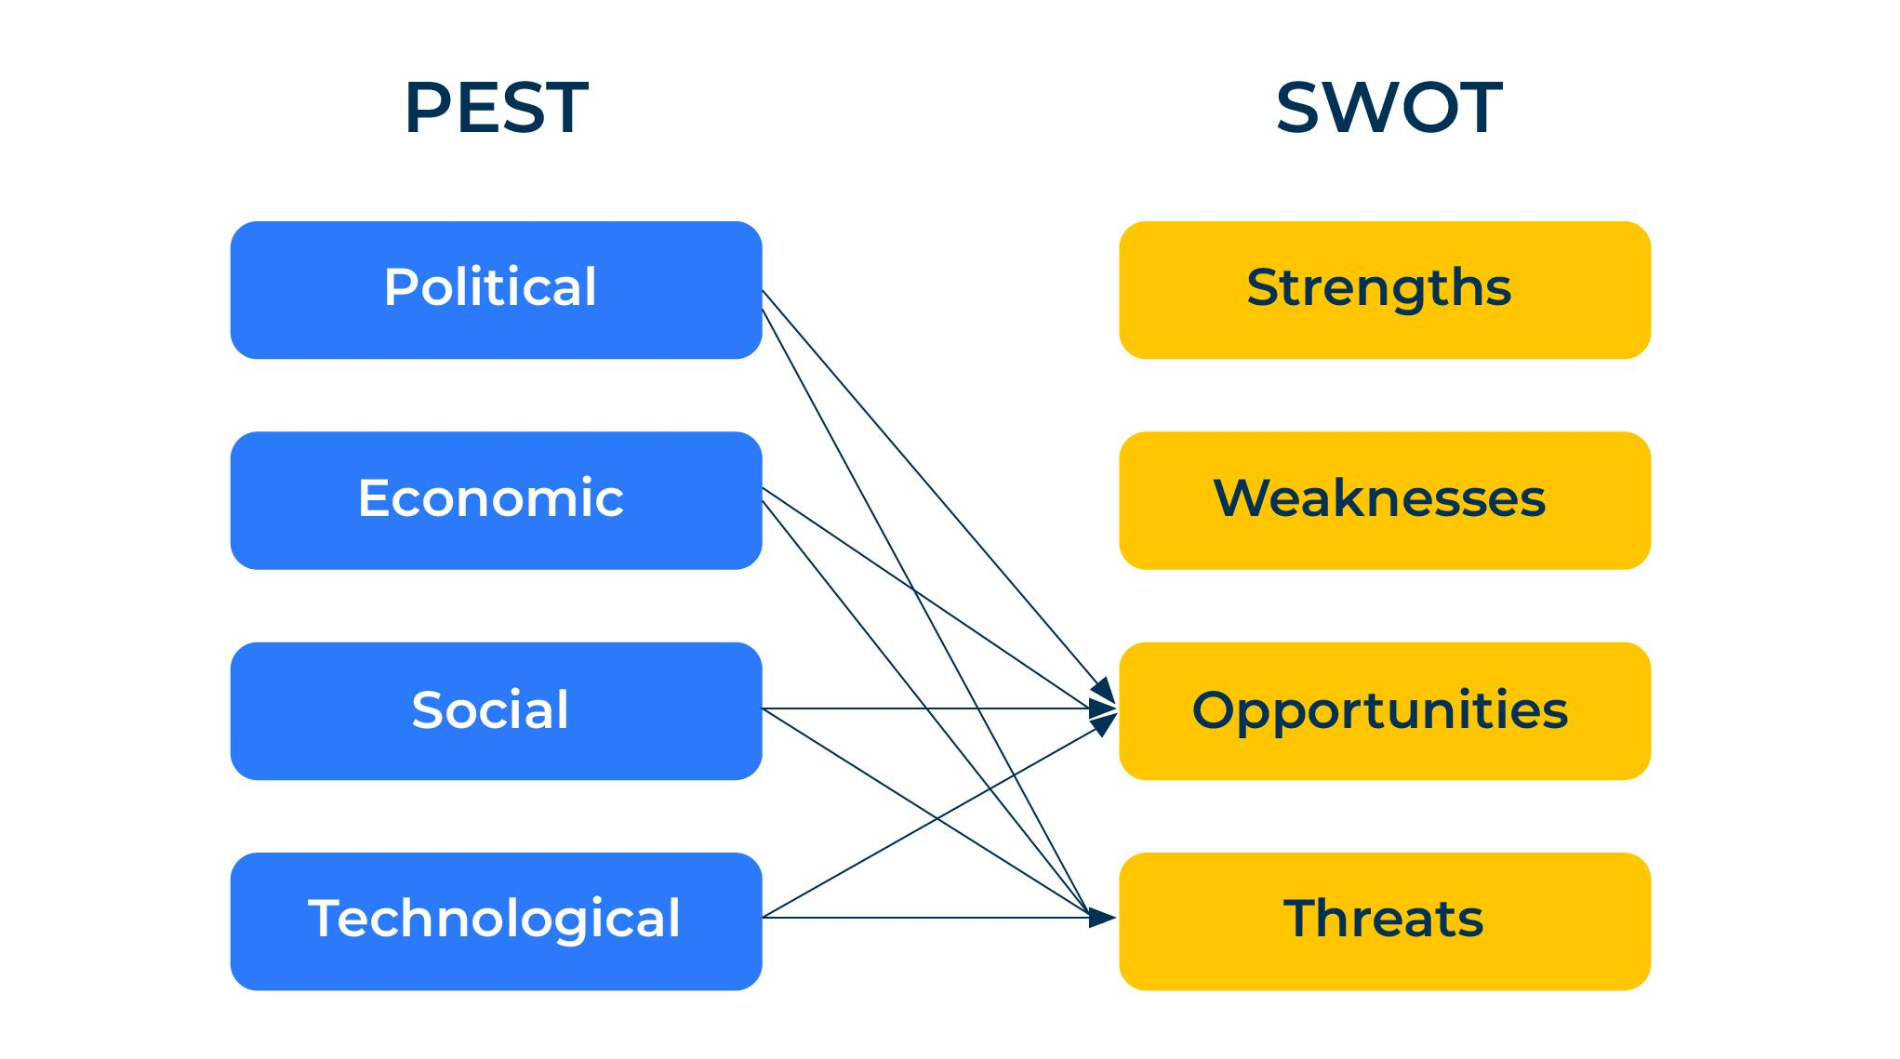
A model to assess forces shaping your business.
Use this model to understand the macro factors that are shaping your company’s future
PEST is an acronym that describes four external forces that shape the business environment – political, economic, social and technological.
The PEST tool is used to examine the macro and micro factors that determine threats and opportunities within the marketplace. It is normally used before a SWOT to provide an understanding of the opportunities and threats. The PEST framework can be used to examine the market for a company, product or brand. It is an analysis worth carrying out at least once a year (more frequently if forces have changed).

Slide 3
Political questions.
Companies are influenced to a greater or lesser extent by the political environment in which they operate. Use the following questions to determine the importance of these forces. Decide whether the force is positive or negative to your business and give it a score out of 10 to indicate the level of influence this force has on your business.
Political forces | Level of influence (10 = very big influence)
 | Positive | Negative
Political stability of the region in which will operate
The effect of taxes on products and services
The effect of taxes on disposable income
Government encouragement or restrictions on your business
Labour laws (including hiring/firing, minimum wages, maternity rights etc)
Pricing regulations (and anti-trust laws)
Environmental laws affecting labelling, product disposal etc
Health and safety laws
Import restrictions and taxes
Data protection and privacy laws
Intellectual property laws
Business friendliness of the government

Slide 4
Economic questions.
The local economy will have a big impact on your business. Consider the following factors for the country (countries) in which you operate. Decide whether the force is positive or negative to your business and give it a score out of 10 to indicate the level of influence this force has on your business.
Economic forces | Level of influence (10 = very big influence)
 | Positive | Negative
The GDP (gross domestic product) of the region – its economic prosperity
The GDP per head
Average incomes and disposable incomes
Employment and unemployment rates
Labour skills and costs
Distribution and channels into the market
Comparative cost advantages of the region (derived from labour costs and costs of raw materials)
The economic system in the country including government interference with businesses
The growth of the economy in the past
Forecast growth in the future
Credit availability
Exchange rates and their stability
Inflation

Slide 5
Social questions.
The demography and make up of the people in the regions where you operate will have a big influence on your company. Consider the following factors:
Social forces | Level of influence (10 = very big influence)
 | Positive | Negative
Population size and growth rates
Language
The demographics of the population; age, gender, religion, education, job skills, household composition etc
Class structures within the country
Media that reaches the population
Average length of life and the health of the population
Attitudes to safety
The culture of the population and its commitment to work
Ethical considerations and tolerances
Creativity of the population
Attitudes to work, leisure, politics, religion
Honesty and integrity in business and family
Customs and religion (including time for holidays, weekends and weekdays)
Social diversity
Access to education
Expectations of welfare and retirement contributions by businesses

Slide 6
Technological questions.
Finally look at the technological factors that influence your company:
Technological forces | Level of influence (10 = very big influence)
 | Positive | Negative
Technical infrastructure in the region (eg broadband distribution and strength)
Technological security
Speed of technological change within the market
Types of technological change that are taking place
Technological skills and interest that exist in the region
The willingness of the population to adopt innovations at home and in the workplace
Research and development spend
Patent protection

Slide 7
Bringing it together.
The forces listed in the templates are by way of example and you may add or subtract some that are appropriate to you in your business.
Some people like to add Legislative forces and Environmental forces so creating the acronym PESTLE. You may want to add these if they are not already covered under the Political factors.
The scores you have given to the positive and negative influences of the forces on your business should help you when carrying out a SWOT analysis (providing a good steer as to the opportunities and threats).

Slide 8
Things to think about.
Take time to build up a deep understanding of each of the PEST factors. Work out which of these forces are the most important influences on your company. Set up alerts to inform you of any changes on these factors.
Pay particular attention to the threats and opportunities that arise from the analysis. Work out an action plan in response to these.

Slide 9
Thank you.

