Slide 1
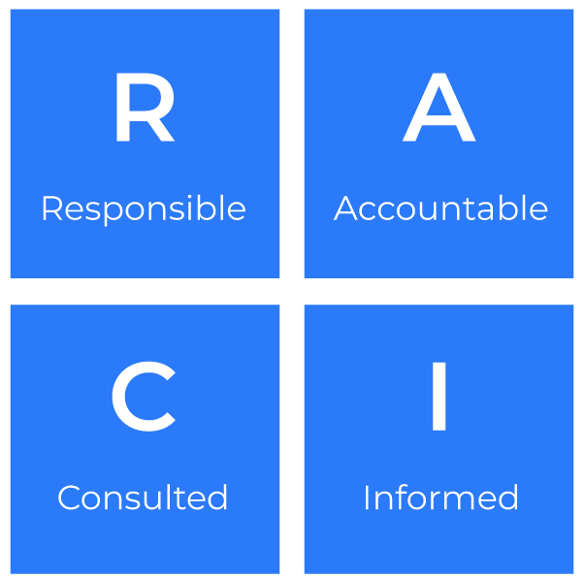
RACI

Slide 2
A framework to help you help others.
Use this framework to improve productivity
The RACI framework is a delegation tool used to clarify roles and responsibilities within a project or organisation. RACI stands for Responsible, Accountable, Consulted, and Informed.
The RACI framework promotes a structured and organised approach to delegation, contributing to improved productivity through enhanced communication, streamlined decision-making, and clear accountability. It helps teams work more efficiently, reducing the likelihood of errors and delays in project execution.

Slide 3
Clarify Roles and Responsibilities
Clearly define who is:
Responsible for certain tasks (who should do what work),
Accountable (make decisions and ensures completion),
Consulted (provide input),
Informed (receive updates).
This will avoid confusion about who is responsible for specific tasks, preventing duplication of efforts and gaps in accountability.

Slide 4
Ensure Effective Communication
Enhance communication by clearly outlining who needs to be consulted or informed, so reducing the risk of misunderstandings and ensuring that key stakeholders are involved appropriately.
This will enable better communication flow as team members know where to seek information and updates.

Slide 5
Prioritise Tasks
Highlight critical responsibilities and dependencies which will reduce time wasted on unnecessary discussions and debates about who should be doing what.
Allocate resources by ensuring that the right people are involved at the right stages of a project and so prevent overloading certain individuals and ensure a balanced distribution of workload.

Slide 6
Minimise Conflicts
Outline roles and responsibilities, so reducing ambiguity and potential areas of contention.
This will facilitate smoother collaboration as team members understand each other's roles and contributions.
You will also have created a framework for reviewing and optimising processes as teams can identify areas where roles and responsibilities can be adjusted for better efficiency.

Slide 7
Things to think about.
Clearly define the scope and objectives of the project.
Identify all the relevant stakeholders involved in the project.
Clearly define each role (Responsible, Accountable, Consulted, Informed) to avoid ambiguity.
Carefully assign responsibilities based on individuals' skills, expertise, and availability.
Clearly specify who is accountable for decisions and outcomes.
Establish effective communication channels.
Implement a system for regular updates and feedback.
Ensure that team members have the necessary skills and knowledge to fulfil their roles.
Document the RACI matrix clearly and make it accessible to all team members.

Slide 8
Thank you.

