Slide 1
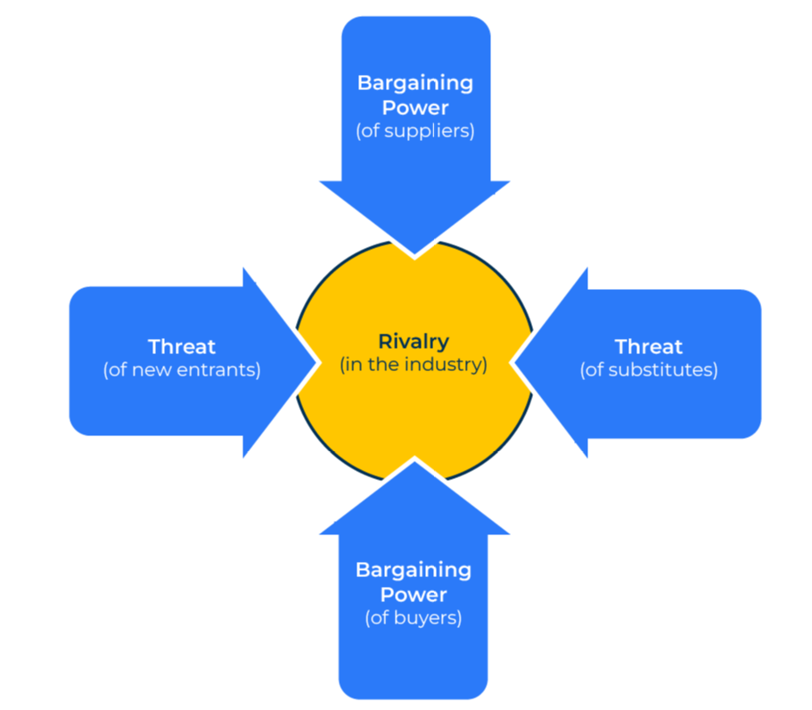
Porter’s 5 Forces

Slide 2
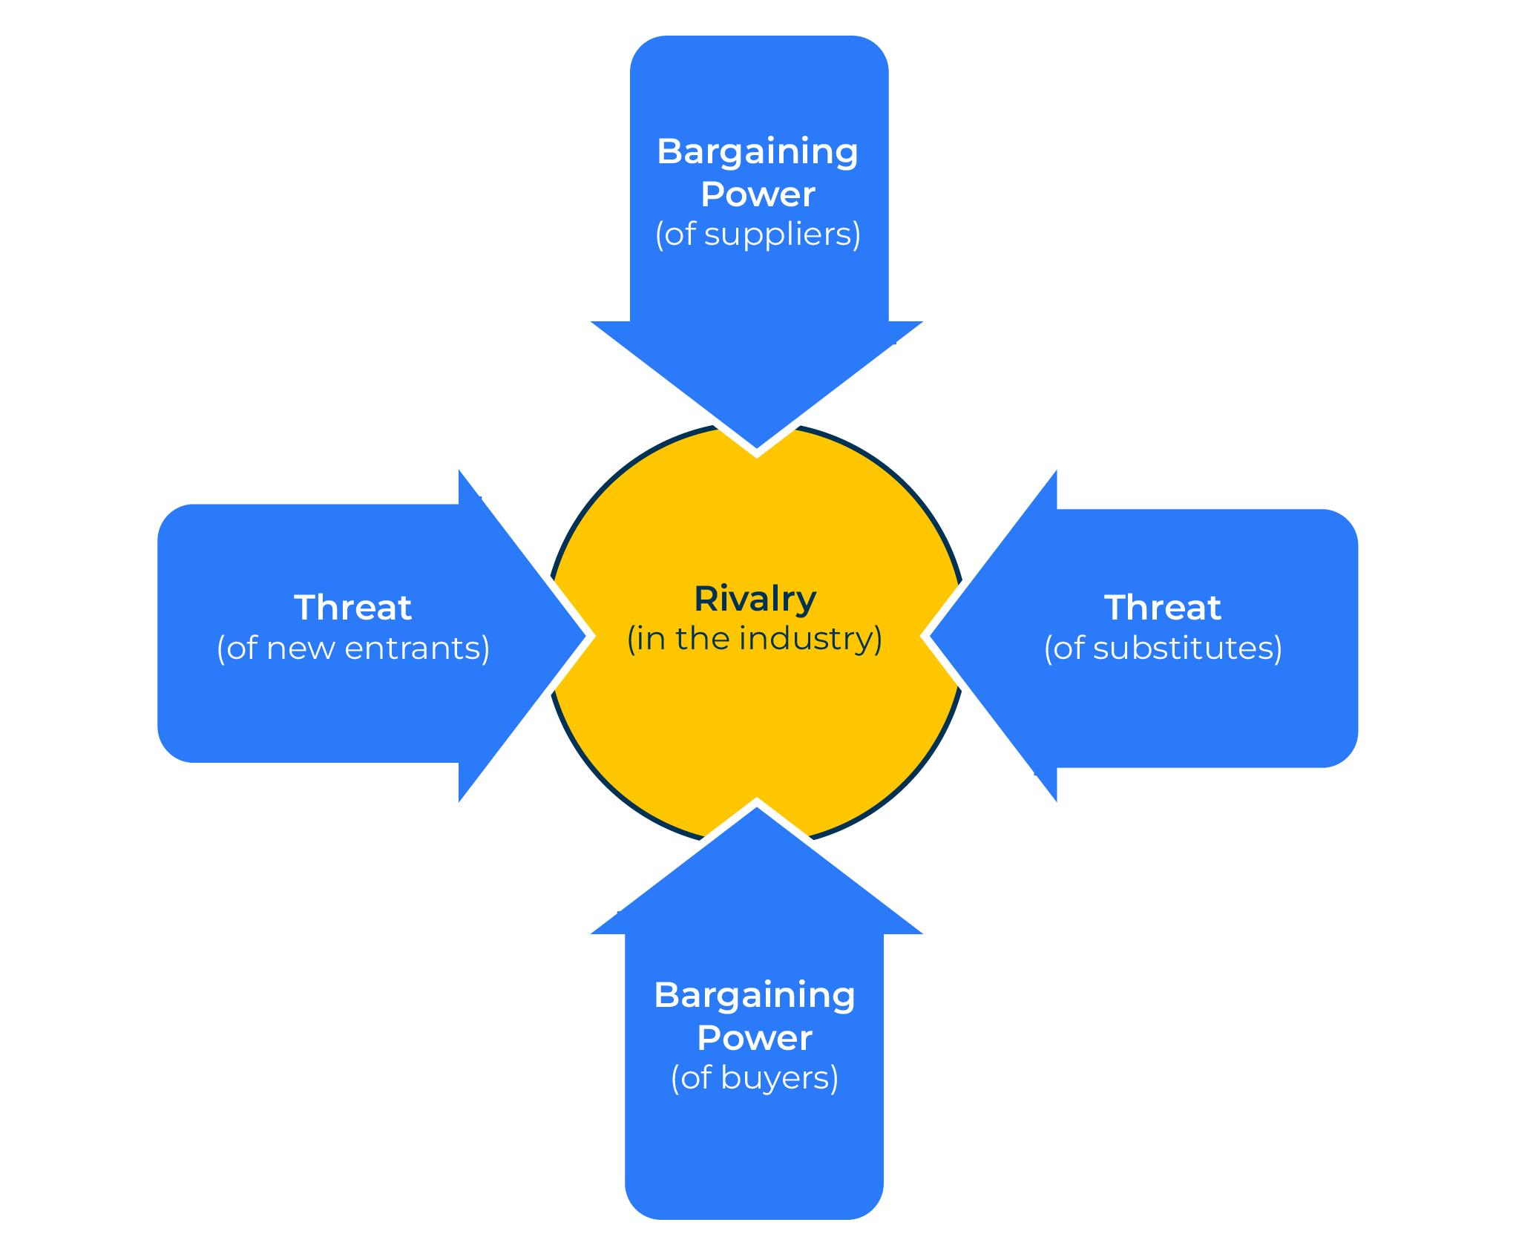
A business model for assessing competitive intensity.
Use this model to understand forces that affect the competitive intensity in your market
Michael Porter recognised five forces that bear down on companies. These five forces are likely to have an immediate effect on the company and influence its ability to serve its customers and make a profit.
The five forces are:
Bargaining power of suppliers
Threats from substitutes
Bargaining power of customers
Threats of new entrants
Rivalry from competitors

Slide 3
Bargaining power of suppliers.
In some markets suppliers of materials are able to dictate what happens. Consider the following factors and their bargaining power (10 means their bargaining power is very high).
Bargaining power of suppliers | Level of force (10 = high)
Monopolistic position of suppliers
Suppliers limited by patents or special technology
Suppliers vertically integrated with competitors
Overall bargaining power of suppliers (average)

Slide 4
Threat of new entrants.
Consider the threat of new companies entering the market. What are the factors that may encourage entry into the market and what is the level of threat on a scale from 1 to 10 (10 means the threat is very high).
Threat of new entrants | Level of force (10 = high)
Start-up costs for entering the market
Threat of a disruptor presenting a low-cost alternative to existing products
High profit margins that could encourage new entrants
Ease/difficulties of penetrating existing channels to market
Loyalty of customers to existing suppliers
Marketing costs to reach customers
Overall threat of new entrants (average)

Slide 5
Threat of substitutes.
In some markets it is easy for buyers to choose alternative products or services. Consider the importance of this force by indicating the level of threat from substitute products or services (10 means a high level of threat).
Threat of substitutes | Level of force (10 = high)
Ease of switching to an alternative product or service
Easy access to alternative products or services
Low cost of alternative products or services
Overall threat of substitutes (average)

Slide 6
The power of buyers.
In certain markets buyers are big enough to have a stranglehold on the market. Consider the force that buyers have on your market (10 means they have a very strong bargaining position).
Power of buyers | Level of force (10 = high)
Size of buyers versus size of suppliers
Limited number of buyers
Difficulties of getting "listed" at buyers
Sensitivity of buyers to price changes
Ease of switching to new suppliers
Overall power of buyers (average)

Slide 7
Internal rivalry.
The forces that arise from the bargaining power of suppliers, the threat of new entrants, the bargaining power of buyers and the threat of substitute products/services influences the rivalry of companies within the market. Consider the following forces and indicate their importance in creating rivalry (10 means a high level of rivalry).
Internal rivalry | Level of force (10 = high)
There is an oversupply of capacity within the market
There is a lack of loyalty amongst customers
There are only a small number of suppliers, each fighting for a significant market share
Customers have low profit margins and seek out low-cost suppliers
Overall internal rivalry (average)

Slide 8
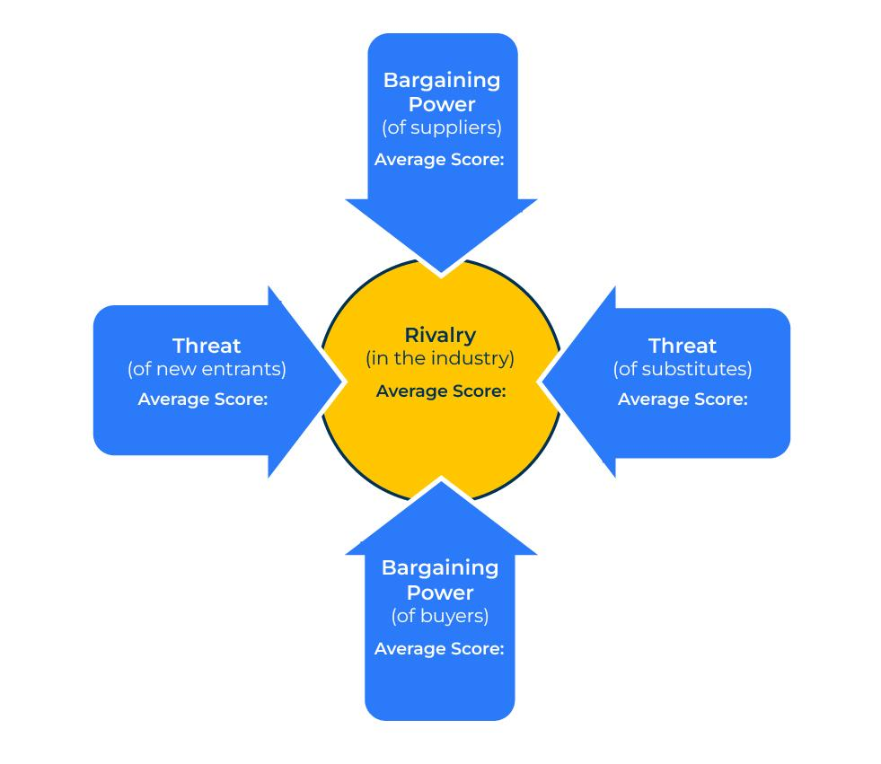
Returning to the model.
You will now have an average score for each of the five forces and an understanding of the root cause of each of these forces.
Try and answer the following questions:
What can you do to mitigate any of the forces? How easy or difficult would this be? If you are successful in mitigating the force, what will be the overall effect on your business?
Bearing in mind the forces you have analysed, where do you expect the market to be in 3 to 5 years time? How will this influence your business? What steps can you take to ensure that you are prepared for the future scenario?

Slide 9
Things to think about.
Competition is a threat but it can usually be managed. Use the 5 forces to work out where the main threats comes from so that they can be minimised.
Consider also carrying out a PEST analysis which will take account of the macro factors shaping your business.

Slide 10
Thank you.

