Slide 1
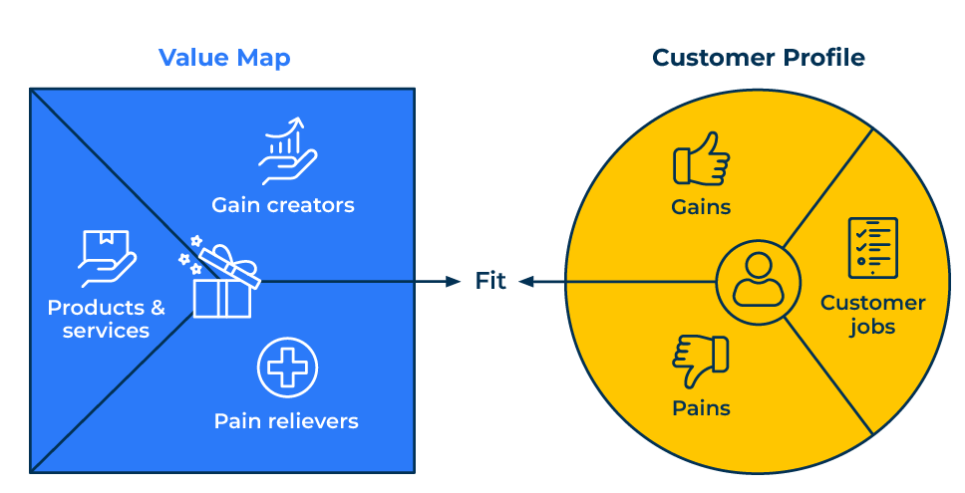
Value Proposition Canvas

Slide 2
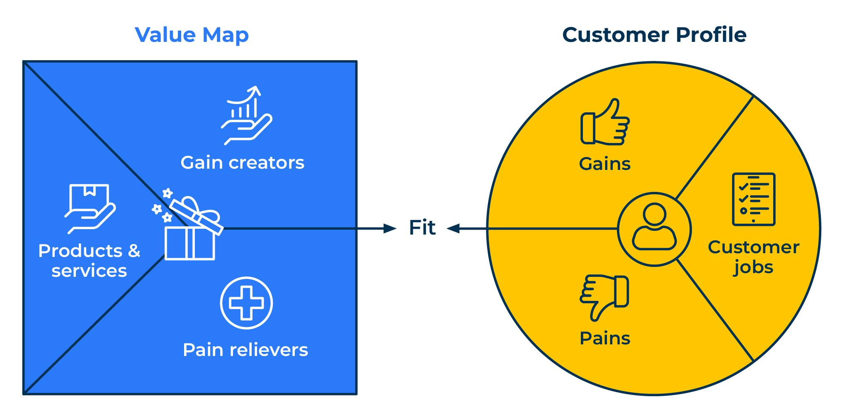
A business model to communicate your offer.
Use this framework to work out a value proposition
The Value Proposition Canvas is a strategic tool that helps businesses create and refine their value proposition. It is part of the broader Business Model Canvas, a framework developed by Alexander Osterwalder and Yves Pigneur. The Value Proposition Canvas specifically focuses on understanding and designing the value that a product or service brings to customers.
The canvas is a dynamic tool that can be iterated and refined as you gather more information about your customers and their preferences. Regularly revisit and update the canvas to stay aligned with changing customer needs and market dynamics.
The Value Proposition Canvas is often used in conjunction with the Business Model Canvas to create a holistic view of a business's value proposition, customer segments, channels, and revenue streams. It's a practical tool for startups, entrepreneurs, and established businesses looking to create or refine their offerings in a customer-centric manner.

Slide 3
Build the customer profile.
The customer profile should consider what the customer need your products for and how they help with any pains that they suffer and benefits that they are seeking. You need to:
Identify your target customer segment.
Understand their main jobs or tasks.
Identify the pains associated with these jobs.
Identify the gains or desired outcomes.
 | Complete these boxes
Customer jobs: What are the main jobs or tasks that your customers are trying to get done? This could be functional, emotional, or social.
Pains: What are the challenges, frustrations, or fears that your customers experience in trying to get their jobs done?
Gains: What are the desired outcomes, benefits, or gains that your customers are seeking?

Slide 4
Value map.
The Value Map considers features and benefits of your offer that help alleviate any pains that customers suffer and provide benefits that they are seeking. You need to:
List the products or services you offer.
Identify how your offerings relieve specific customer pains.
Identify how your offerings create gains or provide benefits.
 | Complete these boxes
Products & Services: What are the features and attributes of your product or service?
Pain Relievers: How does your product or service alleviate or eliminate the pains identified in the Customer Profile?
Gain Creators: How does your product or service provide the desired gains identified in the Customer Profile?

Slide 5
Finally…
The Value Proposition Canvas is a visual tool that encourages a deep understanding of the customer's needs, pains, and gains. By filling out both sections of the canvas, businesses can align their offerings with customer needs more effectively and create a compelling value proposition.
Analyse the fit between the Customer Profile and Value Map. Ensure that your product or service aligns with the identified needs, pains, and gains of your target customers.

Slide 6
Editable framework.
Value Map
Use this to add your own text and edit to suit your own branding
Customer Proﬁle
Gain creators
Gains
Fit
Products & services
Customer jobs
Pain relievers
Pains

Slide 7
Thank you.

