Slide 1
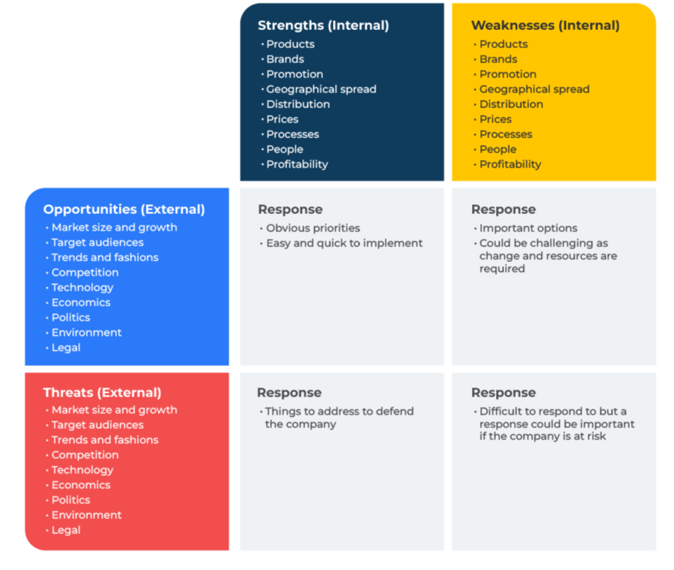
SWOT Analysis

Slide 2
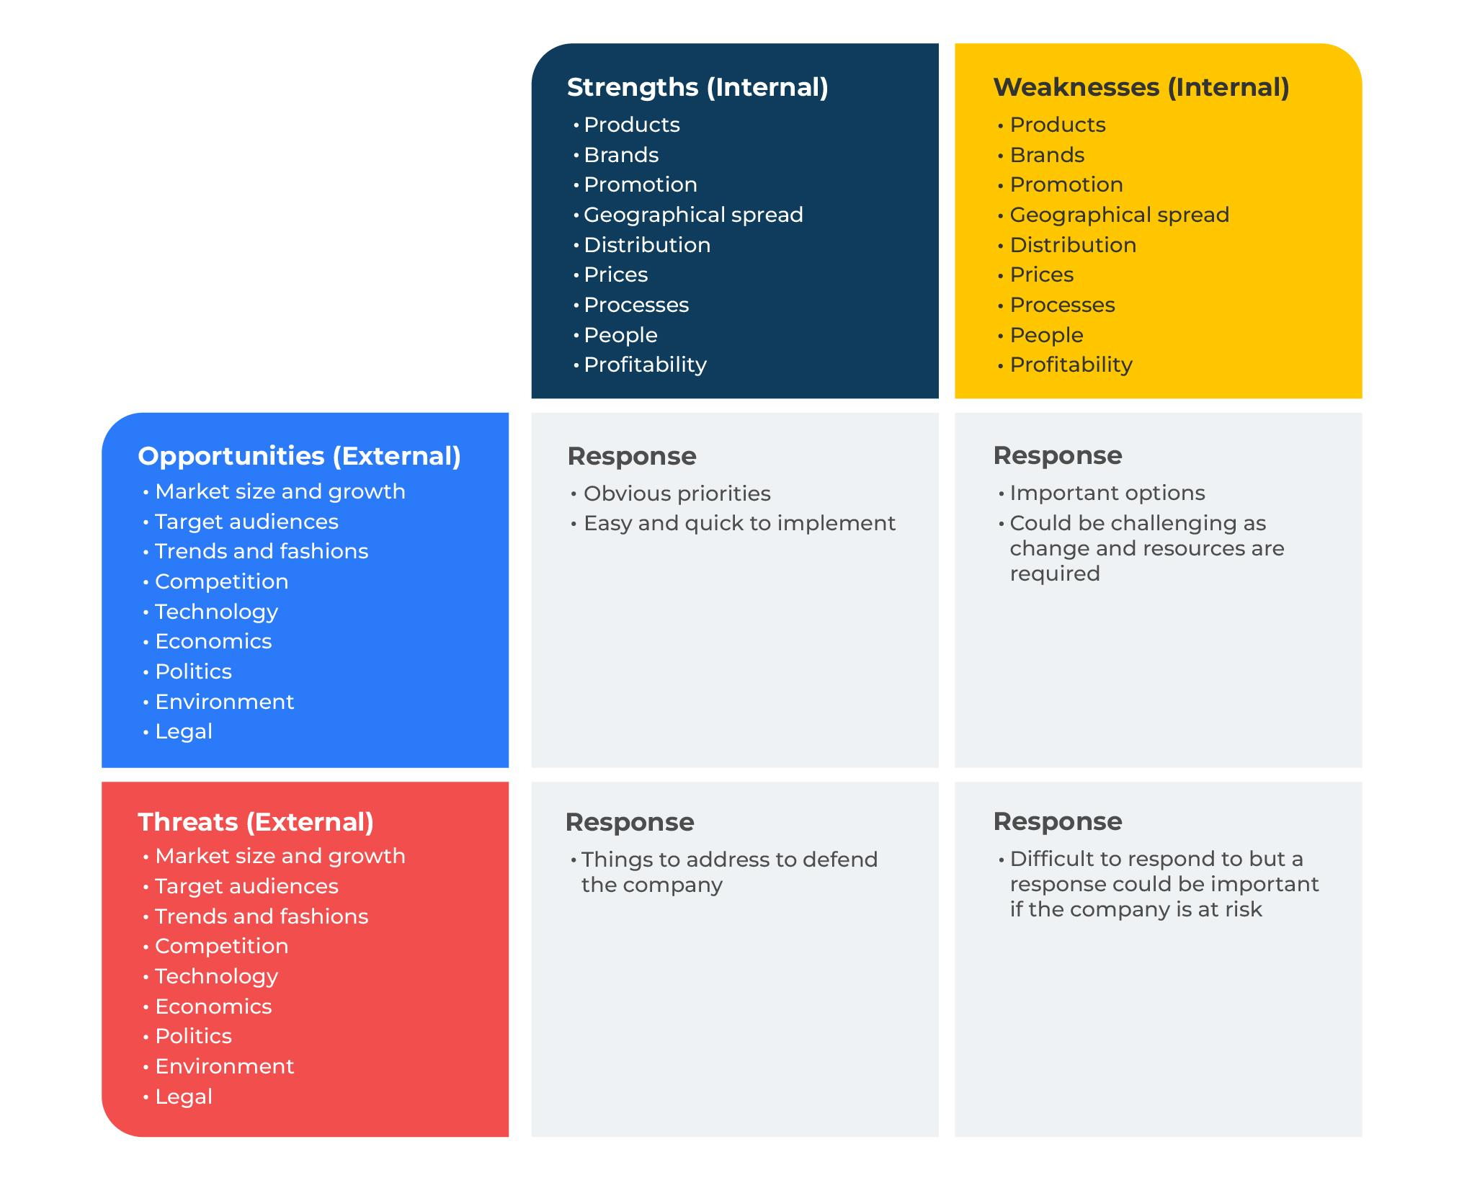
A business model for analysing growth opportunities.
Use this model to analyse growth opportunities at product, team or business level
This model analyses the strengths and weaknesses of a company (these are internal forces) and the opportunities and threats in the marketplace (these are external forces).
The intersection between strengths and opportunities prompts a response. In the same way responses can be developed by an examination of the intersection between weaknesses and opportunities, threats and strengths, threats and weaknesses.
Be clear on the focus of your SWOT - whether a specific brand, business unit, company or product group.
A SWOT is a great brainstorming tool. Use it whenever you are considering a strategy for a product or a business unit.

Slide 3
Preparations.
Before starting the SWOT it should be clear as to the scope. The SWOT could be limited to:
a specific brand or company
a target audience
a product group
a geographical region
It is used in business and marketing to address a company’s position within a market, or the future for a product, brand or business idea. It is also used as a problem solving tool which can be used to guide an acquisition, outsource a service, develop a partnership with a different company, or evaluate an investment opportunity.
The tool can be customised. For example, if there are many components of the SWOT they could be ranked or given a score of importance to provide a degree of focus.
As with many of the tools described in this book the SWOT does not have to stand alone. The PEST tool is a useful adjunct, especially in identifying the threats and opportunities within a market.
A SWOT should be carried out in a workshop. Consider inviting to the workshop people from all parts of the company.

Slide 4
Strengths & weaknesses.
These are the things that your company does well and not so well. Core strengths will stand out and be easy to list. Be sure to also include more subtle and less obvious strengths as these could become differentiators. List all your weaknesses, especially those relative to competitors. In order to determine the relevance and importance of your different strengths and weaknesses, give them a score out of 10:
 | Importance to customers (10 = very important) | Level of strength (10 = very strong)
Products
Brands
Promotion
Geographical spread
Distribution
Prices
Processes
People
Profitability

Slide 5
Opportunities and threats.
When preparing a SWOT, it is easy to confuse strengths and opportunities. The opportunities and threats for a company are those in the marketplace. They are external to the company. Opportunities and threats arise from some aspect of the market – its size, its growth, its composition in terms of demographics, the economic situation, the competition, the environment, legislation etc. Threats come from a shrinking marketplace or a highly competitive market. Legislation may pose a threat. Threats could arise from the changing demographic of a company’s customer base. In order to determine the importance of the opportunities and threats, give them a score out of 10:
 | Importance (10 = very important)
Market size and growth
Target audiences
Trends and fashions
Competition
Technology
Economics
Politics
Environment
Legal

Slide 6
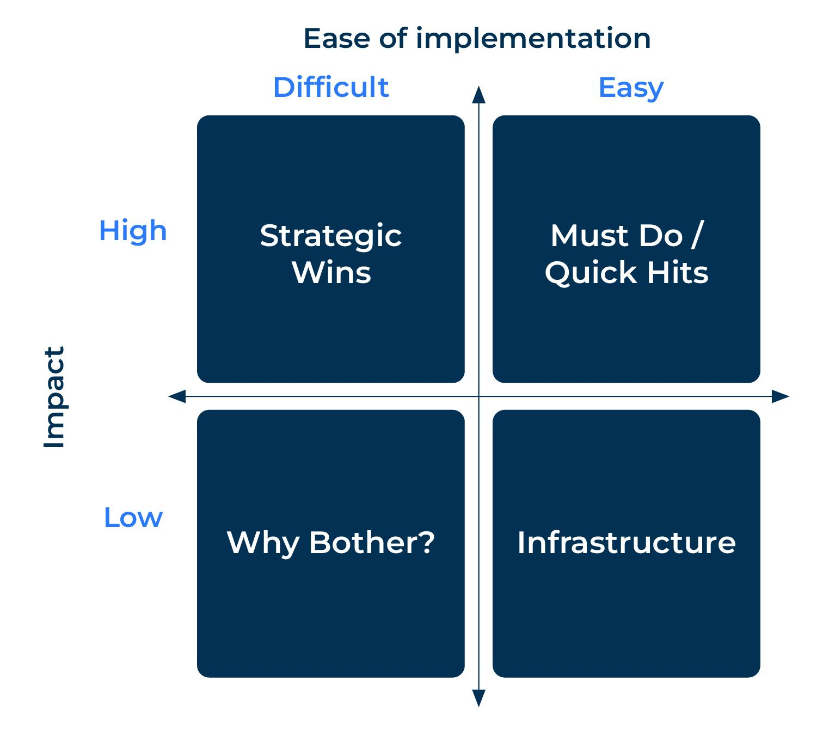
The responses.
You will now have a good understanding of your strengths and weaknesses, opportunities and threats. Consider your responses for each of the intersections.
Use a prioritizing grid to determine the responses.

Slide 7
Things to think about.
A SWOT analysis is a great brainstorming tool. Use it whenever you are considering a strategy for a product or a business unit. Use the SWOT grid which drives action where strengths, weaknesses, opportunities and threats meet.
In developing the SWOT, consider all the detailed strengths and weaknesses, opportunities and threats and then distil them so that the grid contains only those that are most relevant.
Place a priority on actions related to the strengths and opportunities and the weaknesses and the opportunities. These will be where the quickest gains can be achieved.

Slide 8
Thank you.

