Slide 1
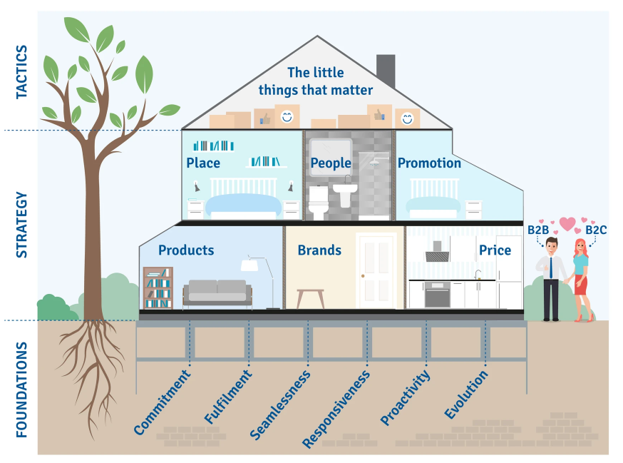
Customer Experience

Slide 2
A business model to build loyal customer.
Use this framework to win new and loyal customers
Everybody knows that it is important to deliver great customer experience. Sadly, most businesses fail to do so. Of course, it is necessary to offer the right product at the right place and at the right time. But it is necessary to go beyond this as all companies in the market will be providing a basic offer. It is also necessary to offer the little things that matter such as customer smiles and asking customers to have a nice day, However, this is not what good customer experience is built on. The foundations of great customer experience are:
commitment to satisfying customers come what may,
fulfilling their needs at all times,
providing a seamless and easy way to do business,
being responsive to their requests,
being proactive and anticipating their needs
and continuously evolving and improving customer service.
These foundations of great customer service are discussed in the following pages.

Slide 3
Commitment.
Delivering excellent customer experience takes time. It requires patience, investment and the belief that it is worthwhile. Whoever is in charge of the customer experience programme has to have absolute faith that it is the way forward. When times get tough, money is short and it is easy to slip into compromise mode. There must be a commitment to deliver excellent customer experience – come what may.
.
 | Complete these boxes
Who in your company is the most senior person and how committed are they to great customer experience?
When the chips are down, and choices must be made between investment in customer experience or something else, which way will they blow?
What historical evidence exists to prove that customer experience is a critical priority?

Slide 4
Fulfilment.
Words are cheap and theories are interesting. However, actions are required if excellent customer experience is to be achieved. Customers have expectations when they do business with a company and they want to see that what was promised is delivered. Customers want every customer experience to be fulfilled consistently, not just once or twice, but every time. It is usually the hardest part of any programme.
 | Complete these boxes
What evidence is there that the company delivers great customer experience?
What are customers’ expectations? How often are they met or not met?
How does you company compare with others in the market in delivering consistent fulfilment?
What can you do to improve the delivery of continuous customer satisfaction?

Slide 5
Seamlessness.
Doing business with a company should be pleasurable. A company that is difficult to work with will not deliver excellent customer experience. Difficult companies are those that believe the complications of serving the customer should be shared with the customer. Customers are passed between departments, becoming frustrated and exhausted. Customers do not want to know about the internal difficulties faced by the company; they want a purchase process that is seamless and easy.
 | Complete these boxes
If someone has a problem with your company, how easy is it to get to speak to one person who can solve it? Who is this person?
Does the boss of the company ever walk in customers’ shoes? Do they ever work on the front line of the company and feel what it is like to deal with customers?
Is your interface with people robotic answering devices or real people?
How well trained are people throughout your company in taking ownership of customers’ problems?

Slide 6
Responsiveness.
Doing business with a company inevitably involves interactions and communications. Communication can be face-to-face, by telephone, email, text, webchat, or letter. The communications could be information about a product, acknowledgement of an order, assurances of deliveries, etc. They must be quick and timely. Customers have become used to quick responses in other aspects of their daily life and this requirement has become an essential ingredient in excellent B2B customer experience.
 | Complete these boxes
How fast is your company in responding to customers’ requests?
In what way do you respond to customers? What is the pressure to reduce costs in customer communication rather than increase them with more personal communication?
What is the benchmark in your industry for superfast communications with customers? How could you be even faster?

Slide 7
Proactivity.
Excellent customer experience is achieved by going beyond expectations. This requires a high level of imagination and proactivity in order to make the experience better, different, faster or cheaper.
 | Complete these boxes
What are “normal” customer expectations in your industry?
What do you do for customers that is beyond their expectations?
If a customer faces a problem do you solve the problem +1 – ie do something extra for the customer?

Slide 8
Evolution.
‘If you always do what you’ve always done, you will always get what you’ve always got.’1 Staying the same means going backwards as inevitably competitors catch on to good ideas and copy them. Customers get used to service, and what is considered excellent customer experience today will seem ‘old hat’ tomorrow. The customer experience recipe needs to be constantly changing and improving.
 | Complete these boxes
How does the customer experience delivery at your company compare to what it was five years ago? In what way has it changed/improved?
Who is responsible for new ideas in customer experience? What authority have “front line” staff got to go an extra mile for customers?
Which companies outside your peer group offer great customer experience? What can you learn or copy from them?

Slide 9
Thank you.

