Slide 1
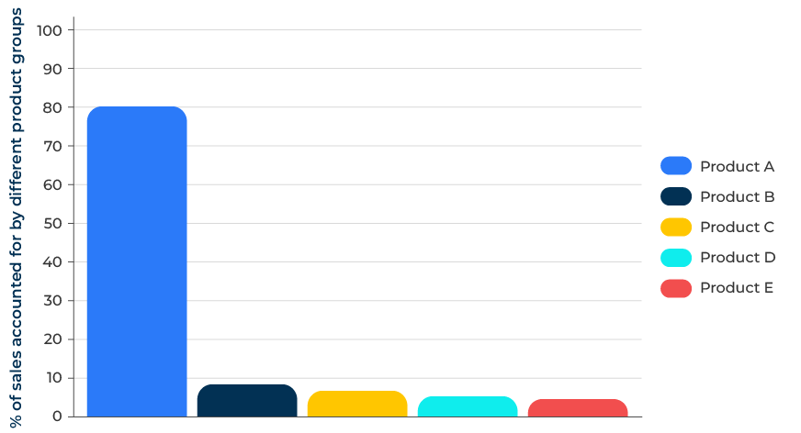
80/20 Rule – Pareto Principle

Slide 2
A business model to improve your profitability.
Use this framework to determine where effort is most justified
The Pareto Principle, often referred to as the 80/20 rule, suggests that roughly 80% of effects come from 20% of causes. In the context of developing a strategic plan, the Pareto Principle can be a valuable tool for focusing efforts on the most significant factors that contribute to success.
By systematically applying the Pareto Principle you can enhance the effectiveness of your strategic planning process. This approach helps you concentrate efforts on the most impactful areas, leading to more efficient resource allocation and a greater likelihood of achieving your strategic objectives.

Slide 3
Define your strategic goals.
Clearly articulate the strategic goals and objectives of your company. Ensure that there is a clear understanding of what success looks like. Determine the key performance indicators (KPIs) that align with your strategic goals. These could include metrics related to revenue, customer satisfaction, operational efficiency, or other relevant factors.
 | Complete these boxes
Where does your company want to be in 5 years time?
What goals must be achieved to meet this objective?
What key performance indicators will help you achieve these goals?

Slide 4
Gather and analyse data.
Collect data on the performance of various aspects of your company. This could include customer data, financial data, operational metrics, or any other data relevant to your goals. Use data analysis techniques to identify the factors or elements that have the most significant impact on your strategic goals. Look for patterns and trends that highlight areas of high performance or significance.
 | Complete these boxes
Analyse your customers from largest to smallest and least to most profitable.
Segment your customers according to which are key to the future.
Collect all operational data on your workforce and production unit to determine strong and weak points.

Slide 5
Apply the 80/20 rule.
Identify the top 20% of factors that contribute to 80% of the desired outcomes. Evaluate the identified factors to prioritise opportunities and challenges. Determine which opportunities have the potential to contribute the most to your goals and which challenges pose the most significant risks. If applicable, apply the Pareto Principle to customer segmentation, product lines, or service offerings. Identify the 20% of customers, products, or services that generate 80% of your desired outcomes.
 | Complete these boxes
What factors will deliver 80% of your goals?
How does the 80/20 rule apply to customers and a segmentation of your customers?
Which of your products and services contribute 80% of your goals?
Which divisions within your company will contribute 80% of your goals?

Slide 6
Allocate your resources.
Assess your resource allocation across different areas of the organisation. Consider reallocating resources to focus more on the critical few factors identified through the Pareto analysis. Based on the prioritised factors, develop action plans that specifically address the critical areas. Allocate resources, set milestones, and define key initiatives that will have the most significant impact on your strategic goals. Implement the action plans and closely monitor the impact on performance. Continuously track the identified factors, KPIs, and overall progress towards strategic goals..
 | Complete these boxes
How can your resources be allocated to be more effective in achieving your goals?
What KPIs and milestones should be set to ensure that you achieve your goals?
How can you monitor, refine and adjust your action plans to meet your goals?

Slide 7
Editable framework.
Use this to add your own text and edit to suit your own branding
100
90
80
70
60
50
40
30
20
10
0
Product A
Product B
Product C
Product D
Product E
% of sales accounted for by different product groups

Slide 8
Thank you.

