Slide 1
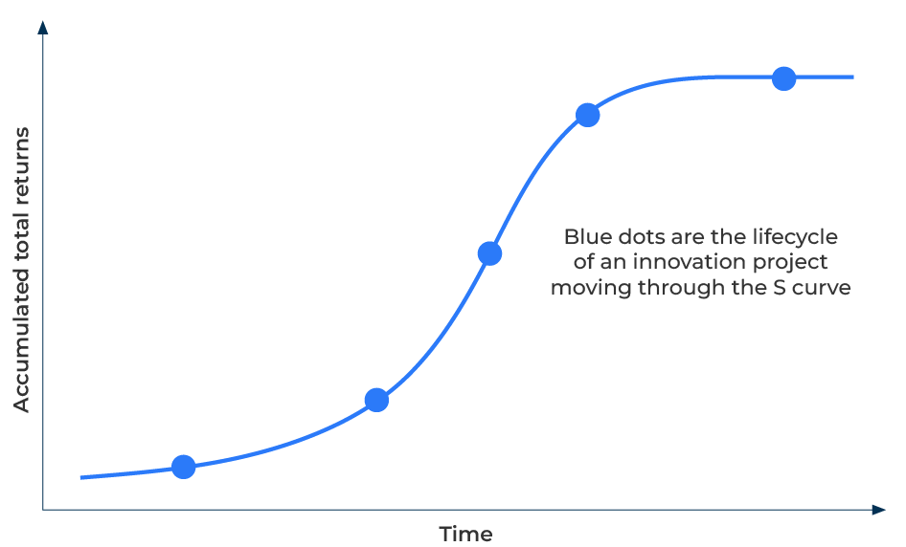
Three Horizons of Innovation

Slide 2
A business model for managing growth.
Use this framework to plan your company's growth
The Three Horizons of Innovation framework, developed by McKinsey & Co, is a strategic model that helps companies manage short and long-term innovation. The framework divides innovation into three horizons, each representing a different time frame and level of innovation.
The Three Horizons framework helps ensure that innovation efforts are strategically aligned with the company's overall vision and goals. It provides a structured approach for managing growth in a way that balances short-term performance with long-term competitiveness.
By applying the Three Horizons of Innovation framework, companies can create a holistic approach to managing growth, ensuring that they optimise their current operations, explore new opportunities, and invest in breakthrough innovations for long-term success.

Slide 3
Horizon 1: Core business (optimise existing operations).
Horizon 1 focuses on optimising and improving existing products, services, and operations. It involves incremental innovations to enhance efficiency, reduce costs, and maximise the performance of current business models. Companies can use Horizon 1 to generate short-term revenue streams by leveraging their existing core competences. This often involves refining and extending the life cycle of current products or services. Horizon 1 innovations are generally less risky as they build on the company's existing strengths. This helps in maintaining stability and ensuring the current business remains competitive.
 | Complete these boxes
What are your company’s core competences?
What minor improvements to your products would bring profitable gains?
How long will these improvements generate improved profits?

Slide 4
Horizon 2: Emerging opportunities (build new business models).
Horizon 2 involves exploring adjacent markets and emerging opportunities. Companies identify and invest in new products, services, or business models that align with their core competencies and this may require some adaptation. This horizon is crucial for companies seeking to diversify their offerings and expand into new markets. It helps in capturing new customer segments and generating additional revenue streams. While Horizon 2 involves more risk than Horizon 1, it also offers the potential for significant growth. Companies must carefully manage and balance the risk-reward equation to ensure successful exploration and exploitation of emerging opportunities.
 | Complete these boxes
What new products/services does your company have in its pipeline?
Who will buy these new products/services? How will they open up new markets?
What are the risks involved in launching these new products?

Slide 5
Horizon 3: Breakthrough innovation (create new business models).
This horizon is about creating entirely new markets, products, or services that have the potential to revolutionize the industry. Horizon 3 innovations are high-risk, high-reward endeavours. Companies must embrace a culture of experimentation, learn from failures, and encourage creative thinking to identify and capitalize on truly disruptive opportunities.
 | Complete these boxes
How bold is your company? How set up is it for taking risky ventures (move fast and break things?)?
What new business model will be required to manage these disruptive innovations?
How prepared is your company to be completely different in every way in the future?

Slide 6
Finally
Portfolio Management: Managing growth using the Three Horizons framework involves balancing investments across all three horizons. Companies need to create and manage a balanced innovation portfolio that addresses short-term needs while positioning the company for long-term success.
Resource Allocation: Effective resource allocation is crucial for managing growth. Companies should allocate resources based on the specific requirements of each horizon, ensuring that the core business is sustained while allowing for exploration and transformation.
Leadership and Culture: Successfully managing growth using this framework requires strong leadership that can navigate the complexities of innovation at different horizons and handle the risk. Fostering a culture that values experimentation, learning, and adaptability is essential for sustained success.
Strategic Alignment: The Three Horizons framework helps ensure that innovation efforts are strategically aligned with the company's overall vision and goals. It provides a structured approach for managing growth in a way that balances short-term performance with long-term competitiveness.

Slide 7
Editable framework.
Use this to add your own text and edit to suit your own branding
Blue dots are the lifecycle of an innovation project
moving through the S curve
Accumulated total returns
Time

Slide 8
Thank you.

