Slide 1
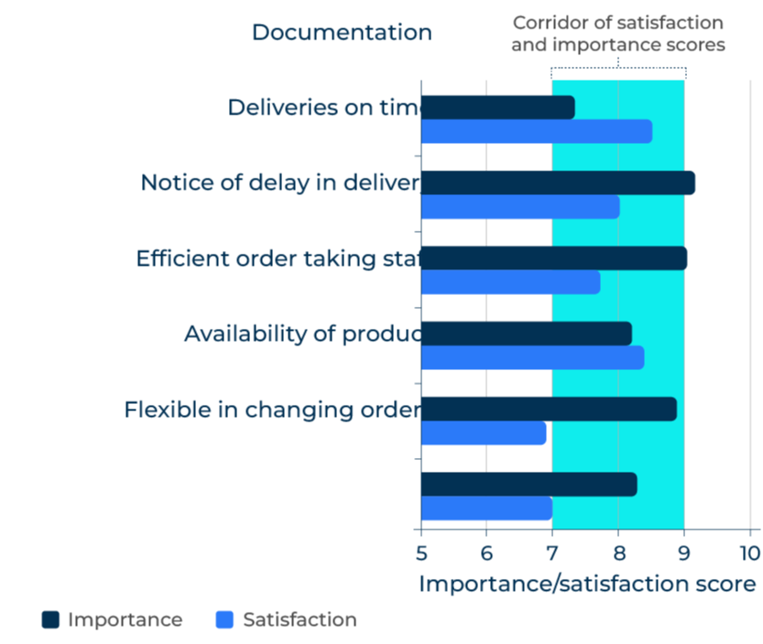
Gap Analysis

Slide 2
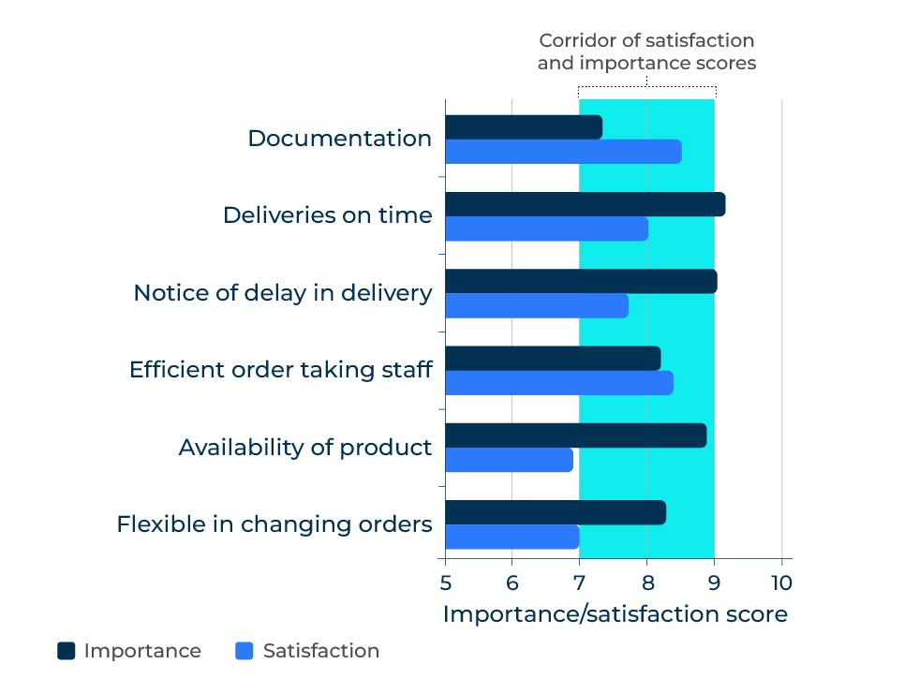
Improve areas of weakness in a company.
Use this model to identify your company’s weaknesses and develop strategies for rectifying them
Gap analysis seeks to find the difference between the current level of performance of a company and where it would like to be. Gaps can be sought in different areas:
Performance gaps with customers – satisfaction and loyalty scores, delivery times, delivery in part and in full, share of wallet.
Product gaps – gaps in the product portfolio.
Segment gaps – groups of customers who are currently not served.
Geographical gaps – regions or territories that could be supplied but are not at the present.
The most common gap analysis for marketers is the performance gap with customers (as shown in the diagram opposite).

Slide 3
Identify the problem.
Step 1
Work through this check list of questions to determine the problem and its cause.
What is the real problem? Be sure to dig deep on this question. Low profitability is of course a problem but it isn’t the cause of the problem. The real problem is likely to be something such as costs that are too high, inefficiencies on the production line, prices that are too low etc.
Keep your thinking wide at the start. There may be many possible causes of the problem and it would be wrong to narrow the focus too quickly.
Focus on the main causes of the problem. There may be a number of causes although two or three are likely to account for 80% of the problem.

Slide 4
Obtain a measure of current performance.
What data do you have on the current performance and the cause of any problems?
Customer survey data on satisfaction levels with different aspects of performance
Number of complaints
Frequency of calls on customers
Market share etc.

Slide 5
Set targets for performance levels.
Targets for performance levels can be determined in a number of ways:
Past levels of performance
Competitors’ levels of performance
Performance of companies in parallel industries
Arbitrary levels of performance (such as increase the Net Promoter Score from 20 to 30)
Ask yourself whether the performance targets are realistic, stretching and achievable. They also must be measurable – SMART according to the acronym:
Specific – a specific target for improvement.
Measurable – a measure that can be used to indicate progress.
Assignable – to a person or people who will be responsible for achieving the target.
Realistic – results that are possible given available resources and timetable.
Time-related – when the result can be achieved.

Slide 6
Determine a plan for filling the gap.
The plans for filling the gap will vary depending on the problem and what is required to solve it. However, it will require:
People to be assigned with responsibility
Resource to be made available as necessary
An agreed timeline
A process for ensuring the timeline is met
Consider using a template such as the following (using the example of a price that is perceived to be too high):
The problem | Current state (describe it) | Metric for current state (customer score) | Description of future state | Metric for target state (customer score) | Action required
Price perceived to be uncompetitive | Products considered poor value for money | 6/10 | Improve customer value proposition | 7.5/10 | Training for the salesforce on the new CVP

Slide 7
Things to think about.
The key to gap analysis is finding out what is important to customers and where your performance is relatively poor.
Once the gaps have been identified, they should be sorted into quick wins (things that are easy to correct and improve) and those that need substantial resource and will take a long time. This will create a plan of action for improvements.

Slide 8
Thank you.

