Slide 1
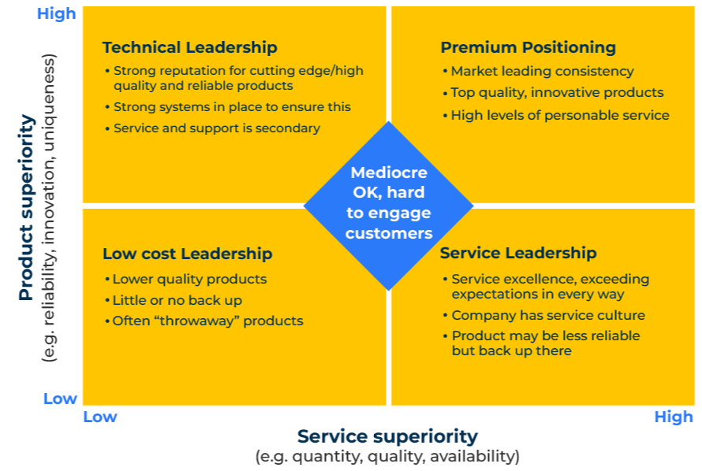
Product Service Matrix

Slide 2
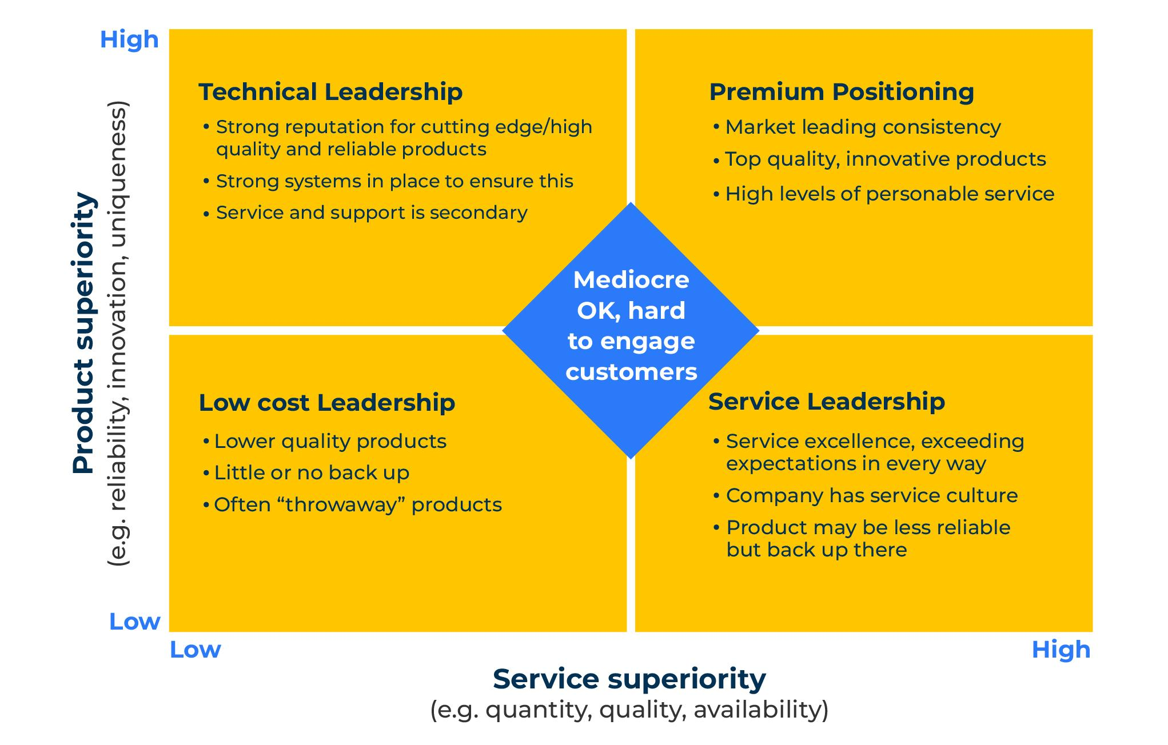
A model to position products by quality and service.
Use this model to determine the positioning of your product on product or service superiority
This is a model for business to business companies. It focuses on the interest of buyers in product quality (either high or low) and service quality (either high or low).
There are four important positions that can be taken by a supplier of B2B products and, as often is the case, it is better to take a clear position in one of the quadrants of the matrix rather than be stuck in the centre.

Slide 3
Premium positioning.
This position is for companies that have best in class, high quality products with excellent service support. Consider the following checklist to determine if your product/service offer is premium positioning.
To take this position you will need:
Significant investment in the brand
A significant investment in people, especially those who can provide high levels of technical service
A significant investment in quality control to ensure products of the highest reliability
A significant investment in innovation
To survive in the future you will need:
To ensure the brand lives up to its premium promise
Customers are prepared to pay a premium for the product and service
Dangers to look out for:
The cost to serve must be kept in check so as not to prejudice profits
Product or service failures that get into the public domain

Slide 4
Technical leadership.
This position is for companies that have industry-leading products that are superior. Consider the following checklist to determine if your product/service offer is technical leadership.
To take this position you will need:
Significant investment product development
A significant investment production processes including quality control
To survive in the future you will need:
Quality systems that outperform those of the competition
Continuous investment in innovation
Dangers to look out for:
Commoditisation of the product
Insufficient innovation which leads to technical leapfrogging by competitors

Slide 5
Service leadership.
This position is for companies that have average products supported by excellent sales and aftermarket service. Consider the following checklist to determine if your product/service offer is service leadership.
To take this position you will need:
People who are customer orientated and put the customer first
Excellent training in technical service
Service provision throughout the day, week and year
To survive in the future you will need:
To maintain a culture of the customer comes first
To keep in check the cost of service so it does not erode profits
Dangers to look out for:
Products become so reliable they don’t need service
Service can be commoditised or offered by other subcontractors

Slide 6
Low-cost leadership.
This position is for companies that can offer their products at a very attractive price. Consider the following checklist to determine if your product/service offer is low-cost leadership.
To take this position you will need:
Production cost advantages either from processes, raw materials or labour costs
Supply chain efficiencies
To survive in the future you will need:
To manage fixed and operational costs
High levels of productivity
Accurate cost to serve data
Dangers to look out for:
Competition from challenger brands or disruptors
Low prices that lead to unreliable products or poor service

Slide 7
Further considerations.
Target audience: which segment of the market are you aiming at? Is your offer aligned with the needs of this market segment?
Product: how are demands for the product changing? How is your product development responding to these changes?
Branding: what is your brand promise? To what extent does your brand live up to its promise?
Price: how do you know that your prices are optimum for the product/service you are offering? Are you leaving money on the table? Are you overcharging and restricting demand?
Profit: how profitable is your strategy? What action could be taken to sell more product, reduce costs, or increase prices?
Channel: what options exist for more efficiently reaching customers?
Advertising: what messages are you using to promote your product/service offer? Are you sure these messages resonate with the target audience?

Slide 8
Things to think about
In business to business markets product quality and service quality are critically important. Established companies can become complacent about their position and charge premium prices which are not justified by their products and services. Use customer feedback from complaints, warranty claims and market research as a reality check. In the short term much can be improved by investing in service quality.
Ask yourself what makes customers delighted about your products. Use the Kano model to find product features that will delight customers.

Slide 9
Thank you.

