Slide 1
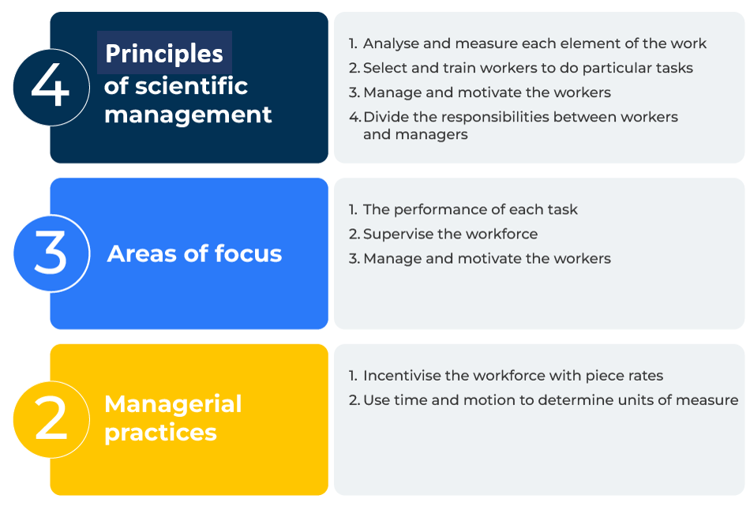
Scientific Management

Slide 2
A business model to improve profitability.
Use this framework to improve productivity
Frederick Taylor's principles of scientific management, developed in the early 20th century, have had a significant impact on the field of management and business practices. While they have been subject to criticism and refinement over time, Taylor's ideas have played a crucial role in shaping modern management thinking.
Taylor's ideas have been adapted and evolved over time and his principles have had a lasting legacy in the field of management. Many of the fundamental concepts he introduced continue to influence business practices, particularly in the pursuit of efficiency, productivity, and evidence-based decision-making. It is important to note that Taylor's approach has been criticised for its mechanistic view of workers and lack of consideration for human factors, leading to the development of more human-centric management theories such as Theory X and Theory Y.

Slide 3
Conduct an analysis of processes.
Begin by conducting a detailed analysis of the work processes and tasks within your organisation. Identify repetitive and routine tasks that can be broken down into smaller, more manageable elements. Use time and motion studies to observe and record the time it takes for workers to perform specific tasks. Analyse the movements and steps involved in each task to identify opportunities for improvement.
 | Complete these boxes
List the processes in your organisation. How many of these are routine? How can they be broken into manageable elements?
How long does it take to perform these tasks?
What are the steps where improvements can be made?

Slide 4
Identify best practices and standardise methods.
Determine the most efficient and effective ways to perform each task. This may involve identifying best practices through the analysis of successful workers or conducting experiments to find the optimal methods. Develop standardised work methods based on the identified best practices. Standardisation helps ensure consistency in performance and facilitates easier monitoring and control of work processes.
 | Complete these boxes
Who or which teams are most effective in performing their tasks?
Why are these teams performing so well? How can what they are doing be copied?
What training is required of other teams to match the performance of the best teams?

Slide 5
Make changes to pay and controls.
Consider implementing a piece-rate pay system, linking employee compensation directly to their output. This system is designed to provide financial incentives for higher productivity. Apply scientific principles to the selection and placement of workers. Match individuals with tasks that align with their skills and abilities to maximise efficiency and effectiveness. Implement Taylor's concept of functional foremanship, where specialised supervisors (foremen) are responsible for specific aspects of the production process. This may include planning, instruction, quality control, and timekeeping.
 | Complete these boxes
How are you paying people for these processes at the present? How would piece rates motivate people? (Be careful it – it can cause dissent).
How can the supervision of the workers be improved by using specialised foremen to plan and control?
What non monetary rewards could be used to incentivise the reorganised teams?

Slide 6
Measure and keep improving.
Develop key performance indicators (KPIs) to measure and evaluate the performance of both individuals and the overall organisation. Metrics may include output per worker, production efficiency, and adherence to standardised work methods. Foster a culture of continuous improvement by regularly reviewing and refining work processes. Encourage feedback from workers and supervisors, and use data to identify opportunities for further improvements.
 | Complete these boxes
What KPIs can be used to measure performance?
How motivated are workers in seeing that their performance is continuously improving?
How can the worker teams and supervisors follow up with further improvements that they suggest?

Slide 7
Editable framework.
Principals of scientiﬁc
management
Use this to add your own text and edit to suit your own branding
Analyse and measure each element of the work
Select and train workers to do particular tasks
Manage and motivate the workers
Divide the responsibilities between workers and managers
4
The performance of each task
Supervise the workforce
Manage and motivate the workers
3
Areas of focus
Incentivise the workforce with piece rates
Use time and motion to determine units of measure
2
Managerial practices

Slide 8
Thank you.

