Slide 1
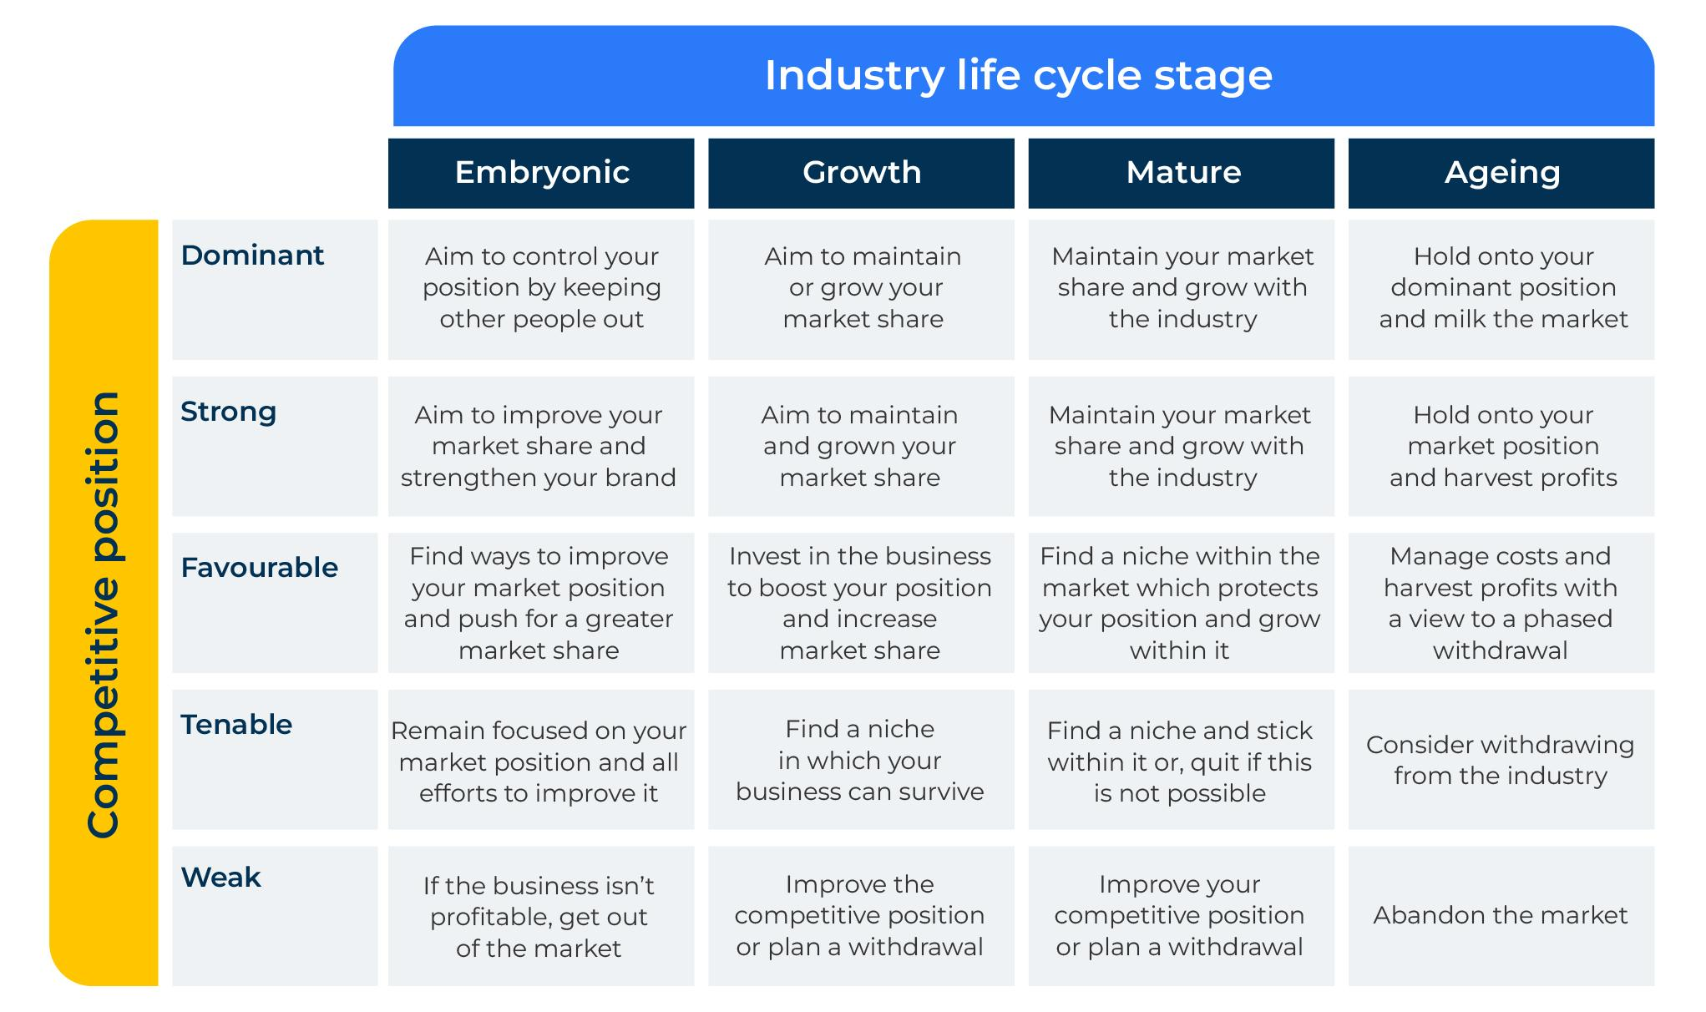
ADL Matrix

Slide 2
A Framework to strengthen a product portfolio.
Use this model to determine where your product or company stands in its life stage and to determine a course of action
This is a model proposed by the consultancy group Arthur D little (hence called the ADL Matrix) and is based on the life-cycle of your product and its competitive position.
There are three steps:
Step 1: Where is your company (or product) in the life-cycle?
Step 2: What is your company’s (or product) competitive position at this stage in the life-cycle?
Step 3: What should your course of action be in the ADL Matrix?
First you need to decide where your product portfolio or your company is in its life stage. This isn’t easy because there are no solid benchmarks to say when you are moving from one life stage to another. Take a look at the next page.
‹#›

Slide 3
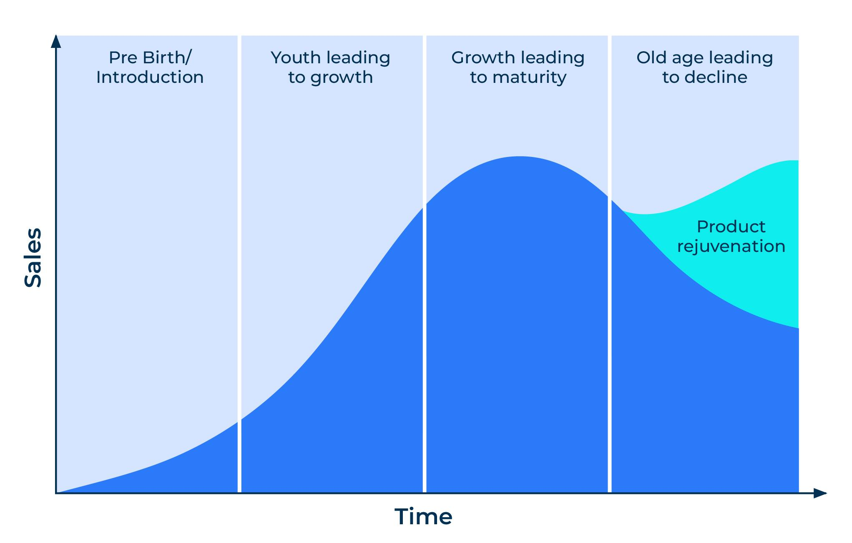
Identify your lifestage.
STEP 1
Mark an X where your company (product) is in the industry/product life cycle
It is easy to see if your product is at the beginning or the end of its life-cycle.
The youthful and mature stages of the life-cycle can sometimes stretch over a number of years and merge into each other. However, the mature stage is usually recognisable by a slowing of growth.
If possible, put a timeline on the X axis. How long do you believe each of these phases lasts?
As with all frameworks you will need to put your thinking cap on from the very start. In Step 1 you need to decide where your product portfolio or your company sits in its life stage. This isn’t easy because there are no solid benchmarks to say when you are moving from one life stage to another.

Slide 4
What is your competitive position at this life stage?
STEP 2
Take a look at some key measures and compare your position with each major competitor. Add extra measures if they are relevant. For competitor #1 how do you score and rank? Carry out this exercise for each major competitor.
 | Score out of 5 (5 = dominant, 1 = weak) | Rank of importance
Market share
Price competitiveness
Product benefits
Channel to market
High profitability
Total
You must now determine the action required to improvement your competitive position for your target audience. See the next slide.

Slide 5
What should your course of action be?
STEP 3
The ADL matrix brings together your position on the life-cycle and your competitive position.
Each position in the matrix offers a recommendation. Consider the recommendation and ask yourself the following questions:
What benefits (financial and otherwise) will this bring to my company?
What resources will be necessary to fulfil the recommendation?
How long will it take?
Who will be responsible for the actions?
What barriers could prevent the recommendation being achieved?
What other options do we have?

Slide 6
Thank you.

