Slide 1
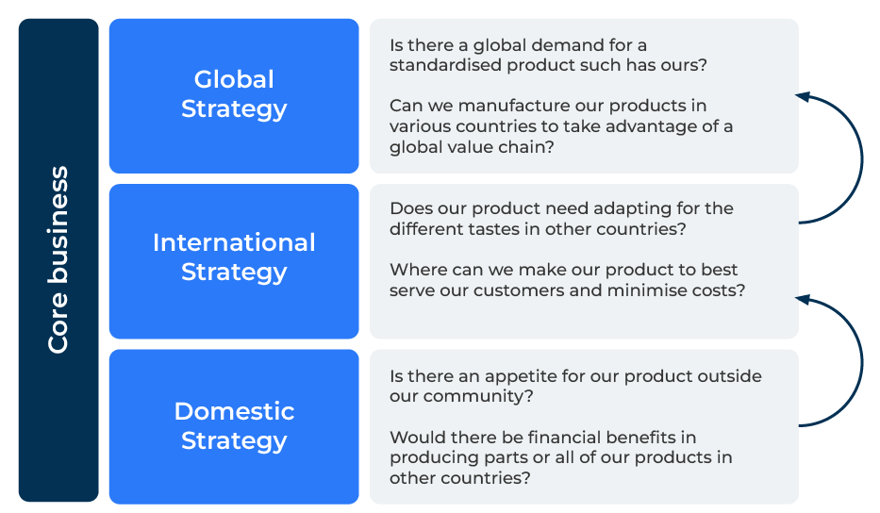
Global Strategy

Slide 2
A business model to take your company global.
Use this framework to develop an international or global strategy
George Yip's global strategy framework, introduced in his book "Total Global Strategy," provides a comprehensive approach for businesses to develop strategies in the global marketplace.
The framework consists of four key components:
Business System,
Headquarters,
Subsidiaries,
Linkages.
By systematically applying George Yip's global strategy framework and considering the specific challenges and opportunities in each component, businesses can develop a well-rounded and effective approach to global expansion. This framework helps organisations balance the need for standardisation with the imperative for local responsiveness, ultimately contributing to sustained success internationally and ultimately in the global marketplace.

Slide 3
Sort out your business systems.
First assess the need for adaptation of your business systems across different markets. Consider the cultural, economic, legal, and technological differences that may require modifications to your products, services, processes, and value propositions. Identify elements of your business system that can be standardised globally to achieve economies of scale and efficiency. This might include core processes, technology platforms, or standardized products.
 | Complete these boxes
How many different business system do you have in your company? How do they vary across the company following acquisitions or the age of subsidiaries?
How integrated are your business systems?
Where do your business systems work best? How difficult would it be to adopt these systems across the whole organisation?

Slide 4
Work out where the power should lie.
Determine the optimal level of centralisation or decentralisation for decision-making at the headquarters. Assess which functions or decisions should be centralised for efficiency and consistency, and which can be decentralized for local responsiveness. Ensure effective coordination between the headquarters and subsidiaries. Develop mechanisms for information sharing, decision-making, and collaboration to maintain alignment with global strategy goals.
 | Complete these boxes
How does the culture of your company lend itself to centralisation or devolution? Which functions can be collapsed across the company to be controlled centrally?
What mechanisms do you have for linking headquarters to the subsidiaries?
Think long term about how you want the company to look in 5 years? Set up sharing mechanisms now so the company is joined up.

Slide 5
Work out how you will manage the subsidiaries.
Empower subsidiaries to respond to local market conditions and needs. Allow flexibility in adapting strategies and tactics to the specific requirements of each market while ensuring alignment with overall global objectives. Integrate subsidiaries into the global strategy by establishing clear communication channels, sharing best practices, and fostering a sense of shared purpose. Encourage the exchange of knowledge and expertise across the organisation.
 | Complete these boxes
Who will lead at the subsidiaries and ensure integration with headquarters?
How much control are your prepared to give to the subsidiaries to respond to local conditions?

Slide 6
Set up linkages.
Identify opportunities for economies of scale by leveraging synergies across different parts of the organisation. Explore how activities and resources in one market or business unit can complement and enhance those in another. Facilitate the transfer of knowledge and best practices between different parts of the organisation. Promote a culture of continuous learning and collaboration to capitalize on the collective expertise of the global organization.
 | Complete these boxes
How will you join the subsidiaries together to share knowledge and best practice?
How will you give the right amount of independence to the subsidiaries and still keep control?

Slide 7
Steps in implementation.
Market Selection: Determine which markets offer the most strategic value for your business. Consider factors such as market size, growth potential, competitive landscape, and regulatory environment.
Segmentation and Targeting: Segment global markets based on relevant criteria, and tailor your offerings to specific target segments. Develop marketing strategies that resonate with local customers while maintaining a consistent global brand image.
Resource Allocation: Allocate resources strategically based on the importance and potential of different markets. Prioritize investments in markets that align with your global strategy and offer the highest returns.
Performance Measurement: Establish key performance indicators (KPIs) to assess the effectiveness of your global strategy. Monitor and evaluate performance at both the global and local levels, adjusting strategies as needed to achieve objectives.
And bear in mind the importance of culture. Remember culture trumps process

Slide 8
Editable framework.
Is there a global demand for a standardised product such has ours?
Use this to add your own text and edit to suit your own branding
Global Strategy
Can we manufacture our products in various countries to take advantage of a global value chain?
Does our product need adapting for the different tastes in other countries?
International Strategy
Core business
Where can we make our product to best serve our customers and minimise costs?
Is there an appetite for our product outside our community?
Domestic Strategy
Would there be ﬁnancial beneﬁts in producing parts or all of our products in other countries?

Slide 9
Thank you.

