Slide 1
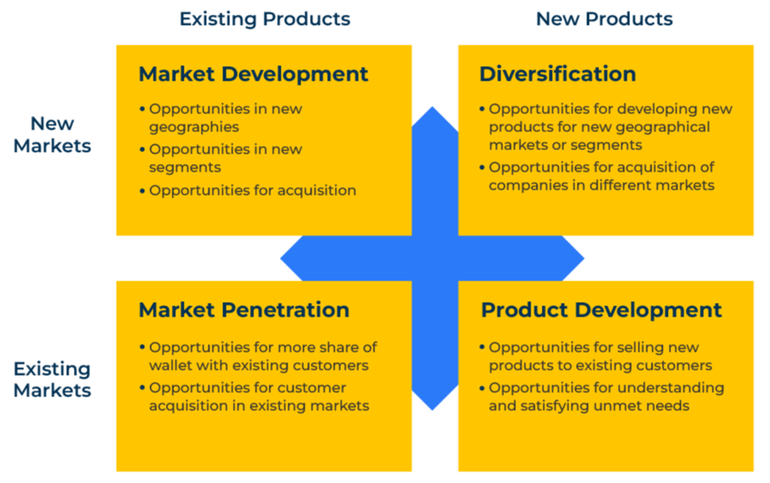
Ansoff Matrix

Slide 2
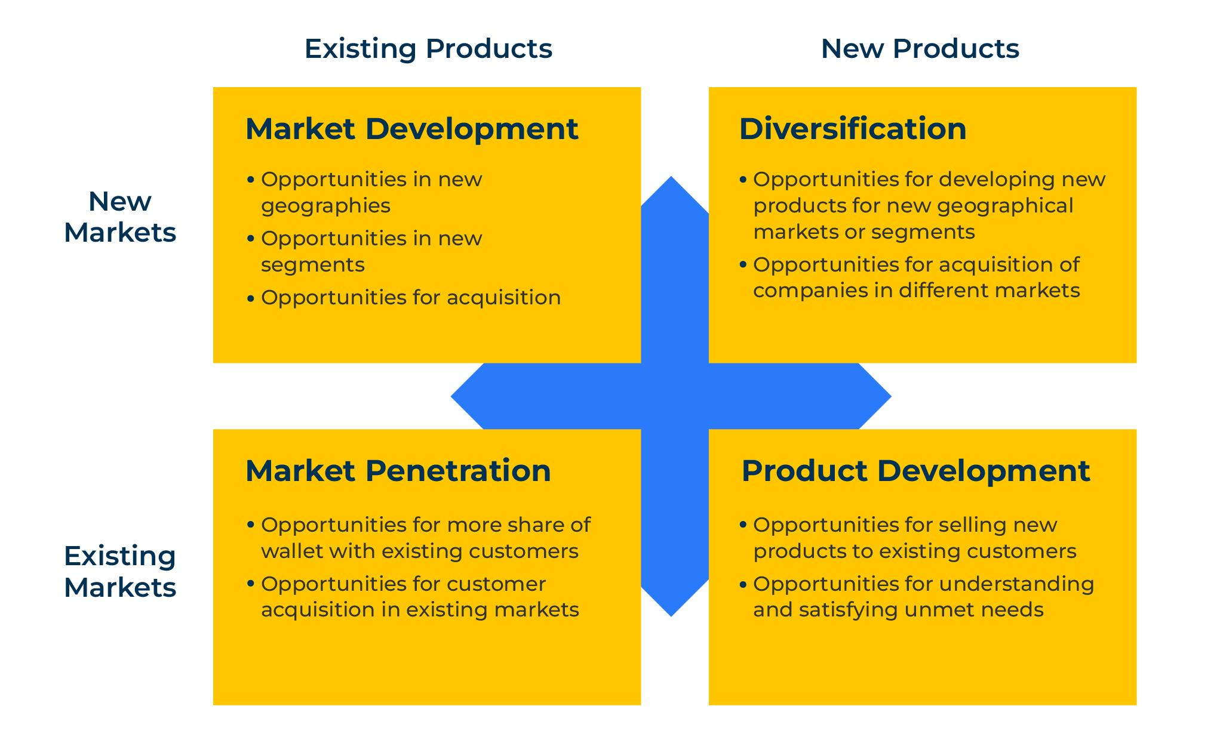
A business model for growing your company.
Use this framework to figure out where to focus your resources and grow the company
Igor Ansoff proposes a model that is useful for working out how to grow a company.
In most cases, the quickest and easiest way of growing a company is to work harder in the South West corner of the matrix and sell more of your existing products to your existing markets.
Thereafter, the next easiest routes to growth are the North West corner or the South East corner. With your existing customers you already have an established position and trust. They may be prepared to buy new products from you if they have a good fit alongside your existing products. Equally, you may be able to take your tried and tested existing products into a new segment or new geography and win new sales. This may be a more expensive option than aiming new products at existing markets.
The most difficult and sometimes most seductive option is to sell new products to new markets. This strategy is likely to involve more risk and more resources.

Slide 3
Complete a SWOT.
Strengths
What are your key product strengths?
What are your key market strengths? (In which segments and geographies are you strongest?)
Weaknesses
If and when your products do not sell, what is the main reason?
What problems have you ever had entering a new market?
Opportunities
Which segments in the market offer most opportunities?
Where in the world is there a market for your products that you do not serve?
Response
Where and how could your strengths exploit some of these opportunities?
Response
How could you rectify your weaknesses to ensure you can take advantage of the opportunities?
Threats
What are the long-term prospects for the products you sell?
How strong are you competitively within the market you currently serve?
Response
How can you use your strengths to respond to market and product threats?
Response
How feasible is it to correct any of your weaknesses and in so doing, head off some threats?

Slide 4
Complete the Ansoff Matrix.
Existing Products
What are your best selling products? What makes them bestsellers?
What specialist products do you have in your range?
New Products
What new products do you have available?
How distinctive and different are these new products to those already on the market?
How profitable will they be?
New Markets
Which new markets could you feasibly enter?
How favourable are these new markets in size, growth and profit ability?
Opportunities for market development
Which new geographies? Which new segments? With which products?
Opportunities for diversification
Which new geographies? Which new segments? With which new products?
Existing Products
What share of your existing markets do you currently hold?
What is holding you back in your existing markets? How easy would it be to rectify these?
Opportunities for market penetration
Which customers will be targeted? With which products? What do we need to do different for success?
Opportunities for product development
Which customers will be targeted? With which new products?

Slide 5
Things to think about.
The key is to understand your customer and potential customer base
Look first of all underneath your nose. There are usually growth opportunities to sell more of the same to existing customers. This means you need to know your share of wallet with each customer so you can assess the potential to sell them more.
The next place to look for growth is with your existing products and new customers. What new segments could you attack? Which countries where you do not sell at the present could be attractive markets for your products?

Slide 6
Thank you.

