Slide 1
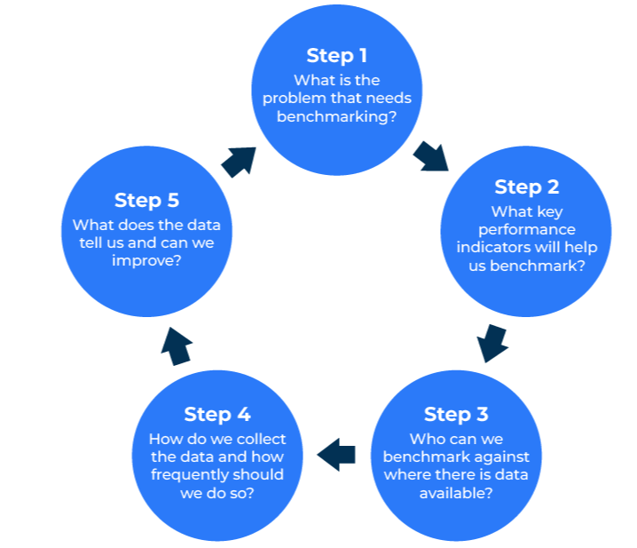
Benchmarking

Slide 2
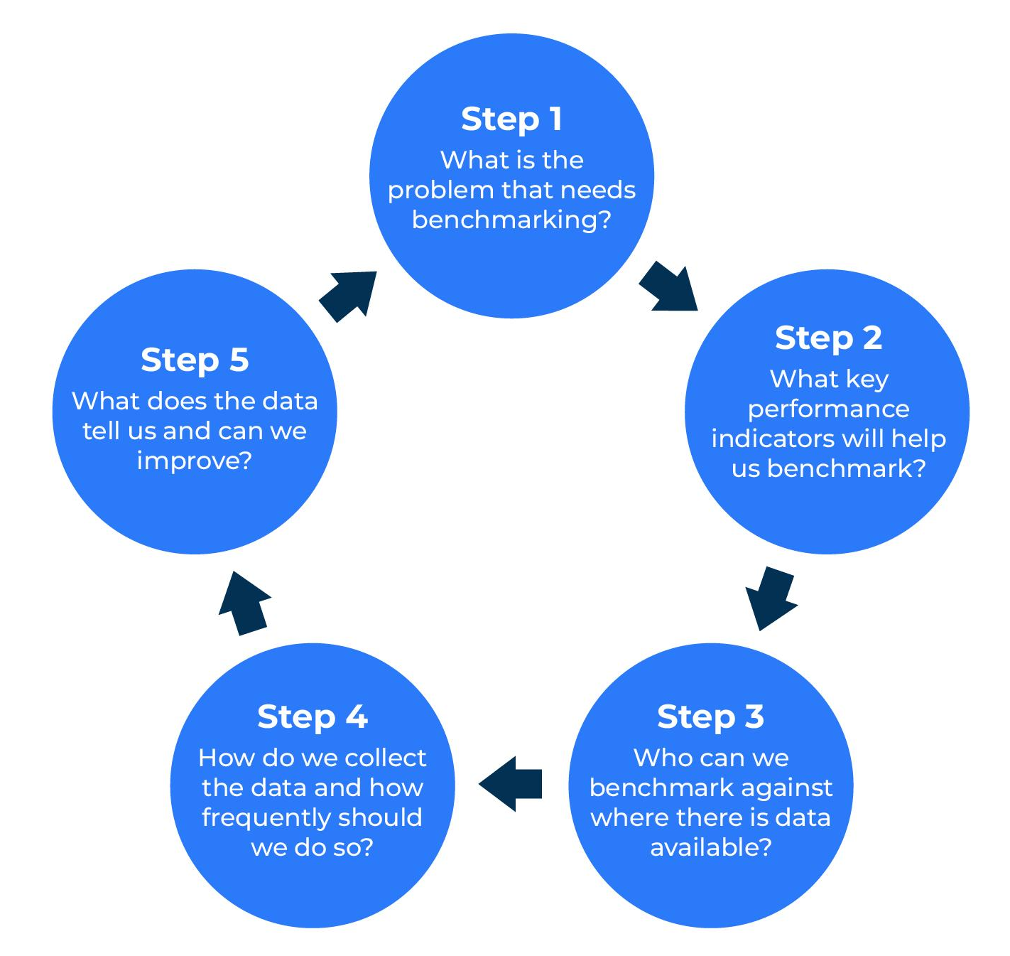
A business model for making improvements.
Use this model to set targets for business and marketing KPIs
Benchmarking is important in business. Benchmarks provide reference points against which you can measure your performance.
The benchmarking wheel (the figure opposite) takes you through the five steps.
The trickiest part of benchmarking can be step 3 – finding an easily available source against which to make comparisons.

Slide 3
Decide what needs benchmarking.
STEP 1
The starting point is to decide what to benchmark. Some possibilities are indicated in the worksheet below. Once you’ve decided what needs benchmarking, think through the problem and the cause of the problem. This may give you ideas as to what the metrics are that can be benchmarked.
Benchmarking possibilities | What is the problem? | What is the cause of the problem? | Feasibility of benchmarking
Customer loyalty metrics such as NPS, customer satisfaction, likelihood to purchase, customer effort etc.
Quality metrics such as product failure rates, product length of life, cost of maintenance etc.
Cost and effectiveness metrics such as price, cost in use, perceived value for money etc.
Timeliness metrics such as delivery on time, speed of response to enquiries, speed of response to complaints etc.

Slide 4
Key performance indicators (KPI’s) to be measured.
STEP 2
In addition to the KPIs that are to be measured, be specific about the target audience that will provide these measurements. Also, at this early stage try to anticipate what KPI you have right now and what you would like it to be.
List the KPIs to be measured | Amongst which target audience? | What KPI score do we think we have? | What KPI would we like to achieve?

Slide 5
Who to benchmark against.
STEP 3
Be specific about the target audience that will provide these measurements – the benchmarks. Also, it is worth postulating what the KPIs will be for comparison with the actual result when it is available – can it be done?
Consider internal benchmarks (different SBUs, different geographical groups), competitive companies, and any best in-class companies in non-competitive businesses.
If the comparative KPI’s will be difficult or impossible to achieve, new/alternative ones must be determined.
Comparative benchmarks | Which audiences will be used as comparative KPIs? | How available are these comparative KPIs? | What will be the source of the comparative KPIs?

Slide 6
How to collect the data.
STEP 4
Most benchmarking exercises fail because they are overambitious in wanting to collect data from competitive sources that cannot be reached.
Also, bear in mind that KPIs obtained from market surveys can weary respondents if they are too frequent. Annual measurements are the norm for most customer satisfaction surveys.
The telephone is an expensive method of collecting KPIs. Online is the most cost-effective method but it may not be possible without up-to-date and accurate email addresses and unless the target audience is fully engaged.
Comparative benchmarks | Proposed method of collecting the KPIs | Frequency of KPI measurement | Cost of measurement

Slide 7
How can we improve?
STEP 5
If the question “why?” is asked after the numeric score is received, it should give an indication of what action is required.
Comparative benchmarks | KPI Score | Delta with anticipated KPI (see Step 2) | Action required
What KPI targets will be set for future measurement programs?

Slide 8
Things to think about.
The key is finding the right things to benchmark against
The key to benchmarking is finding data against which to benchmark. External data may be the gold standard but if it is not available then find an internal data source that is.
Be realistic with your KPI's. It can take two or three years to make a significant positive difference.

Slide 9
Thank you.

