Slide 1
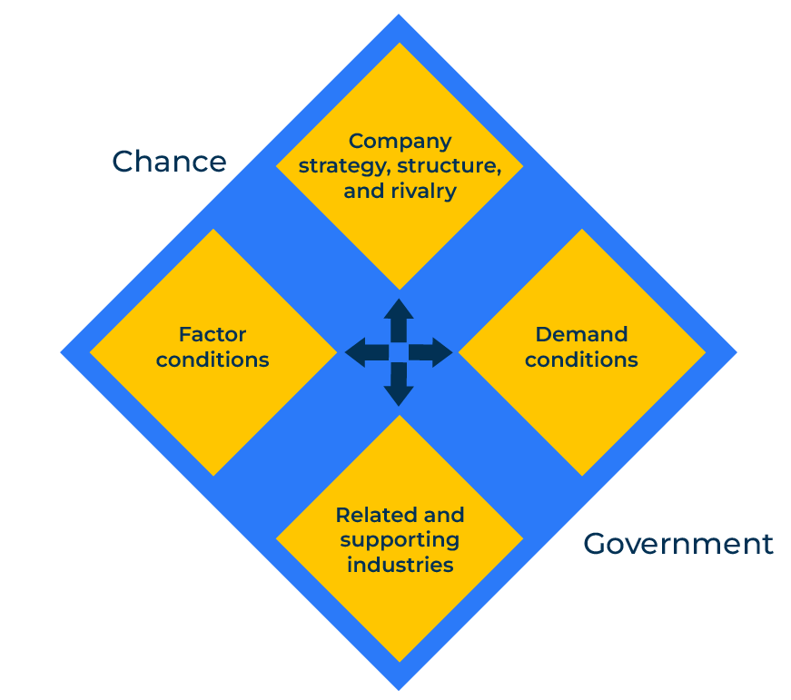
Porter’s Diamond

Slide 2
A business model to enhance competitiveness.
Use this framework to determine a competitive advantage
Porter’s Diamond is an economic model developed by Michael Porter in his book The Competitive Advantage of Nations. The tool is used to analyse the competitive environment and marketplace and so help a company in a market, determine its relative strength.
The diamond consists of four interconnected factors that influence competitiveness – key factors of production, demand conditions, supporting industries, and the rivalry of companies in the market.
The effectiveness of Porter's Diamond may vary across industries and regions. It's important to customise your approach based on the specific context of your business and market conditions. Regularly reassess and adjust your strategies to stay ahead of the competition.

Slide 3
Identify factor conditions.
Identify and assess the key factors of production in your industry or market. This includes human resources, physical resources, knowledge resources, capital resources, and infrastructure. Invest in developing and upgrading these factors. This might involve improving education and training, upgrading technology, or enhancing infrastructure.
 | Complete these boxes
What factors are required for your company in your market?
How important are the various factors – physical resources, human resources, access to capital?
Where are there shortfalls and advantages in these factors?

Slide 4
Assess demand conditions.
Analyse the characteristics of the local or global demand for your product or service. Focus on innovation and meeting customer needs. Tailor your products or services to specific customer demands and preferences. Understand the trends and changes in customer demand and adjust your strategies accordingly.
 | Complete these boxes
What is driving demand for your products? Who are the major customers? What do they need that you can offer?
How can you better adjust your offer to meet the needs of your market?
How is demand changing in your market? What is driving this change? How quickly is it happening?

Slide 5
Consider related and supportive companies.
Build strong relationships with suppliers, manufacturers, and other related industries. Foster collaboration and innovation within the supply chain. A strong and efficient network of supporting industries can enhance competitiveness. Invest in research and development to create synergies with related industries.
 | Complete these boxes
Which companies in your market are worthy of collaboration? Consider suppliers, universities, trade associations etc.
What relationships does my company have with these supportive organisations? How can I improve and strengthen relationships?

Slide 6
Assess firms’ strategies and rivalry.
Manage rivalry positively by focusing on differentiation, cost leadership, or niche strategies. Promote healthy competition that drives innovation and efficiency..
 | Complete these boxes
Who are the leaders in the market? What makes them leaders?
How can my company position itself to compete more effectively? What position can I take that will give me a competitive advantage?

Slide 7
Government and chance.
Work closely with the government to create a favourable business environment. This may include policies that support education, infrastructure, and research and development. Monitor and adapt to changes in the external environment, such as economic fluctuations or technological advancements.
 | Complete these boxes
How would working closely with government help my company? What can I offer government? What do I want from government?
What events are happening or could happen that I need to be aware of? What about technical break throughs, wars, social changes?

Slide 8
Editable framework.
Chance
Use this to add your own text and edit to suit your own branding
Company strategy, structure,
and rivalry
Factor conditions
Demand conditions
Related and supporting industries
Government

Slide 9
Thank you.

