Slide 1
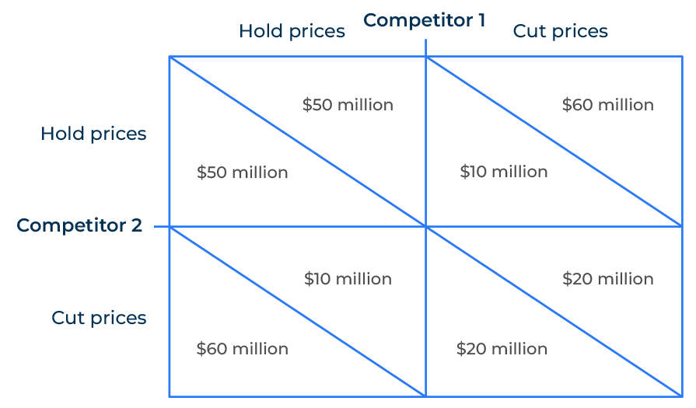
Game Theory

Slide 2
A business tool to understand interactions.
Use this tool to figure out what will be the result of certain actions
Game theory is a branch of mathematics that studies strategic interactions between rational decision-makers and can be a powerful tool in developing business strategy.
By applying game theory in business strategy, companies can gain valuable insights into the interactions within their industry, anticipate competitors' moves, and make more informed decisions to achieve their objectives.
In the example on the right, two competitors start out in the northwest corner, each holding their price and achieving revenues of $50 million per company. However, competitor 2 cuts its prices, raises its revenue to $60 million and competitor 1 suffers with revenues of only $10 million. This causes competitive 1 to retaliate and reverse the position. In the end, they both end up with reduced revenues of only $20 million per company because they haven't understood the effects of the price war. Game theory helps us understand the interactions between competitors.

Slide 3
Understanding strategic positioning.
Game theory helps in analysing the strategic positioning of competitors. By understanding competitors' potential moves and responses, a company can make more informed decisions about its own strategy.
Analysing competitors as players in a game allows for predicting likely responses to specific strategic moves. This insight helps in anticipating competitive dynamics and planning accordingly.
 | Complete these boxes
Who are the competitors your company faces? What are their market shares?
What do you know about their past moves in relation to changes you have made?
Can you construct a table that contains the options that are available to all companies in the market. This should illustrate the possible outcomes that are involved in strategic decision-making. The rows of the table represent the options for one company, and the columns represent the options for the other company.

Slide 4
Understanding price positioning.
Game theory can be applied to understand and mitigate the risks of price wars. Companies can model and analyse pricing strategies, taking into account competitors' potential reactions to changes in pricing.
In certain situations, game theory can help identify cooperative pricing strategies that benefit all players in a market. This might involve tacit agreements to maintain stable pricing.
 | Complete these boxes
Who are the competitors your company faces? What are their market shares? What are their prices? Where do they sit on the value equivalence line?
What do you know about their past moves in relation to price changes in the market?

Slide 5
Other possibilities for game theory.
Product Launch and Timing:
First-Mover Advantage: Game theory helps analyse the benefits and risks associated with being a first mover in a market. It considers the potential reactions of competitors and helps in deciding the optimal timing for product launches.
Sequential Decision-Making: When planning product releases or expansions, understanding how competitors might respond sequentially is crucial. Game theory provides a framework for modelling and analysing such sequential decision-making.
Resource Allocation:
Strategic Investments: Game theory can guide strategic investments by considering how competitors may react to resource allocations. This includes decisions related to R&D, marketing spend, and capital investments.
Market Entry and Exit: When entering or exiting markets, companies can use game theory to model competitive responses and assess the potential impact on market dynamics.
Brand and Reputation Management:
Cooperation and Reputation: Game theory can be applied to understand how cooperation and reputation impact strategic interactions. Building and maintaining a positive reputation may influence competitors' behaviour.
Deterrence: By signalling commitment to certain strategies or actions, companies can use game theory to deter competitors from taking specific actions.

Slide 6
Contd: Other possibilities for game theory.
Regulatory Compliance:
Strategic Compliance: In regulated industries, game theory can help organizations strategically comply with regulations. Understanding how competitors may respond to regulatory changes is vital for compliance planning.
Policy Advocacy: Companies can use game theory to assess the potential impacts of advocating for specific regulatory policies or changes.
Innovation Strategy:
Technology Races: Game theory can be applied to analyse technology races and innovation dynamics. Companies can model scenarios to understand the implications of investing in specific technologies.
Patent Strategies: Understanding the potential responses of competitors to patent strategies is crucial. Game theory can assist in making informed decisions about patent filing, licensing, and litigation.

Slide 7
Editable framework.
Competitor 1
Use this to add your own text and edit to suit your own branding
Hold prices
Cut prices
 | $50 million | $50 million | $10 million | $60 million
 | $60 million | $10 million | $20 million | $20 million
Hold prices
Competitor 2
Cut prices

Slide 8
Thank you.

