Slide 1
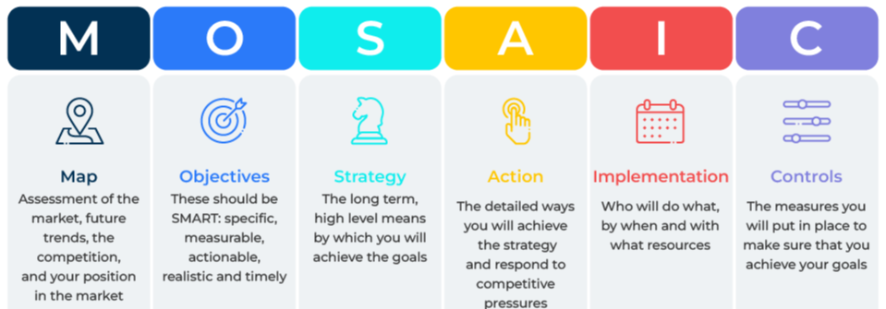
MOSAIC

Slide 2
A business model for setting and reaching objectives.
Use this model to help achieve your goals
One of the oldest and simplest frameworks for addressing problems and opportunities is to answers the following three questions:
Where are we now?
Where are we going?
How can we get there?
The MOSAIC model is an extension of these three questions. It is a framework for addressing macro and micro business issues.
MOSAIC is an acronym for mapping, objectives, strategy, action, implementation, and controls.

Slide 3
Map
This first series of questions get you thinking about the market place.
What do you know about the market – how big is it, how does it segment, who are the main customers, what is the channel to market, what are the trends, what are the prices, what are the most effective means of promotion?
Who makes the buying decision, who influences it, what factors prompt them to choose a particular supplier, which of these factors are most important, how loyal are they to incumbent suppliers?
What motivates people to choose a supplier? What are their needs and unmet needs?
Why do they choose your products?
What are the channels to market? How does your company move its products through the market?
What are your company’s strengths? Where do you have a competitive advantage?
What are your company’s weaknesses? What do you lack that is necessary for success in this marketplace?
Who are the main competitors? What are their market shares? What are their strengths and weaknesses?
What is the future of this market? Where will it be in 5 to 10 years time? What are the forces that are driving these trends?

Slide 4
Objectives
Now lay out your objectives.
What do you want to achieve?
How specific can you be about these objectives in terms of revenue, market share, profitability etc?
How realistic are these objectives? Are they stretching enough or are they too stretching?
By when do you expect these objectives to be achieved?
Make sure that these goals are aligned with your company mission.

Slide 5
Strategy
Consider the strategies that will enable you to achieve your objectives.
Determine your strategy based on your strengths and weaknesses and the opportunities and threats in the marketplace.
Your strategy could follow one of the generic strategies suggested by Michael Porter – low cost, differentiated, niche.
In preparing your strategy you must be clear about the 4Ps - your product strategy, your pricing strategy, your promotional strategy, and your channel strategy.
You should also outline your operational strategy which could include moving into new geographies, investing in new equipment, hiring new staff etc.
Which brings us onto the financial strategy. You need to outline what investment will be required, where the money will come from, and what the profit/payback will be.
Make sure that this strategy is aligned to your objectives.

Slide 6
Action
The strategy must be put into practice with tactics. This is the action part of the programme. Tactics are the manoeuvres you anticipate making in the marketplace in order to deliver your strategy. Tactics are the short-term and flexible means by which your longer term strategy will be achieved.
What pricing tactics will you use? What competitive responses do you anticipate? What will be your reaction to these responses? What use can you make of discounts and price promotions? Where will these be used and for how long? Where can you achieve premium prices?
What product tactics can you use? Are there opportunities for bundling products? Are there opportunities for launching different products to different segments of the market? Are there opportunities for introducing new products on specific occasions?
Are there any packaging tactics you can use? Can you take advantage of recycling or sustainability in developing packaging for certain customers? How can you use packaging to communicate with customers? How can you make packaging attractive to customers?
How will you use tactics within your channels to market? How will you balance your distribution network with online sales?.
What promotional tactics can you use? What promotions can you use to steal competitive share? Where will these promotions be used, what types of promotion will you use, how much will they cost, what competitive reaction do you expect?
Make sure that your strategy and tactics are aligned.

Slide 7
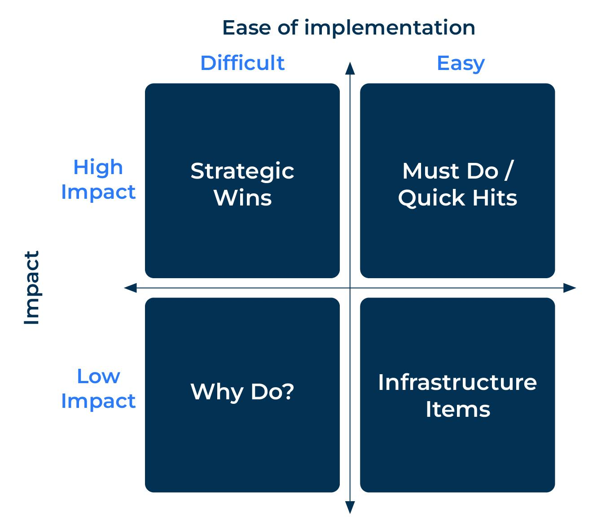
Implement
All plans require implementation. This can be the most difficult part of the plan as something that looks easy on paper may turn out to be more difficult to implement in practice.
List all the potential actions that have arisen from the strategic and tactical plans and map them on a grid as shown:

Slide 8
Controls
Control mechanisms ensure that the actions take place as planned.
Think which control alerts will tell you if corrective action is required. Will someone need to make a physical check or will the alert be automatic?
For those items that are actioned, identify:
Action to be taken | Who is responsible | Dates for completion | Monitoring by: | Corrective action if required

Slide 9
Things to think about.
The MOSAIC template can be used to drive action in a wide range of marketing and promotional plans.
Mapping a market takes time and is a critical part of any plan. Once the market has been mapped, the objectives, strategy, action and implementation plans can be devised quickly.
The most difficult part of the MOSAIC process is implementation. There will be inevitable pushbacks, which need to be dealt with using the control mechanism.

Slide 10
Thank you.

