Slide 1
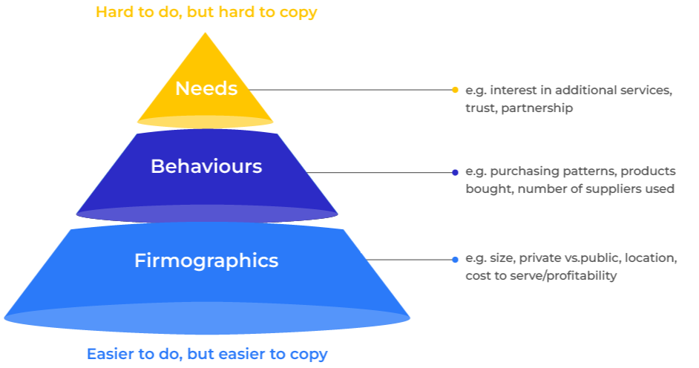
Segmentation

Slide 2
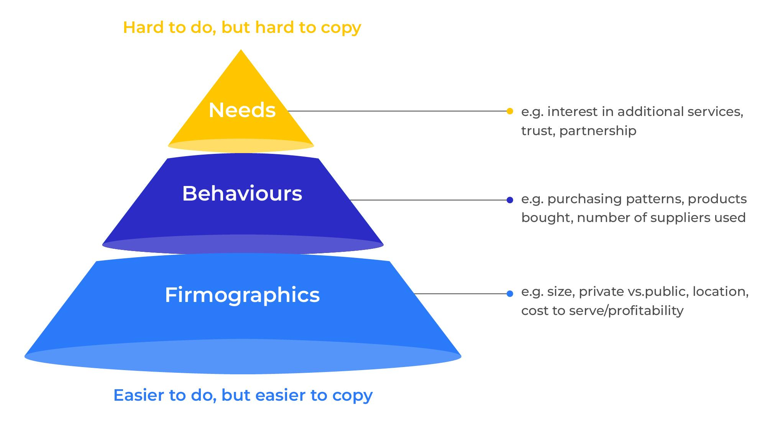
Gain an advantage by targeting customer groups.
Use this model to find out how to align your products with the different needs of customer groups
Segmentation is the grouping together of customers (or potential customers) with common characteristics.
In business-to-business markets we recognize three different types of segmentation: firmographics, behavioural and needs.
It is easy to recognise companies with different physical characteristics but this gives little advantage as most competitors will do the same. It is more difficult to recognise companies with different needs and behaviours. However if this is possible it provides the opportunity for improving customer experience and satisfaction. Needs based segmentation is therefore a goal even though it is hard to implement.

Slide 3
Steps in segmenting a market.
The four steps to segmenting the market are summarised as follows:

Slide 4
Map the market.
The starting point for segmentation is to understand the target audience. Ask yourself the following questions:
Who makes the decision to buy the products that you sell? How important is this person in the decision-making unit?
Who influences the decision and what degree of influence to they have?
What types of companies buy (or could potentially buy) your products in terms of their size (number of employees), industry classification, geographical location? These are firmographic (in consumer markets, demographic) characteristics.
What penetration do you have of these companies? What share of wallet do you have within these companies?
How many companies are there of these different types?
What is the channel to market for your products? How important is distribution? How many distributors are there?

Slide 5
Identify key buying criteria.
Consider the following checklist of questions to determine what causes companies to buy your products/services. For each type of company and for a cross section of decision makers and influencers, ask the following questions:
Consider customers’ different needs
Consider customers’ different behaviours
How important is price, quality, service and availability? (The hygiene or basic factors)
How important is the brand?
How important are psychological factors? (Status, security, power etc)
What role does the channel play in influencing the choice of products?
How loyal are customers to suppliers?
How frequently do they switch suppliers?
To what extent to buyers dual or triple source? What are their reasons for doing so?
How many customers have established contracts with suppliers?
How frequently are supplier contracts reviewed?
What other needs and behaviours can you recognise that could usefully classify your customers?

Slide 6
Discover the segments.
Now analyse the data to see if groups of customers have similar characteristics. Look for patterns of needs such as companies that are diehard price driven or companies that want a wide range of products and services. Recognising key groupings of customers will start to show the possibilities for a needs based segmentation. There nearly always is a group of companies that are transitional between a couple of polarised segments and those who want a bit of everything. You will be faced with a number of options and skill and judgement is required to decide which groups are appropriate for you.
When a segment begins to take shape it should include a group of customers with a strong disposition towards a particular offer. The checklist on the next page will help decide if the segments are separated by clear blue water.

Slide 7
Validate the segments.
The segments that emerge should pass the 4D test. Each segment should be measured in terms of it being:
Distinctive – if there aren’t any distinctive attributes to the segment, it will be hard to recognise and introduce new customers to it. Marginal differences in needs are not enough to justify a different segment.
Desirable – each segment must have a strong need for the products and services you offer. If a segment doesn’t have a resounding appetite for what you are selling, it isn’t a segment you will want to serve.
Durable - segments need to stand the test of time. Companies are put into segments and expected to stay in them for a year or two. If you place a company in a segment that has changing needs, your marketing plan will be out of date before you know it and the messages you use to target companies will create dissonance.
Defendable – you need to be able to demonstrate that what you are offering for this segment can be delivered. You need testimonies to defend your claims.
If a segment fails these tests, consider the possibility of a correction. If there is no possibility of working with the segment BE PREPARED TO DE-SELECT IT. It is not for you.

Slide 8
Things to think about.
Separate out the big dogs: at the outset consider removing your very largest customers from the segmentation. These large customers or big dogs are each worth treating as a segment in their own right as they are so important.
Limit the number of segments. Every segment represents a group of customers with their own needs. Each segment will have its own marketing plan. A segmentation strategy that has too many segments could fail. Four or five segments is ideal. Start with a small number and add segments if new ones emerge.
Implementing the segmentation: needs based segmentations are difficult to implement because it is hard to recognise which companies should be allocated to certain segments. Killer questions can be developed that help position companies within different segments but this isn’t always easy. Needs change and in any case customers don’t always know what they are (try to identify System 1 and System 2 thinking). Behavioural segments can sometimes work best because behaviours are easier to recognise and they link strongly with needs.
Bringing the salesforce on board: a business to business segmentation has to be developed with the salesforce in mind. They will use the segmentation and have to be convinced of its rationale and know how to apply it.
Be flexible: applying a needs-based segmentation is a learning exercise. Be prepared to adjust it if necessary.

Slide 9
Thank you.

