Slide 1
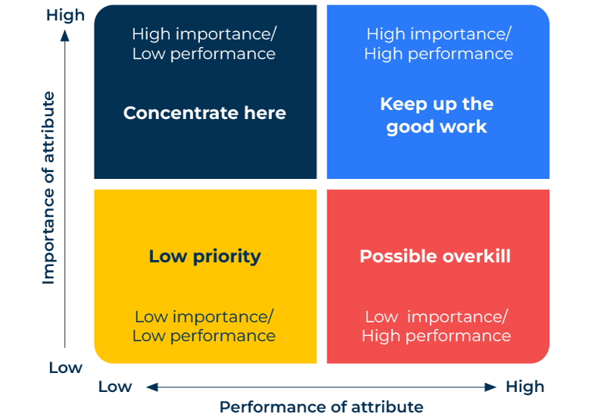
Shared Future Analysis

Slide 2
A business tool to prioritise marketing initiatives.
Use this framework to assess what the marketing teams need to focus on
Shared future analysis is a tool developed by marketing consultant, Peter Cheverton, and shared in his book, Key Marketing Skills: Strategies, Tools and Techniques for Marketing Success (2005). It examines the strengths and weaknesses of a company in delivering against the needs of individual customers or segments.
It is a tool for focusing on what will deliver most reward for a company in the future. When the options are presented as a grid it is easy to share with marketing teams.

Slide 3
Start with the needs of the customer.
First make a list of everything customers look for and the things they try to avoid. Now rank or score these in terms of their impact on the customer.
 | Complete these boxes
What is it about the products you (and others) sell that excites customers?
What is it about the products you (and others) sell that causes distress for customers?
Give these attributes a score to indicate the degree to which they excite or distress customers?

Slide 4
How do you perform on the delivery of attributes?
Next you look at what customers (and potential customers) perceive you to be good at and what you are poor at. It is best that these are ratings from customers. It is possible to also consider these factors in internal brainstorming sessions (best to have representations from all departments of the company at the session).
 | Complete these boxes
What do you do well in customers’ eyes?
Where to you perform badly in customers’ eyes?

Slide 5
Now complete the grid and share with the team.
You can now plot the attributes on a grid.
The previous two steps will have provided you with attributes which are important to customers and those on which you perform well. These high performance/high importance attributes are critical to the future of your company.
Those where you perform badly but which are of high importance to customers clearly need priority action.
Attributes of low importance to customers should be reviewed to see if there is overkill or if you can withdraw some of your resources completely.

Slide 6
Editable framework.
High importance/ Low performance
Use this to add your own text and edit to suit your own branding
High
High importance/ High performance
Concentrate here
Keep up the good work
Importance of attribute
Low priority
Possible overkill
Low importance/ Low performance
Low importance/ High performance
Low
Low
High
Performance of attribute

Slide 7
Thank you.

