Slide 1
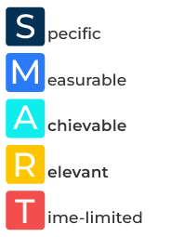
SMART Objectives

Slide 2
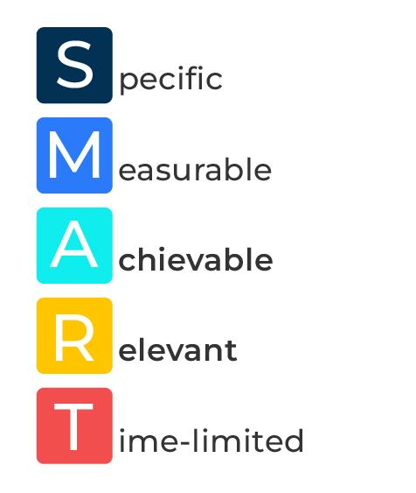
A business tool to get things done.
Use this framework to set and achieve objectives
We all know that it is easy to simply dive in to something and get cracking. That isn’t usually the best way. Think about what you need to achieve and use SMART objectives.
This is a goal-setting and project management tools that ensures objectives are clear, achievable, and measurable. The acronym SMART stands for Specific, Measurable, Achievable, Relevant, and Time-bound.
By applying the SMART criteria to your objectives, you increase the likelihood of success, as they become more focused, measurable, and realistic. This framework is widely used in various industries to enhance the effectiveness of goal-setting and project planning processes.

Slide 3
Specific.
Objectives should be clear and specific, leaving no room for ambiguity. Clearly define what you want to accomplish and who is involved. Ask yourself questions like What? Why? Who? Where? When? Instead of setting a vague goal like "Increase sales," a specific objective would be "Increase online sales of product X by 15% in the next quarter."
 | Complete these boxes
What is the ultimate goal?
What sub goals need to be achieved?
How are you going to achieve those goals?
When do they have to be achieved by?

Slide 4
Measurable.
Objectives should be quantifiable so that progress can be tracked. Establish concrete criteria for measuring progress toward the attainment of each goal. For example, rather than setting a goal like "Improve customer satisfaction," a measurable objective would be "Achieve a customer satisfaction rating of 90% or above based on customer surveys within the next six months.“ It is similar to being specific.
 | Complete these boxes
What can be measured?
How can you measure it?
How frequently will it be measured?
What tolerance do you have for not hitting the planned measure?

Slide 5
Achievable.
Objectives should be realistic and attainable. While it's good to set challenging goals, they should still be feasible given the resources and constraints of the organization. For example, setting an achievable objective would involve considering factors like the available budget, manpower, and technology. For instance, "Launch a new feature within the software in the next three months" is achievable if the necessary resources are available.
 | Complete these boxes
What are reasonable targets to set – stretching but achievable?
What could stop you achieving your targets?
What resources do you need to achieve the targets?

Slide 6
Relevant.
Objectives should be aligned with broader organisational goals and mission. Ensure that pursuing the objective will contribute positively to the overall strategy. For example: If the overall goal is to increase market share, a relevant objective might be "Capture 10% more market share in the target demographic by the end of the year."
 | Complete these boxes
How will the targets you have set get you closer to your overall goal?
Who is going to be responsible for this goal? Who will be checking on it?

Slide 7
Timely.
Set a specific timeframe for achieving the objective. This helps create a sense of urgency and provides a clear deadline for completion. For example, instead of saying "Improve employee training," a time-bound objective would be "Implement a new employee training program and conduct training sessions for all staff within the next two months."
 | Complete these boxes
Get dates in the diary for when goals and targets must be met. Are they realistic?
Who will check on progress so there is no waiting till the last minute and finding something has gone wrong?

Slide 8
Editable framework.
Use this to add your own text and edit to suit your own branding
S
M
A
R
T

Slide 9
Thank you.

