Slide 1
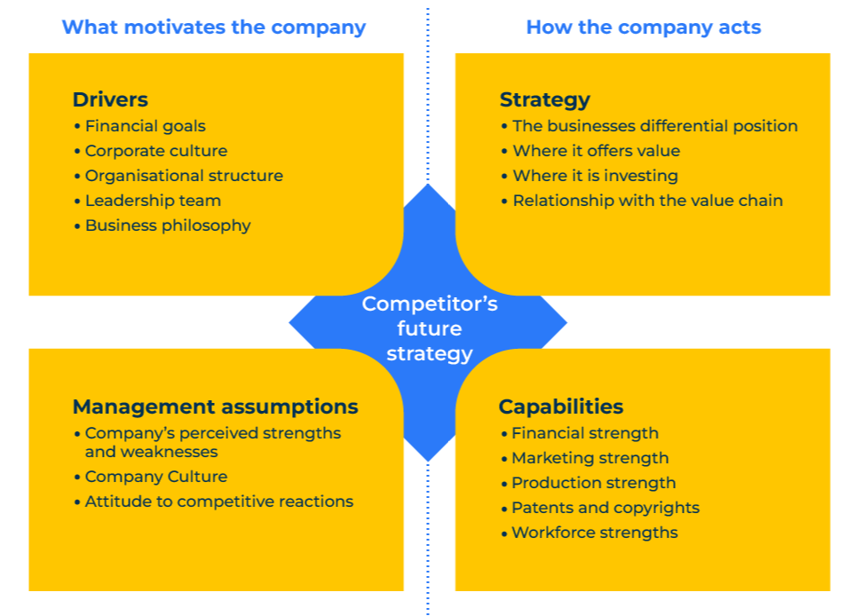
Four Corners

Slide 2
Building a competitive strategy
Use this model to analyse competitors’ strategies
The four corners model was developed by Michael Porter of Harvard Business School. It is so called because it considers four specific aspects of a competitor’s strategy:
Drivers: the financial goals, culture and philosophies that motivate the competitor
Management assumptions: the perceived strengths and weaknesses of the competitor and its attitude to competitors
Strategy: how the competitor differentiates itself and offers value to customers
Capabilities: the strength of the competitor in all respects – financially, marketing, workforce etc.

Slide 3
Step 1: Things that drive the competitor
Work through this check list of questions to determine the things that drive the competitor.
What can you determine about the drivers of the competitor from its financial accounts, website, LinkedIn, articles, and sales peoples’ reports?
Is the competitor driven more by profit than revenue?
Is the competitor driven by a requirement to “fill the mill”?
What is the estimated breakeven point of the competitor?
How close to breakeven point is the competitor working at the present?
What is the corporate culture of the competitor – short-term or long-term?
To what extent is the competitor “command and control” versus flat and empowered?
Who are the main individuals wielding power within the competitor?
What do we know about the motivation of these individuals?
What is the ethical stance of the competitor?
What evidence do you have for these assertions?

Slide 4
Step 2: Strategy of competitor
Work through this check list of questions to determine the strategy of the competitor.
What can you determine about the strategy of the competitor from its adverts, website, financial accounts, website, LinkedIn, articles, and your sales peoples’ reports?
How does the competitor differentiate itself from others in its peer group?
By how much is it distinct and different from others in its peer group? How sustainable is this difference?
How does the competitor portray the added value of its products and services? How believable are these claims of added value?
How does the competitor reach its market through the value chain?
Where are its strengths and weaknesses within the value chain?
What evidence is there of the competitor moving into new territories – either geographical or new activities?
To what extent is the competitor committed to its core business?
What evidence do you have for these assertions?

Slide 5
Step 3: Management assumptions of competitor
Work through this check list of questions to determine the management assumptions of the competitor.
What can you determine about the management assumptions of the competitor from www.glassdoor.com the competitor’s website, financial accounts, website, LinkedIn, articles, and sales peoples’ reports?
What does the competitor perceive to be its greatest strengths – financially, marketing, geographically, technologically, personnel?
What do you believe the competitor perceives is its greatest weaknesses on the same factors?
How would you assess the competitor’s internal culture – friendly, aggressive, results driven, collaborative, hire and fire, supportive etc?
How would you assess the competitor’s external culture – its perception amongst suppliers and customers?
How does the competitor react to competitive movements – does it act as a market leader, an observer, a follower?
What is the competitor’s behaviour when changing its prices – is it first to do so, is it arrogant, is it apologetic, is it explanatory?
What evidence do you have for these assertions?

Slide 6
Step 4: Capabilities of competitor
Work through this check list of questions to determine the capabilities of the competitor.
What can you determine about the capabilities of the competitor from its website, financial accounts, website, LinkedIn, articles, and sales peoples’ reports?
What is the competitor’s financial strength? What is its profit record? What are its liquid assets? What is its indebtedness?
What is the competitor’s marketing strength? In which segment of the market is it strongest? What gives it this strength? What are its marketing strengths geographically?
What are the competitor’s production strengths? What special processes does it use and what advantages do these give the competitor? How capable is the competitor of ramping up production quickly if required to do so? At what capacity is the competitor working at the present?
What technical advantages or patent’s does the competitor have? When will these expire?
How strong and skilled is the competitor’s workforce? What competitive advantages does the competitor have through its workforce?
What evidence do you have for these assertions?

Slide 7
Step 5: Determine the strategy of the competitor
Bring the intelligence from the four corners (steps 1 to 4) to determine the strategy of the competitor.
Write a strategy for the competitor as if you were a corporate planner within that company.
What do you imagine is the vision statement for the competitor? Where do you think it expects to be in 3 to 5 years time?
What do you imagine is the mission statement for the competitor? In other words, at a very high level what do you believe it is setting out to do in order to achieve its vision?
How would you describe the core values of the competitor that will ensure that it survives against the competition?
What would you say are five specific long-term goals of the competitor?
What do you believe is the competitor’s objectives over the next 12 months?
What are the key success factors the competitor needs to ensure happen if its plans are to be achieved?
What do you believe the competitor fears most will derail its plans?
Which of its current competitors do you believe it fears most? Why is this?

Slide 8
Things to think about.
Make sure you have assembled as many facts as possible about the competition (and have verified them)
There are many visible clues in the marketplace as to what motivates the competition. The behaviour of a company is a good indication of its motivations.
Competitive intelligence is vital when carrying out a four corners analysis. Take a look at the competitive intelligence framework on this website.

Slide 9
Thank you.

