Slide 1
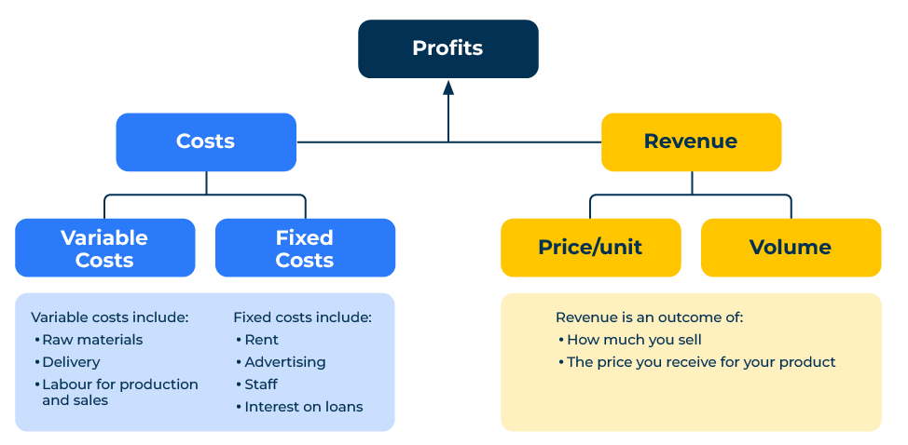
Profitability Framework

Slide 2
A business model to improve profitability.
Use this framework to improve your profitability
The profitability framework is a structured approach used in business strategy to analyse and improve a company's profitability. This framework helps identify key factors that contribute to a company's financial success or challenges. While there are various profitability frameworks, one commonly used model is the "Three Cs" framework, which stands for Costs, Customers, and Competition.
It's important to note that the profitability framework should be tailored to the specific industry, company size, and market conditions. Regularly reassessing and adjusting strategies based on changes in the business environment is crucial for sustained profitability.
Competition
Costs
Customers

Slide 3
Costs.
Identify all the fixed costs ie costs that do not vary with production levels. This includes rent, salaries, and administrative expenses. Strategies to optimize fixed costs might involve renegotiating contracts, improving operational efficiency, or exploring cost-sharing arrangements. Also identify all variable costs ie costs that change with production levels, such as raw materials and direct labour. Assess ways to reduce variable costs through bulk purchasing, process improvements, or supplier negotiations.
 | Complete these boxes
What are your fixed costs? Which of these costs dominate? How could they be reduced?
What are your variable costs? Which dominate? How could they be reduced?
What are benchmarks for these costs in your industry? How do your costs compare?

Slide 4
Customers.
Evaluate your different revenue streams and customer segments. Identify high-margin products or services and focus on strategies to increase sales in those areas. Analyse the cost of acquiring new customers versus retaining existing ones. Develop strategies to retain loyal customers and attract new ones more cost-effectively. Review pricing strategies to ensure they align with the value perceived by customers. Consider dynamic pricing, bundling, or other pricing tactics to optimise revenue.
 | Complete these boxes
Consider carrying out a Pareto analysis of your customers and their revenue? What is the profitability of these customers?
How do you set prices in your company? What are the options for value based pricing?

Slide 5
Competition.
Identify the competition in your market and your leverage from any competitive advantages. This could include unique products, superior customer service, or cost leadership. Strengthening and promoting these advantages can contribute to increased profitability.
 | Complete these boxes
Who are your main competitors? Which company leads price changes? Which company makes most profit?
What competitive advantage do you have? Why do people buy your products in preference to your competitors? Will customers pay a premium for your products?
What are the threats to new competitors entering your market including from imports? How can you counter these threats?

Slide 6
Other things to think about.
Optimise processes:
Examine internal processes to identify inefficiencies and bottlenecks. Streamline operations to reduce costs and improve productivity.
Examine supply chain management:
Assess the efficiency of the supply chain. Identify opportunities to reduce lead times, improve inventory management, and enhance overall supply chain performance.
Use technology integration:
Explore the adoption of technology and automation to improve operational efficiency. Investments in technology can lead to long-term cost savings and process improvements.
Check out compliance and risks:
Consider the impact of regulatory compliance on costs and operations. Identify potential risks and uncertainties associated with regulatory changes and adapt strategies accordingly.
Look for Government incentives:
Explore opportunities for leveraging government incentives or subsidies that can positively impact profitability.
Be aware of external factors:
Monitor economic trends that may affect consumer spending, inflation, and interest rates. Adapt pricing and cost strategies to align with the economic environment. Stay informed about industry trends and technological advancements that could impact your business. Position your company to capitalise on emerging opportunities.

Slide 7
Editable framework.
Proﬁts
Use this to add your own text and edit to suit your own branding
Costs
Revenue
Variable Costs
Fixed Costs
Price/unit
Volume
Variable costs include: Raw materials Delivery
Labour for production and sales
Fixed costs include: Rent
Advertising Staff
Interest on loans
Revenue is an outcome of how much you sell
The price you receive for your product

Slide 8
Thank you.

